Slide 1
Statistical Learning Models for Text and Graph Data
Network Representation Learning
Instructor: Yangqiu Song
Slides credits: Lada Adamic and James Moody, Mehmet H Gunes, Bing Liu, Jure Leskovec, William L. Hamilton, Rex Ying, Rok Sosic

Slide 2
Example: Node Classification
?
?
?
?
Machine Learning
?

Slide 3
Example: Link Prediction
?
?
x
?
Machine Learning

Slide 4
Machine Learning Lifecycle
(Supervised) Machine Learning Lifecycle: This feature, that feature. Every single time!
Raw Data
Structured Data
Learning Algorithm
Model
Feature Engineering
Automatically
learn the features
Downstream
prediction task

Slide 5


Feature Learning in Graphs
Goal: Efficient task-independent feature learning for machine learning
in networks!
node
2
vec
u
$$f:u→ℝ^{d}$$
$$ℝ^{d}$$
Feature representation, embedding

Slide 6
Example
  Zachary’s Karate Club Network:
Input
Output
Image from: Perozzi et al. 2014. DeepWalk: Online Learning of Social Representations. KDD.

Slide 7
Why Is It Hard?
Modern deep learning toolbox is designed for simple sequences or grids.
  CNNs for fixed-size images/grids….
  RNNs or word2vec for text/sequences…

Slide 8
Why Is It Hard?
But networks are far more complex!
  Complex topographical structure (i.e., no spatial locality like grids)
  No fixed node ordering or reference point (i.e., the isomorphism problem)
  Often dynamic and have multimodal features.

Slide 9
Embedding Nodes
Input
Output
Intuition: Find embedding of nodes to d-dimensions so that “similar” nodes in the graph have embeddings that are close together.

Slide 10
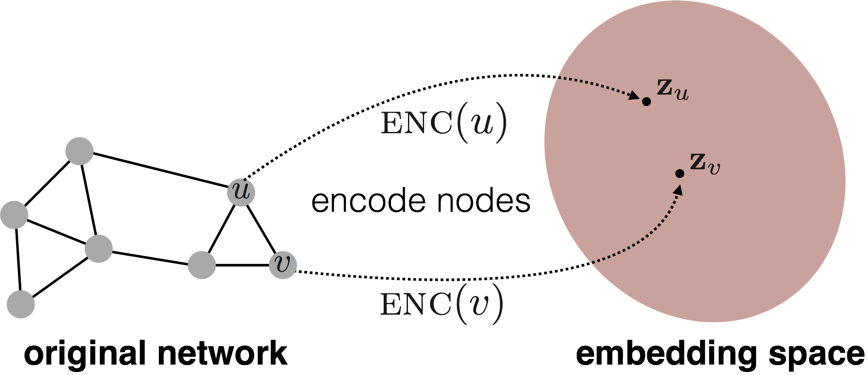
Embedding Nodes
Goal is to encode nodes so that similarity in the embedding space (e.g., dot product) approximates similarity in the original network.

Slide 11
Embedding Nodes
Goal:
Need to define!

Slide 12
From “Shallow” to “Deep”
So far we have focused on “shallow” encoders, i.e. embedding lookups:
embedding vector for a specific node
embedding matrix
Dimension/size of embeddings
one column per node

Slide 13
From “Shallow” to “Deep”
We will now discuss “deeper” methods based on graph neural networks.
In general, all of these more complex encoders can be combined with the similarity functions from the previous section.
complex function that depends on graph structure.

Slide 14
Outline for this Section
We will now discuss “deeper” methods based on graph neural networks.
  The Basics
  GraphSAGE

Slide 15
The Basics: Graph Neural Networks
Based on material from:
Hamilton et al. 2017. Representation Learning on Graphs: Methods and Applications. IEEE Data Engineering Bulletin on Graph Systems.
Scarselli et al. 2005. The Graph Neural Network Model. IEEE Transactions on Neural Networks.

Slide 16
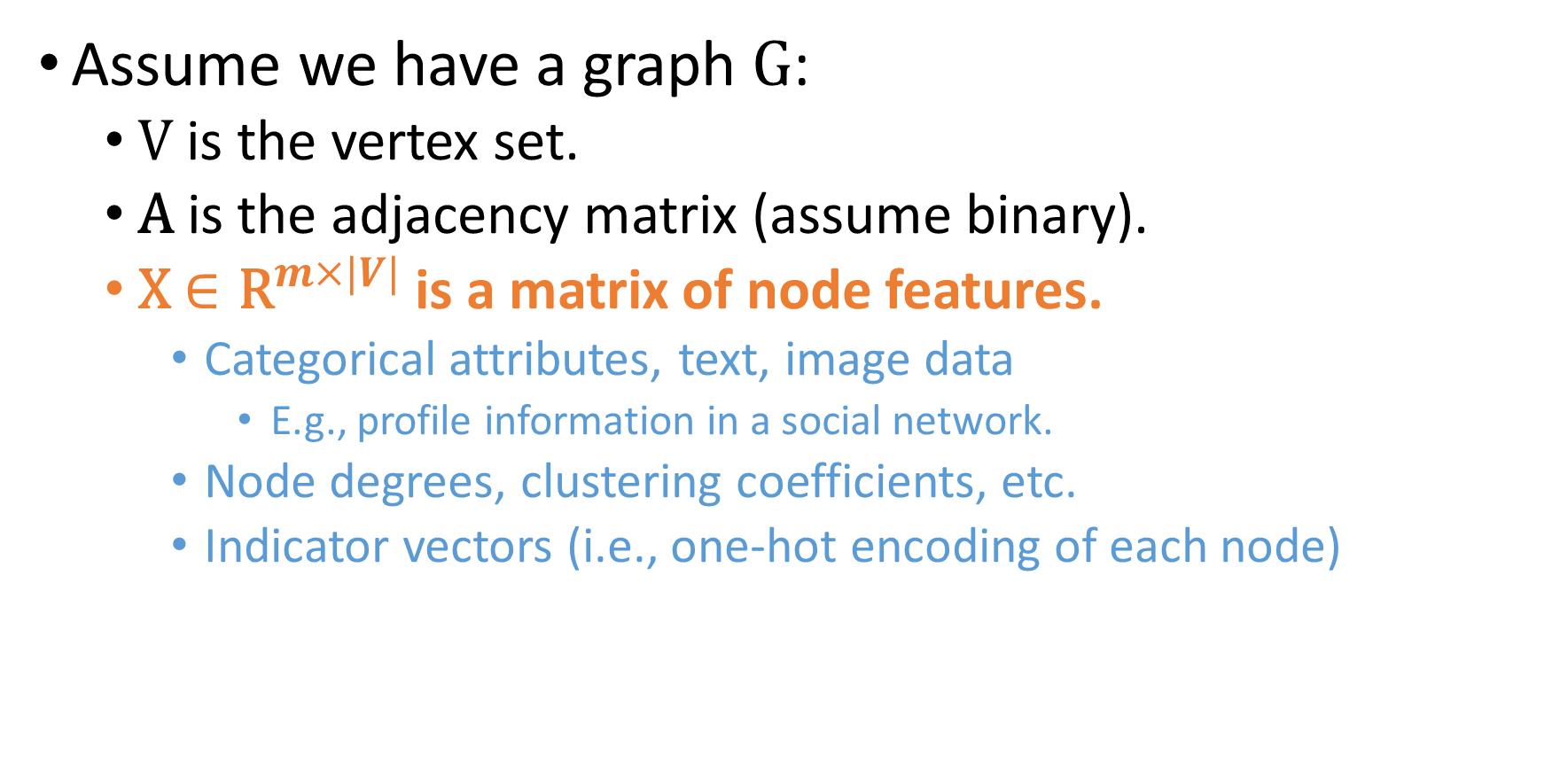
Setup
Assume we have a graph G:
  V is the vertex set.
  A is the adjacency matrix (assume binary).
  X $∈{\text{R}}^{m×|V|}$ is a matrix of node features.
    Categorical attributes, text, image data
      E.g., profile information in a social network.
    Node degrees, clustering coefficients, etc.
    Indicator vectors (i.e., one-hot encoding of each node)

Slide 17
Neighborhood Aggregation
Key idea: Generate node embeddings based on local neighborhoods.

Slide 18
Neighborhood Aggregation
Intuition: Nodes aggregate information from their neighbors using neural networks

Slide 19
Neighborhood Aggregation
Intuition: Network neighborhood defines a computation graph
Every node defines a unique computation graph!

Slide 20
Neighborhood Aggregation
Nodes have embeddings at each layer.
Model can be arbitrary depth.
“layer-0” embedding of node u is its input feature, i.e. x_{u}.
Layer-0
Layer-1
Layer-2

Slide 21
Neighborhood “Convolutions”
Neighborhood aggregation can be viewed as a center-surround filter.
Mathematically related to spectral graph convolutions (see Bronstein et al., 2017)

Slide 22
Neighborhood Aggregation
Key distinctions are in how different approaches aggregate information across the layers.
what’s in the box!?
?
???
?
?

Slide 23
Neighborhood Aggregation
Basic approach: Average neighbor information and apply a neural network.
1) average messages from neighbors
2) apply neural network

Slide 24
The Math
Basic approach: Average neighbor messages and apply a neural network.
Initial “layer 0” embeddings are equal to node features
previous layer embedding of v
kth layer embedding of v
non-linearity (e.g., ReLU or tanh)
average of neighbor’s previous layer embeddings

Slide 25
Training the Model
How do we train the model to generate “high-quality” embeddings?
Need to define a loss function on the embeddings, L(z_{u})!

Slide 26
Training the Model
trainable matrices (i.e., what we learn)
After K-layers of neighborhood aggregation, we get output embeddings for each node.
We can feed these embeddings into any loss function and run stochastic gradient descent to train the aggregation parameters.

Slide 27
Training the Model
Train in an unsupervised manner using only the graph structure.
Unsupervised loss function can be anything from the last section, e.g., based on
  Random walks (node2vec, DeepWalk)
  Adjacent neighbor similarity
    i.e., train the model so that “similar” nodes have similar embeddings.

Slide 28
Training the Model
Alternative: Directly train the model for a supervised task (e.g., node classification):
Human or bot?
Human or bot?
e.g., an online social network

Slide 29
Training the Model
Alternative: Directly train the model for a supervised task (e.g., node classification):
classification weights
Human or bot?
output node embedding
node class label

Slide 30
Overview of Model Design
1) Define a neighborhood aggregation function.
2) Define a loss function on the embeddings, L(z_{u})

Slide 31
Overview of Model Design
3) Train on a set of nodes, i.e., a batch of compute graphs

Slide 32
Overview of Model
4) Generate embeddings for nodes as needed
Even for nodes we never trained on!!!!

Slide 33
Inductive Capability
The same aggregation parameters are shared for all nodes.

Slide 34
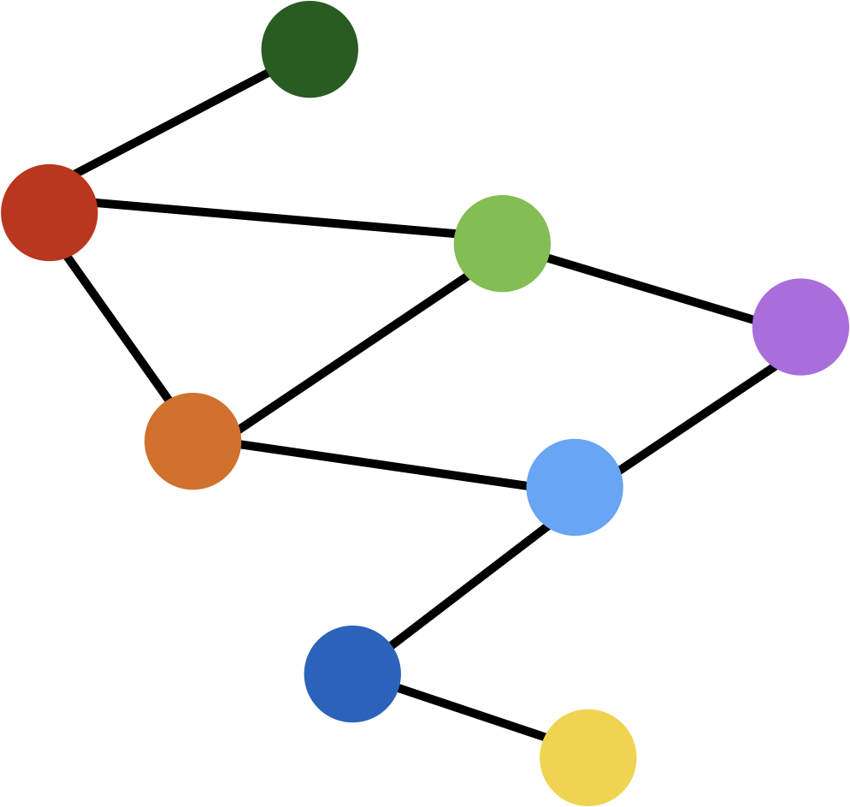
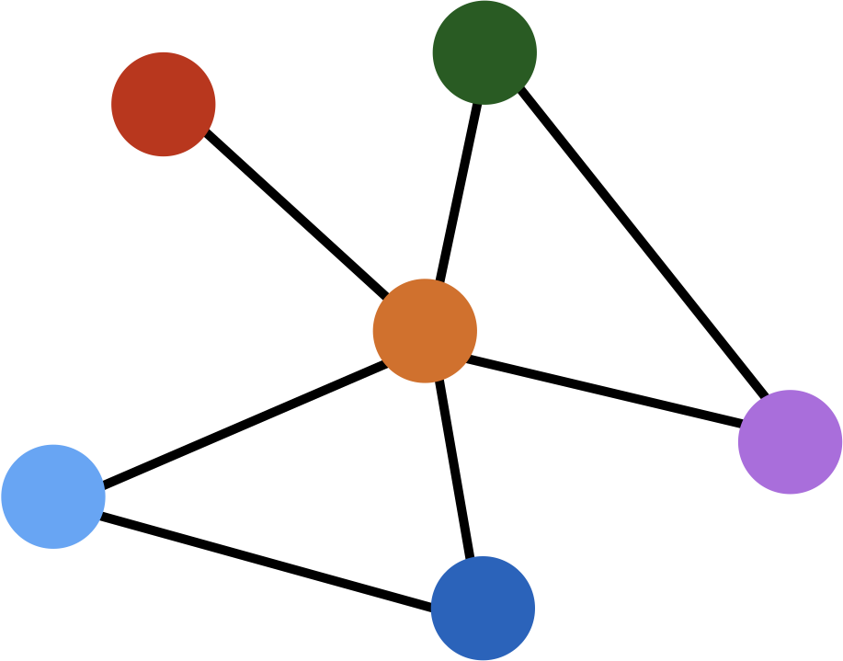
Inductive Capability
train on one graph
generalize to new graph
Inductive node embedding generalize to entirely unseen graphs
e.g., train on protein interaction graph from model organism A and generate embeddings on newly collected data about organism B

Slide 35
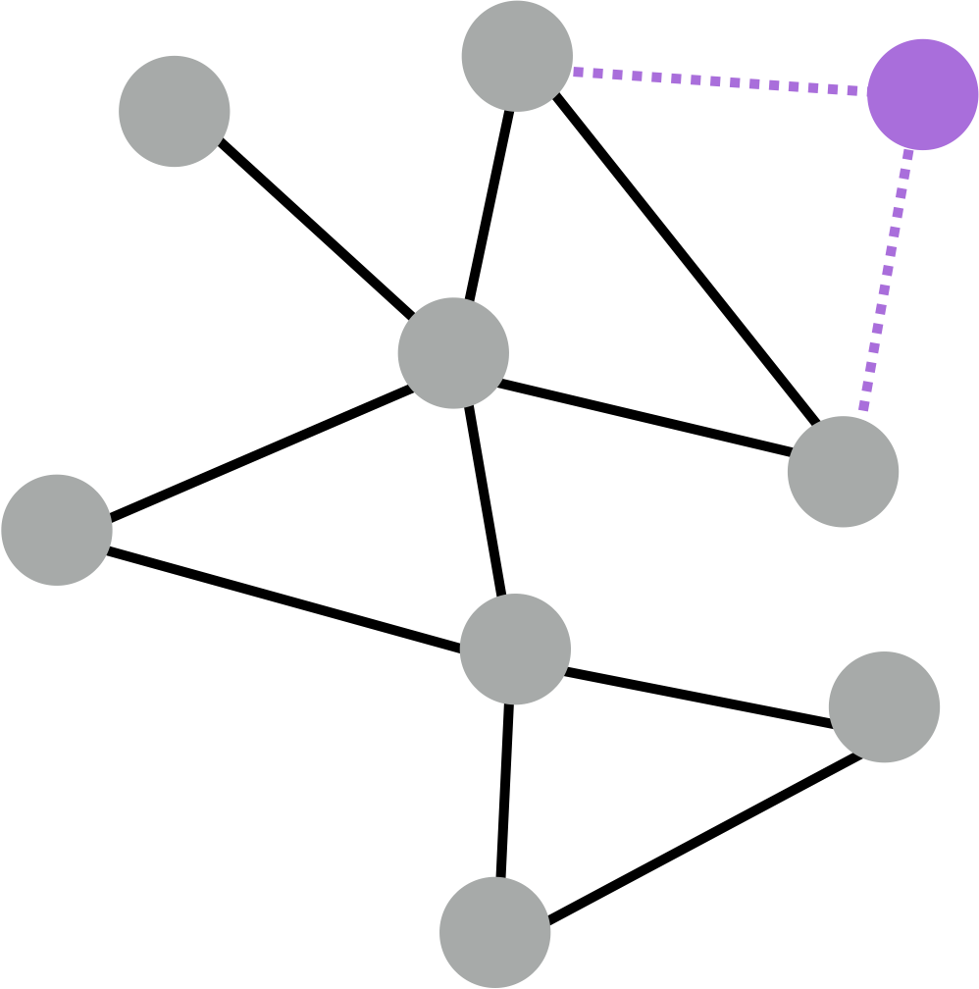
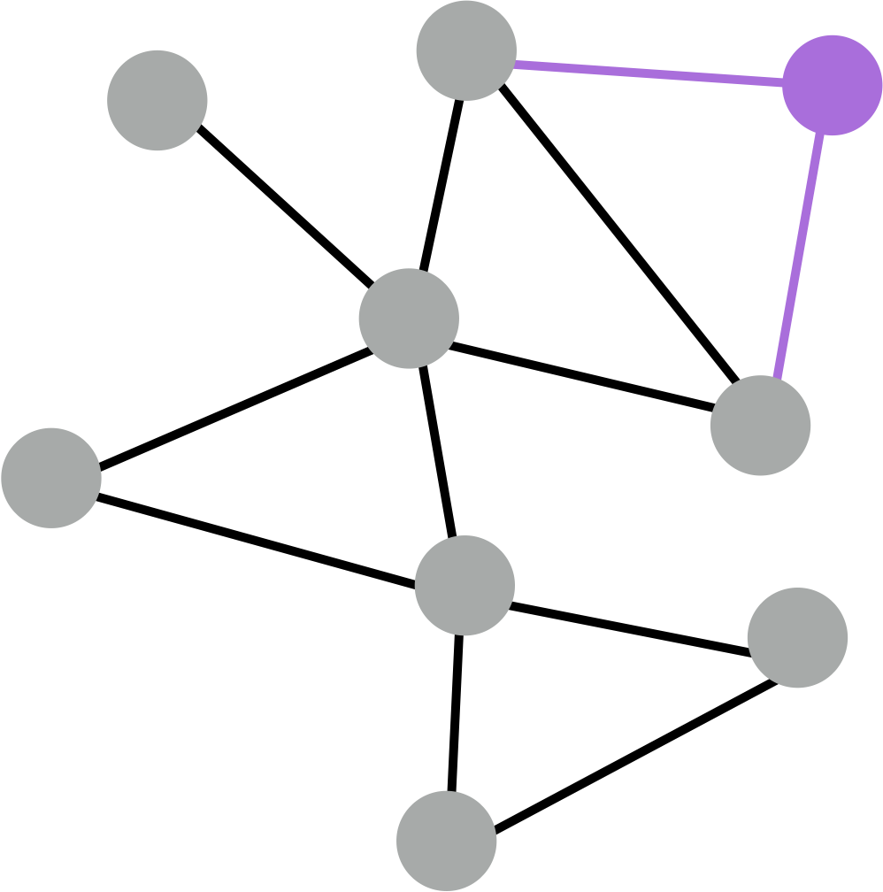
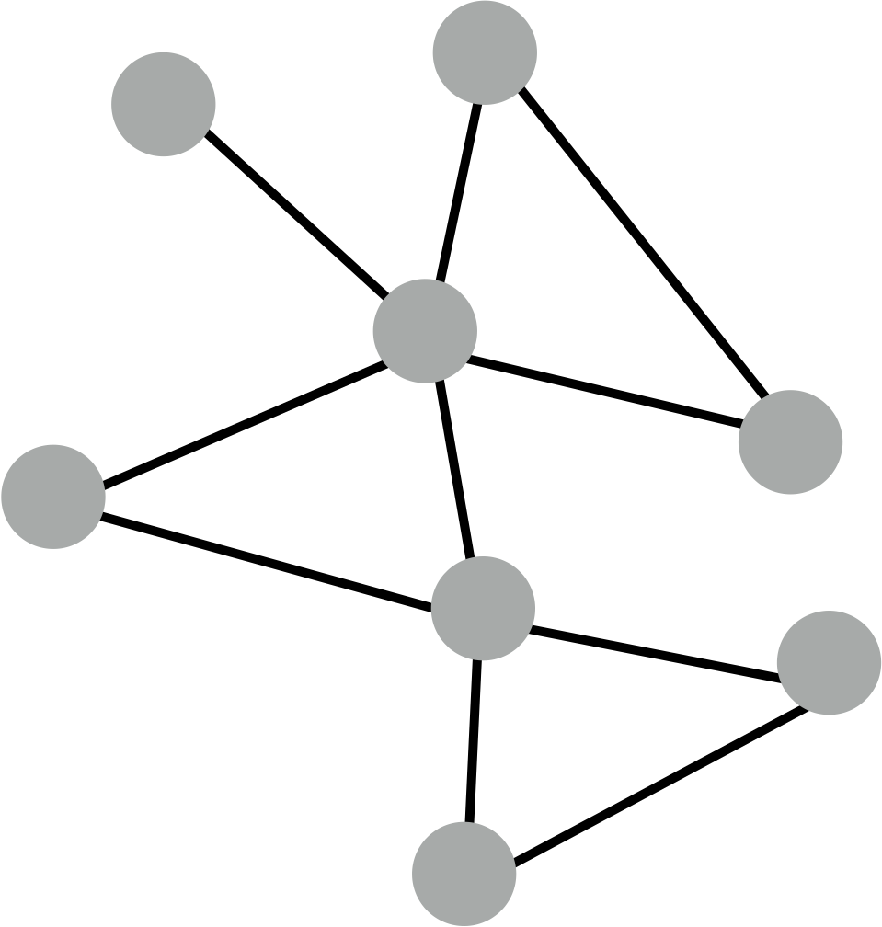
Inductive Capability
generate embedding for new node
train with snapshot
new node arrives
Many application settings constantly encounter previously unseen nodes.
e.g., Reddit, YouTube, GoogleScholar, ….
Need to generate new embeddings “on the fly”

Slide 36
Quick Recap
Recap: Generate node embeddings by aggregating neighborhood information.
  Allows for parameter sharing in the encoder.
  Allows for inductive learning.

Slide 37
Neighborhood Aggregation
Key distinctions are in how different approaches aggregate messages
What else can we put in the box?
?
???
?
?

Slide 38
GraphSAGE
Based on material from:
Hamilton et al., 2017. Inductive Representation Learning on Large Graphs. NIPS.

Slide 39
GraphSAGE Idea
So far we have aggregated the neighbor messages by taking their (weighted) average, can we do better?
?
???
?
?

Slide 40
GraphSAGE Idea
Any differentiable function that maps set of vectors to a single vector.

Slide 41
GraphSAGE Differences
Simple neighborhood aggregation:
GraphSAGE:
concatenate self embedding and neighbor embedding
generalized aggregation

Slide 42
GraphSAGE Variants
Mean:
Pool
  Transform neighbor vectors and apply symmetric vector function.
LSTM:
  Apply LSTM to random permutation of neighbors.
element-wise mean/max

Slide 43
Summary so far
  The Basics
GraphSAGE
  Generalized neighborhood aggregation.
Still a very active research field

