Slide 1
Statistical Learning Models for Text and Graph Data
Network Representation Learning
Instructor: Yangqiu Song
Slides credits: Lada Adamic and James Moody, Mehmet H Gunes, Bing Liu, Jure Leskovec, William L. Hamilton, Rex Ying, Rok Sosic

Slide 2
What is a Network?
Network is a mathematical structure
composed of points connected by lines
Network Theory <-> Graph Theory
Network ↔ Graph
Nodes ↔ Vertices (points)
Links ↔ Edges (Lines)
A network can be build for any functional system
System vs. Parts = Networks vs. Nodes

Slide 3
Networks As Graphs
Networks can be undirected or directed, depending on whether
the interaction between two neighboring nodes proceeds in both
directions or in only one of them, respectively.
⇔
1
2
3
4
5
6
The specificity of network nodes and links can be quantitatively
characterized by weights
2.5
7.3
3.3
12.7
5.4
8.1
2.5
Vertex-Weighted
Edge-Weighted

Slide 4
Networks As Graphs - 2
A network can be connected (presented by a single component) or
disconnected (presented by several disjoint components).
connected
disconnected
Networks having no cycles are termed trees. The more cycles the
network has, the more complex it is.
trees
cyclic graphs

Slide 5
Networks As Graphs - 3
Some Basic Types of Graphs
Paths
Stars
Cycles
Complete Graphs
Bipartite Graphs

Slide 6
Social network analysis
Social network is the study of social entities (people in an organization, called actors), and their interactions and relationships.
From the network, we can study the properties of its structure, and the role, position and prestige of each social actor.
We can also find various kinds of sub-graphs, e.g., communities formed by groups of actors.

Slide 7
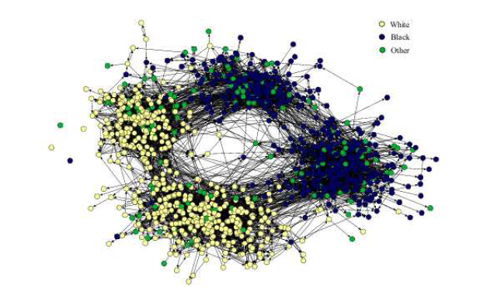
Social Networks
Links denote a social interaction
  collaboration networks
    actor networks
    co-authorship networks
    director networks
  phone-call networks
  e-mail networks
  home page/blog networks
  …

Slide 8
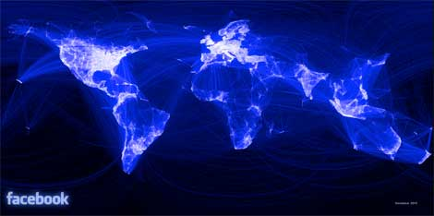
Online social networks
https://www.datacenterknowledge.com/archives/2012/02/02/facebooks-1-billion-data-center-network

Slide 9





























Network of actor co-starring in movies

Slide 10
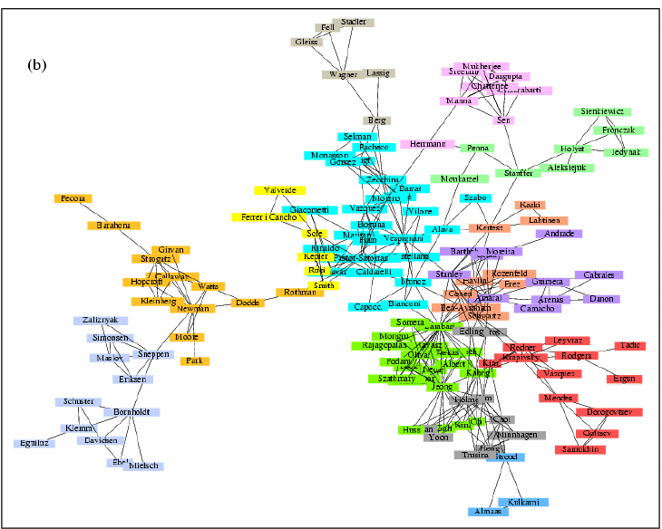
Networks of scientists’ co-authorship of papers

Slide 11
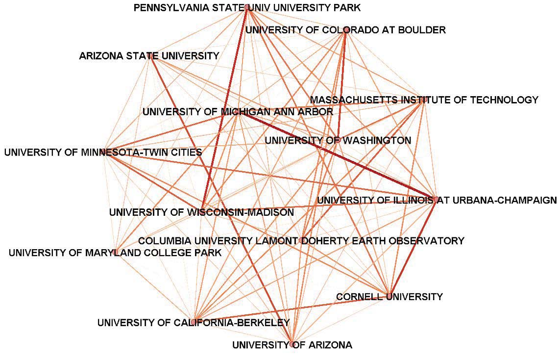
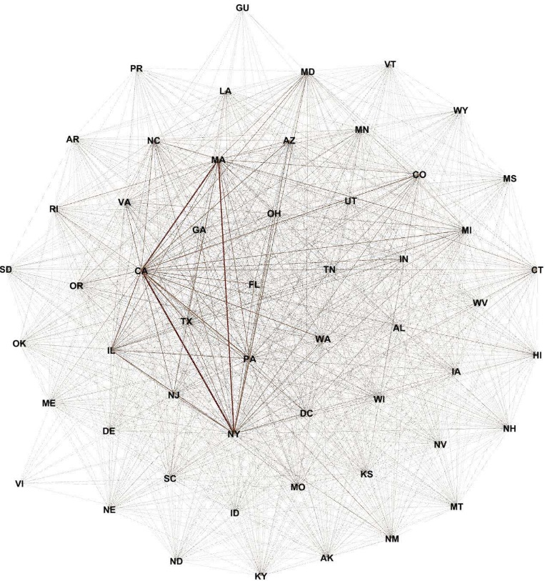
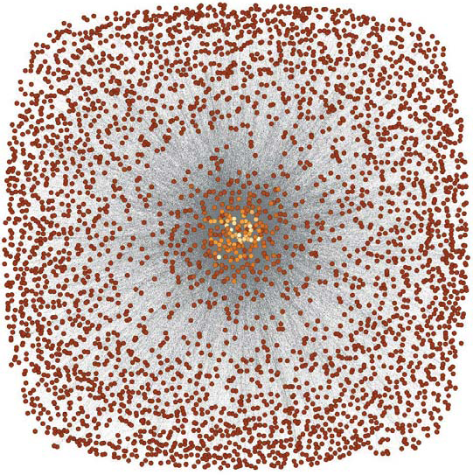
Funding Networks
Organization Network Characteristics
# of Nodes | 3.5K
# of Edges | 27K
Diameter | 6.5
Average Path Length | 3.07

Slide 12
Knowledge (Information) Networks
Nodes store information, links associate information
  Citation network (directed acyclic)
  The Web (directed)
  Peer-to-Peer networks
  Word networks
  Networks of Trust
  Software graphs

Slide 13
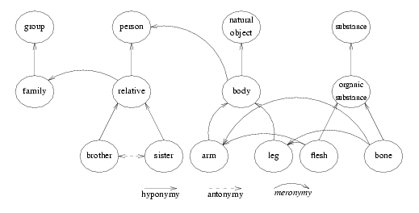
Natural language processing
Wordnet
Source: http://wordnet.princeton.edu

Slide 14
World Wide Web

Slide 15
Networks of personal homepages
Stanford
MIT
Source: Lada A. Adamic and Eytan Adar, ‘Friends and neighbors on the web’, Social Networks, 25(3):211-230, July 2003

Slide 16
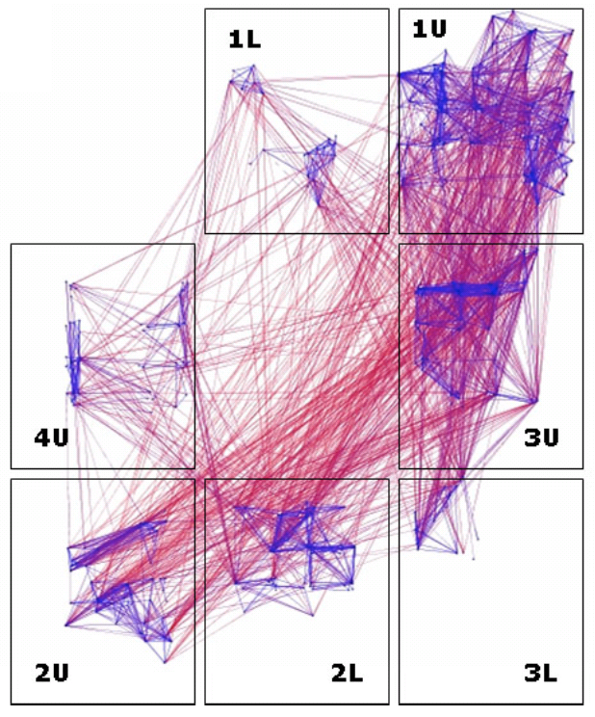
HP e-mail communication

Slide 17
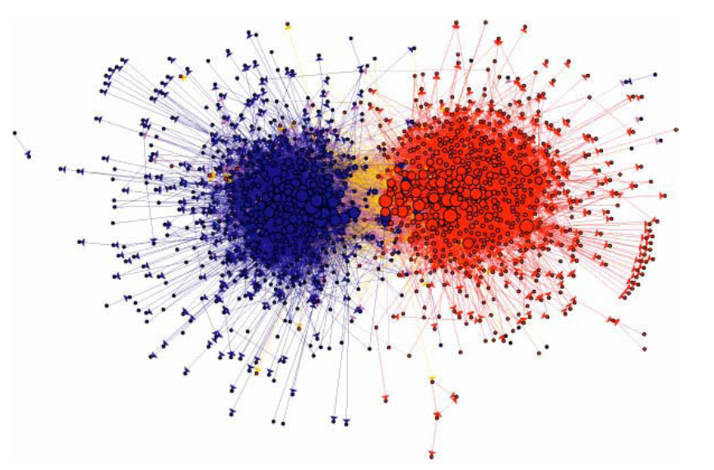
Links among blogs (2004 presidential election)

Slide 18
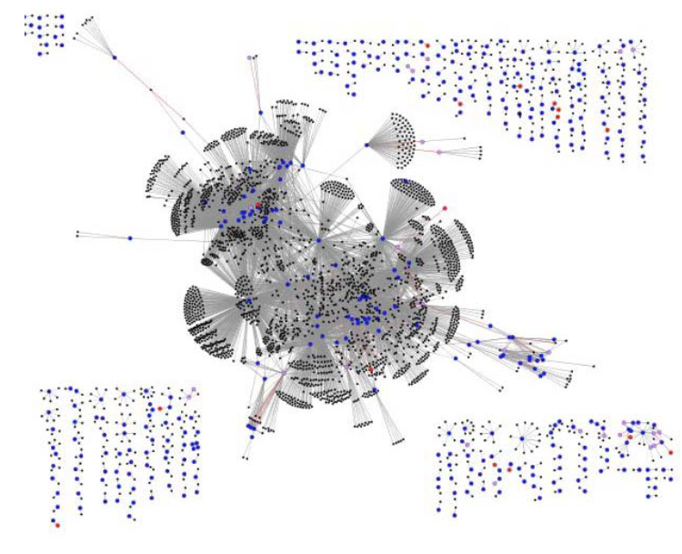
Product recommendations

Slide 19
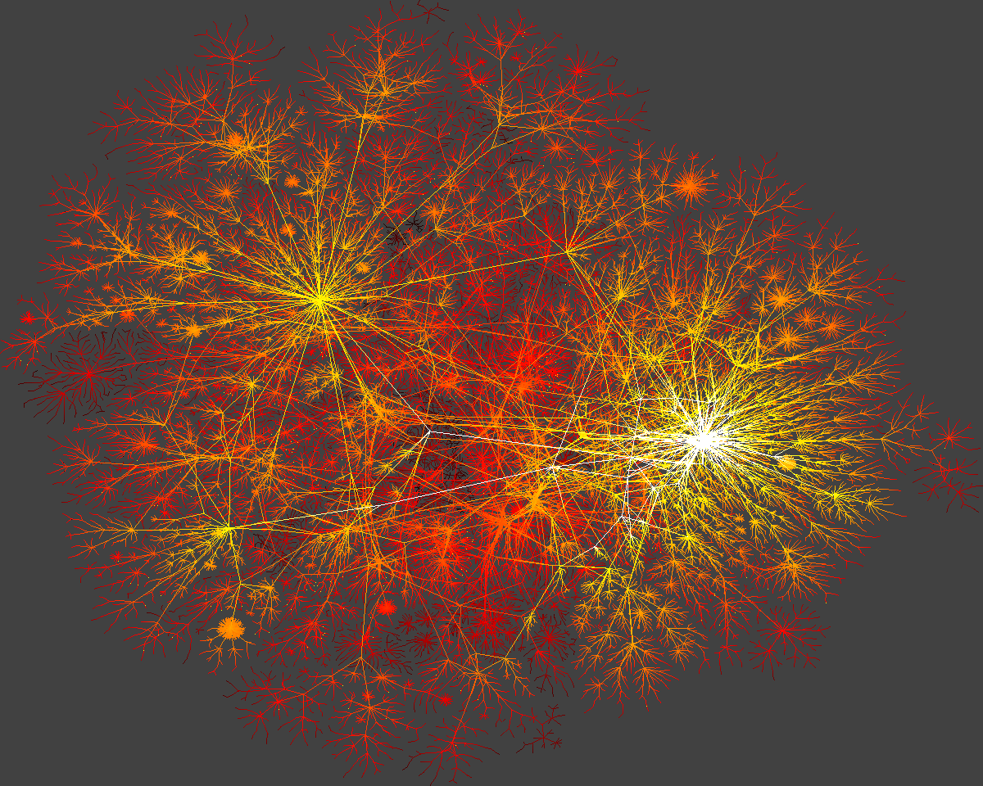
Technological networks
Networks built for distribution of commodity
  The Internet
    router level, AS level
  Power Grids
  Airline networks
  Telephone networks
  Transportation Networks
    roads, railways, pedestrian traffic

Slide 20
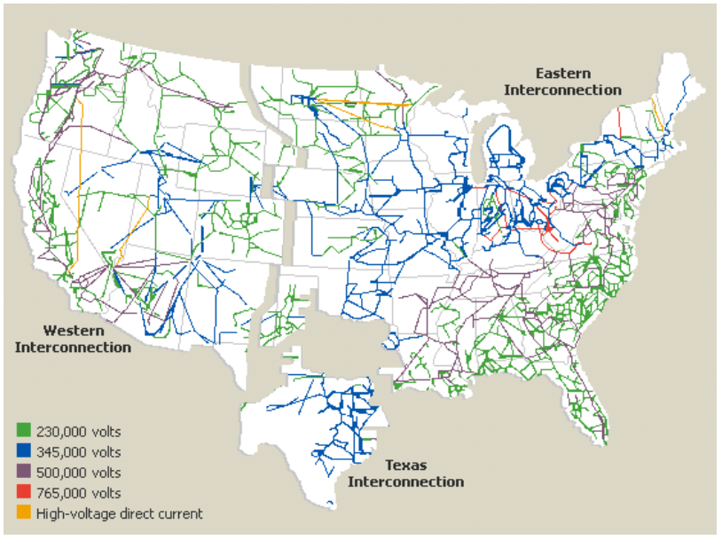
Power networks

Slide 21
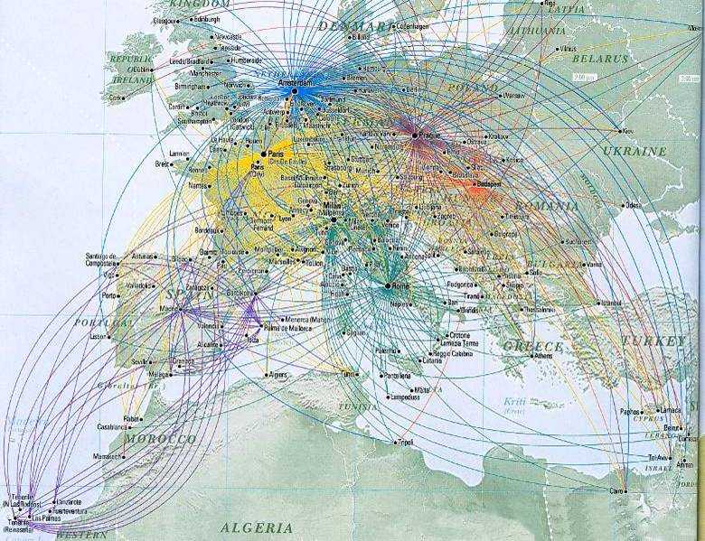
Transportation networks: airlines
Source: Northwest Airlines WorldTraveler Magazine

Slide 22
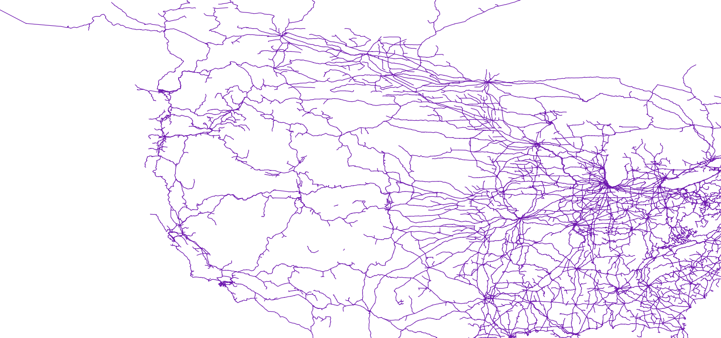
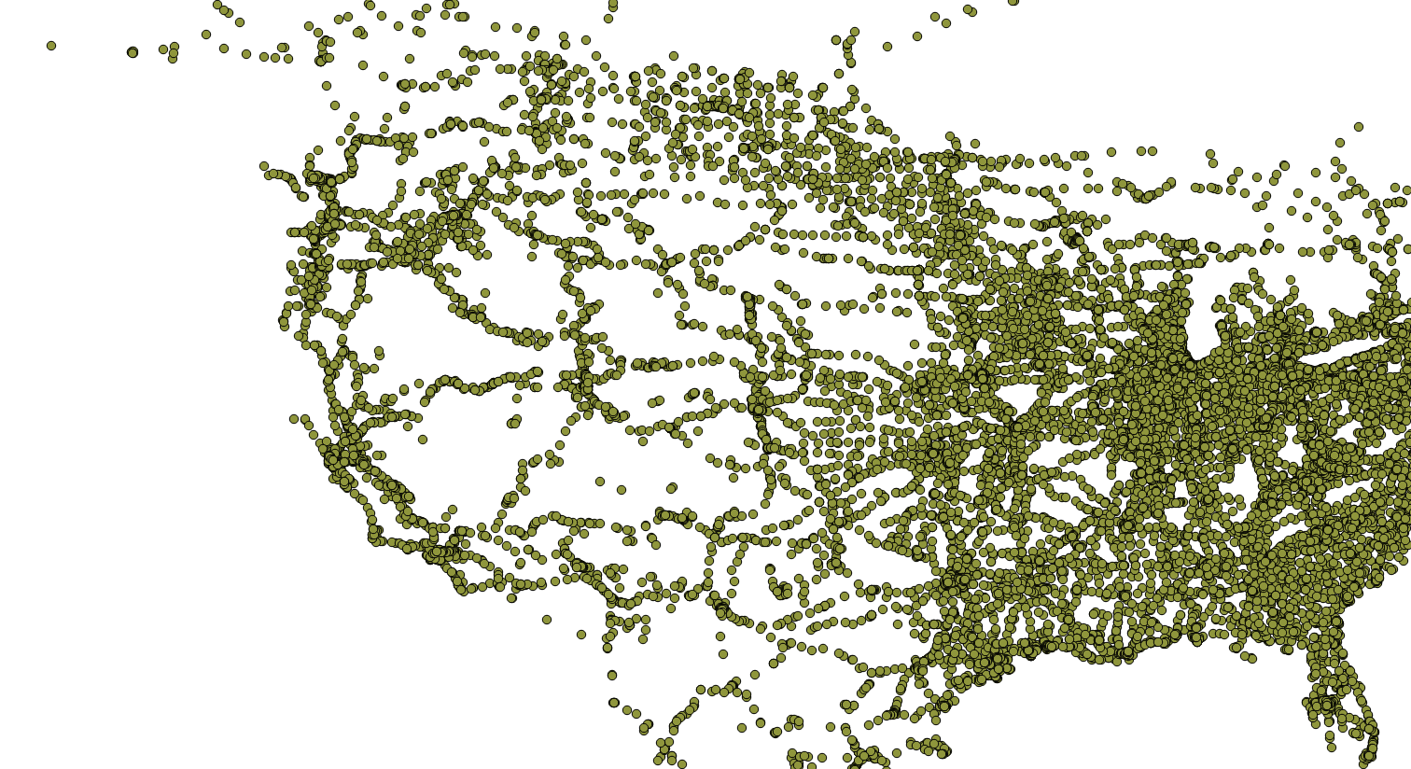
US railroad network

Slide 23
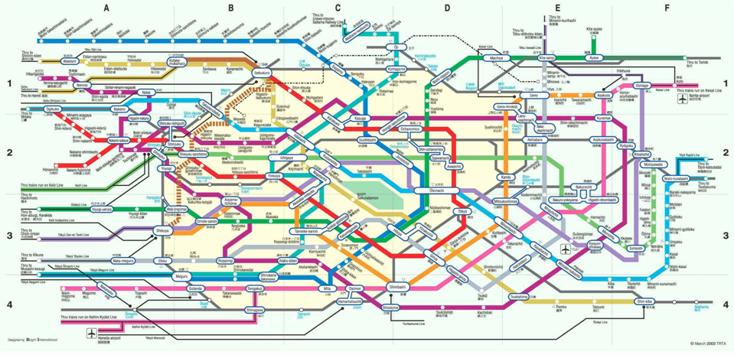
Transportation networks: railway maps
Source: TRTA, March 2003 - Tokyo rail map

Slide 24
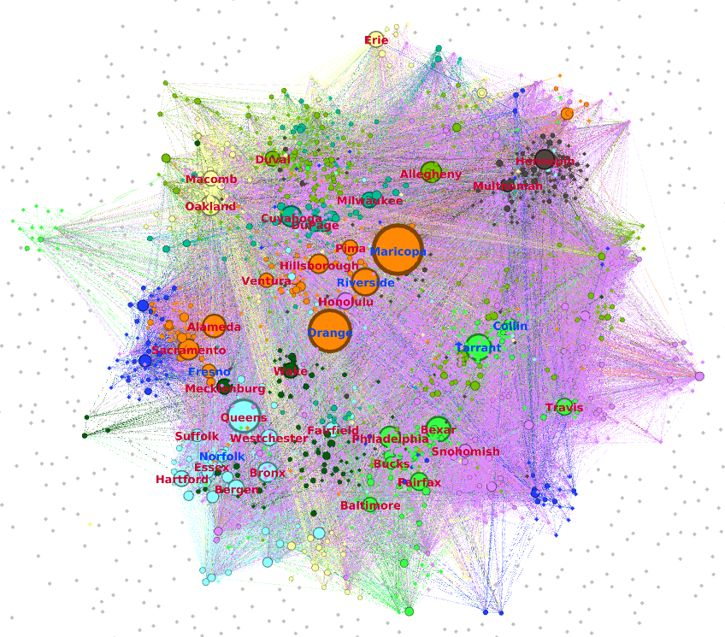
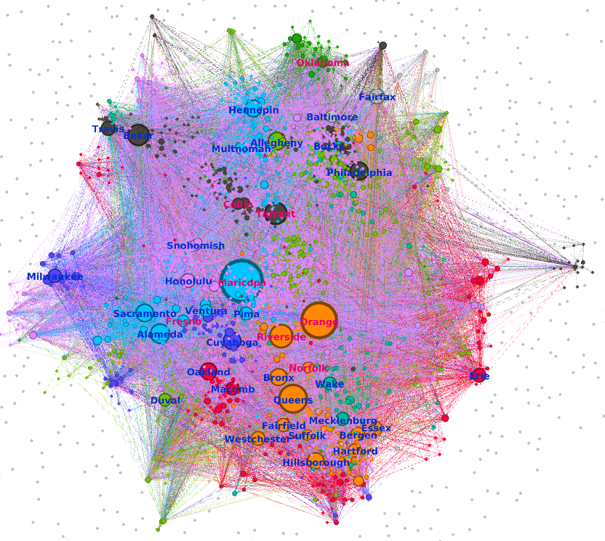
US Migration
Housing Boom (2004-2007)
Housing Bust (2008-2011)

Slide 25
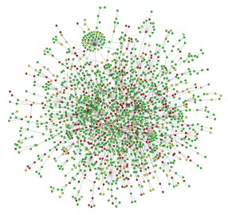
Biological networks
Biological systems represented as networks
  Protein-Protein Interaction Networks
  Gene regulation networks
  Gene co-expression networks
  Metabolic pathways
  The Food Web
  Neural Networks

Slide 26
Machine Learning with Networks
Classical ML tasks in networks:
Node classification
  Predict a type of a given node
Link prediction
  Predict whether two nodes are linked
Community detection
  Identify densely linked clusters of nodes
Network similarity
  How similar are two (sub)networks

Slide 27
Example: Node Classification
?
?
?
?
Machine Learning
?

Slide 28
Example: Link Prediction
?
?
x
?
Machine Learning

Slide 29
Machine Learning Lifecycle
(Supervised) Machine Learning Lifecycle: This feature, that feature. Every single time!
Raw Data
Structured Data
Learning Algorithm
Model
Feature Engineering
Automatically
learn the features
Downstream
prediction task

Slide 30


Feature Learning in Graphs
Goal: Efficient task-independent feature learning for machine learning
in networks!
node
2
vec
u
$$f:u→ℝ^{d}$$
$$ℝ^{d}$$
Feature representation, embedding

Slide 31
Example
  Zachary’s Karate Club Network:
Input
Output
Image from: Perozzi et al. 2014. DeepWalk: Online Learning of Social Representations. KDD.

Slide 32
Why Is It Hard?
Modern deep learning toolbox is designed for simple sequences or grids.
  CNNs for fixed-size images/grids….
  RNNs or word2vec for text/sequences…

Slide 33
Why Is It Hard?
But networks are far more complex!
  Complex topographical structure (i.e., no spatial locality like grids)
  No fixed node ordering or reference point (i.e., the isomorphism problem)
  Often dynamic and have multimodal features.

Slide 34
Embedding Nodes
Input
Output
Intuition: Find embedding of nodes to d-dimensions so that “similar” nodes in the graph have embeddings that are close together.

Slide 35
Important works in the history
Graph/Network Embedding
  ISOMap [Tenenbaum et al., Science’00]
  LLE [Roweis and Saul, Science’00]
  Laplacian EigenMap [Belkin et al., NIPS’01]
  (t)-SNE [Maaten and Hinton, JMLR’08]
  Deepwalk [Perozzi et al., KDD’14]
  LINE [Tang et al., WWW’15]
  Node2vec [Grover and Leskovec, KDD’16]

Slide 36
Setup
Assume we have a graph G:
  V is the vertex set.
  A is the adjacency matrix (assume binary).
  No node features or extra information is used!

Slide 37
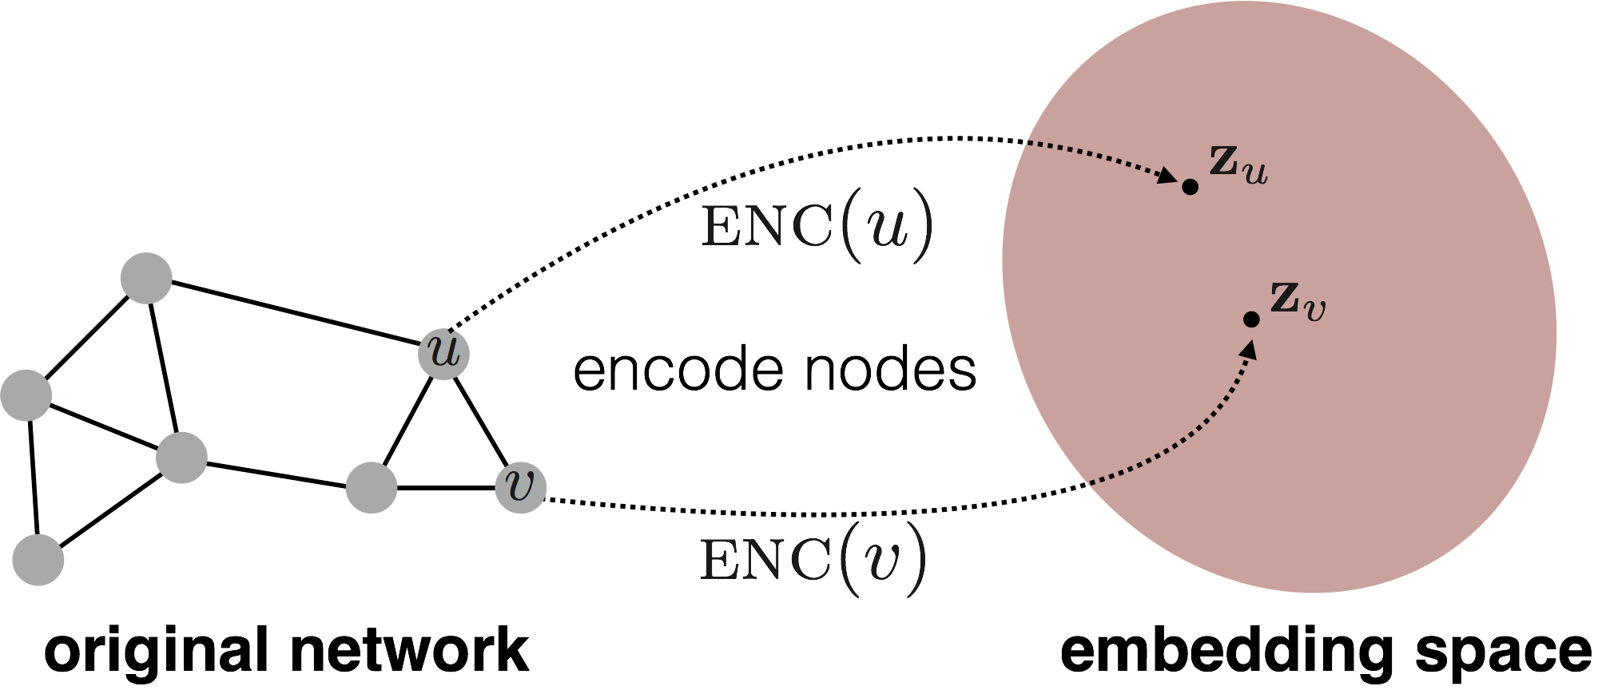
Embedding Nodes
Goal is to encode nodes so that similarity in the embedding space (e.g., dot product) approximates similarity in the original network.

Slide 38
Embedding Nodes
Goal:
Need to define!

Slide 39
Learning Node Embeddings
Define an encoder (i.e., a mapping from nodes to embeddings)
Define a node similarity function (i.e., a measure of similarity in the original network).
Optimize the parameters of the encoder so that:
Notes:
Note that other distance measures other than dot products could be used (e.g., Euclidean distance), but the dot product is the standard measure of similarity used.

Slide 40
Two Key Components
Encoder maps each node to a low-dimensional vector.
Similarity function specifies how relationships in vector space map to relationships in the original network.
d-dimensional embedding
node in the input graph
Similarity of u and v in the original network
dot product between node embeddings
Notes:
Note again that other distance measures other than dot products could be used (e.g., Euclidean distance), but the dot product is the standard measure of similarity used.

Slide 41
“Shallow” Encoding
Simplest encoding approach: encoder is just an embedding-lookup
matrix, each column is node embedding [what we learn!]
indicator vector, all zeroes except a one in column indicating node v

Slide 42
“Shallow” Encoding
Simplest encoding approach: encoder is just an embedding-lookup
embedding vector for a specific node
embedding matrix
Dimension/size of embeddings
one column per node

Slide 43
“Shallow” Encoding
Simplest encoding approach: encoder is just an embedding-lookup.
i.e., each node is assigned a unique embedding vector.

Slide 44
How to Define Node Similarity?
Key distinction between “shallow” methods is how they define node similarity.
E.g., should two nodes have similar embeddings if they….
  are connected?
  share neighbors?
  have similar “structural roles”?
  …?

Slide 45
We introduce two ways
Adjacency-based similarity
Random walk approaches
High-level structure and material from:
Hamilton et al. 2017. Representation Learning on Graphs: Methods and Applications. IEEE Data Engineering Bulletin on Graph Systems.

Slide 46
Adjacency-based Similarity
Material based on:
Ahmed et al. 2013. Distributed Natural Large Scale Graph Factorization. WWW.

Slide 47
Adjacency-based Similarity
Similarity function is just the edge weight between u and v in the original network.
Intuition: Dot products between node embeddings approximate edge existence.
loss (what we want to minimize)
embedding similarity
(weighted) adjacency matrix for the graph
sum over all node pairs

Slide 48
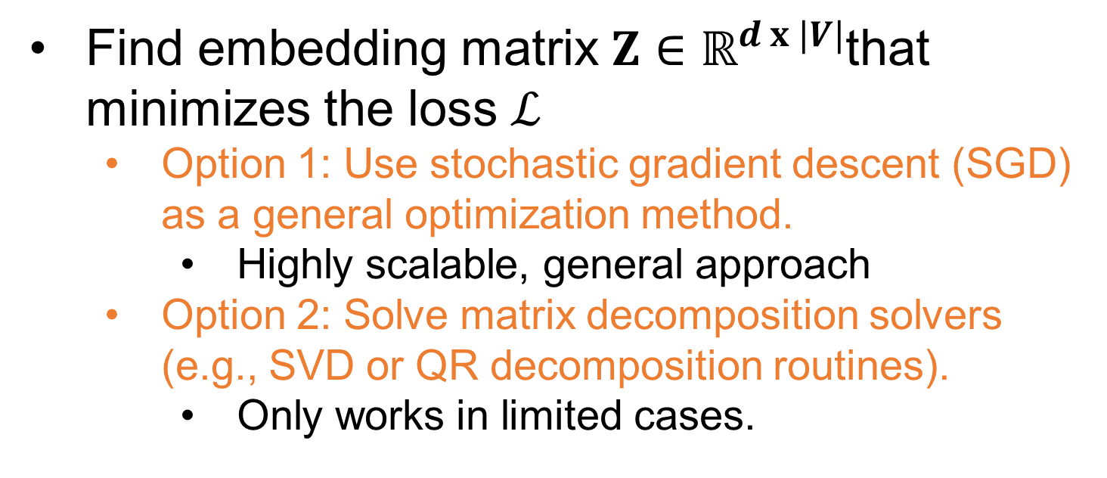
Adjacency-based Similarity
Find embedding matrix $Z∈ℝ^{d x |V|}$that minimizes the loss $ℒ$
  Option 1: Use stochastic gradient descent (SGD) as a general optimization method.
    Highly scalable, general approach
  Option 2: Solve matrix decomposition solvers (e.g., SVD or QR decomposition routines).
    Only works in limited cases.

Slide 49
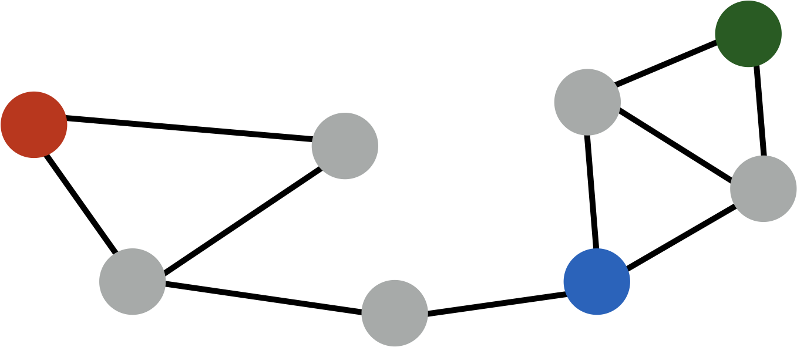
Adjacency-based Similarity
Drawbacks:
  O(|V|²) runtime. (Must consider all node pairs.)
    Can make O([E|) by only summing over non-zero edges and using regularization (e.g., Ahmed et al., 2013)
  Only considers direct, local connections.
e.g., the blue node is obviously more similar to green compared to red node, despite none having direct connections.

Slide 50
Random Walk Approaches
Material based on:
Perozzi et al. 2014. DeepWalk: Online Learning of Social Representations. KDD.
Grover et al. 2016. node2vec: Scalable Feature Learning for Networks. KDD.

Slide 51
Random-walk Embeddings
probability that u and v co-occur on a random walk over the network

Slide 52
DeepWalk: The Big Idea
DeepWalk learns a latent representation of adjacency matrices using deep learning techniques developed for language modeling

Slide 53
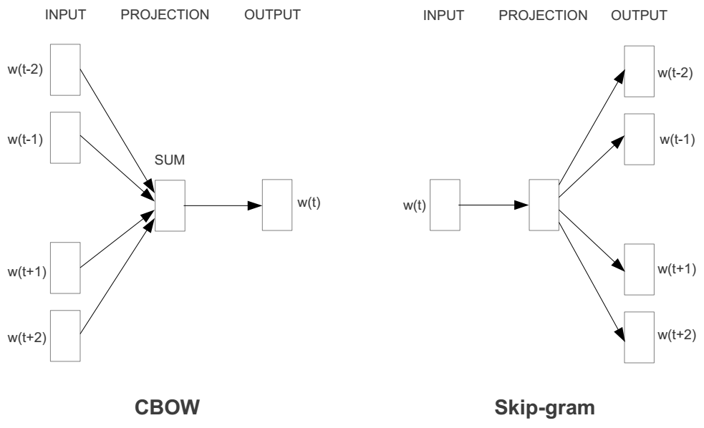
Language Modeling

Slide 54
Random Walk Paths as Documents

Slide 55
Random-walk Embeddings
Estimate probability of visiting node v on a random walk starting from node u using some random walk strategy R.
Optimize embeddings to encode these random walk statistics.

Slide 56
Why Random Walks?
Expressivity: Flexible stochastic definition of node similarity that incorporates both local and higher-order neighborhood information.
Efficiency: Do not need to consider all node pairs when training; only need to consider pairs that co-occur on random walks.

Slide 57
How should we randomly walk?
So far we have described how to optimize embeddings given random walk statistics.
What strategies should we use to run these random walks?
  Simplest idea: Just run fixed-length, unbiased random walks starting from each node (i.e., DeepWalk from Perozzi et al., 2013).
  But can we do better?

Slide 58
node2vec: Biased Walks
Idea: use flexible, biased random walks that can trade off between local and global views of the network (Grover and Leskovec, 2016).

Slide 59



node2vec: Biased Walks
Two classic strategies to define a neighborhood $N_{R}\left(u\right)$ of a given node $u$:
$$N_{BFS}\left(u\right)=\{ s_{1},s_{2},s_{3}\}$$
Local microscopic view
$$N_{DFS}\left(u\right)=\{ s_{4},s_{5},s_{6}\}$$
Global macroscopic view

Slide 60
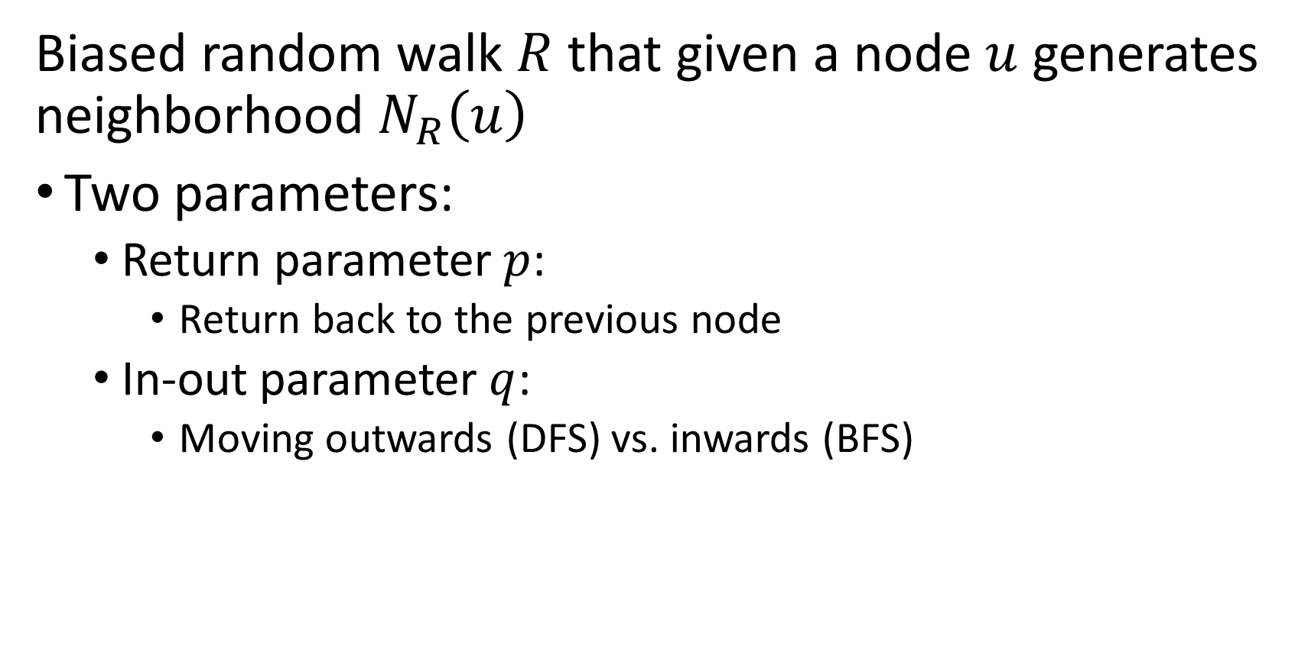
Interpolating BFS and DFS
Biased random walk $R$ that given a node $u$ generates neighborhood $N_{R}\left(u\right)$
Two parameters:
  Return parameter $p$:
    Return back to the previous node
  In-out parameter $q$:
    Moving outwards (DFS) vs. inwards (BFS)

Slide 61




Biased Random Walks
Biased 2nd-order random walks explore network neighborhoods:
  Rnd. walk started at $u$ and is now at $w$
  Insight: Neighbors of $w$ can only be:
  Idea: Remember where that walk came from
Same distance to $u$
s₂
s₃
w
Farther from $u$
u
s₁
Closer to $u$

Slide 62






Biased Random Walks
Walker is at $w$. Where to go next?
  BFS-like walk: Low value of $p$
  DFS-like walk: Low value of $q$
$N_{S}(u)$ are the nodes visited by the walker
s₂
$$1$$
s₃
s₁
s₂
s₃
$$1/p$$
$$1$$
$$1/q$$
w
$w→$
$$1/q$$
u
s₁
$$1/p$$
Unnormalized
transition prob.

Slide 63
Random Walk
1/3
Transition Probability
 | A | B | C
A | 0 | 1/3 | 2/3
B | 1 | 0 | 0
C | 0 | 1 | 0
1
A
B
2/3
1
C

Slide 64

Random Walk
1/3
Transition Probability
 | A | B | C
A | 0 | 1/3 | 2/3
B | 1 | 0 | 0
C | 0 | 1 | 0
1
A
B
2/3
1
C
Path: A -

Slide 65
Random Walk
1/3
Transition Probability
 | A | B | C
A | 0 | 1/3 | 2/3
B | 1 | 0 | 0
C | 0 | 1 | 0
1
A
B
2/3
1
C
Path: A - C

Slide 66
Random Walk
1/3
Transition Probability
 | A | B | C
A | 0 | 1/3 | 2/3
B | 1 | 0 | 0
C | 0 | 1 | 0
1
A
B
2/3
1
C
Path: A - C - B

Slide 67
Random Walk
1/3
Transition Probability
 | A | B | C
A | 0 | 1/3 | 2/3
B | 1 | 0 | 0
C | 0 | 1 | 0
1
A
B
2/3
1
C
Path: A - C - B - A

Slide 68
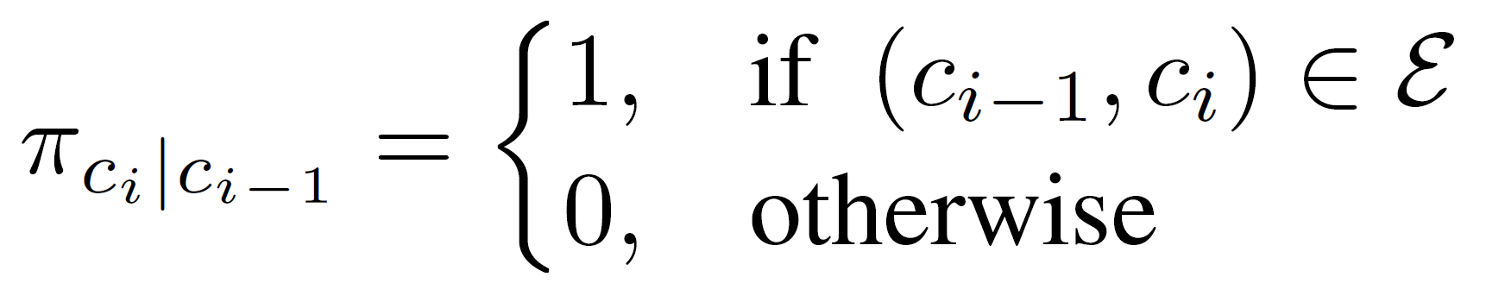
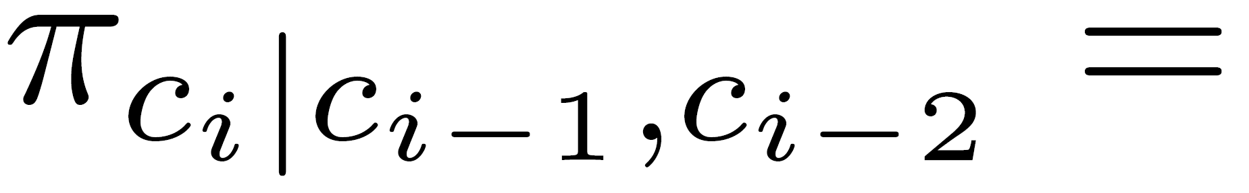

First-order Random Walk
A random walker moves to next node based on the last node.
Second Last Node
Last Node
Node
Perozzi et al., Deepwalk: Online learning of social representations, KDD, 2014.

Slide 69
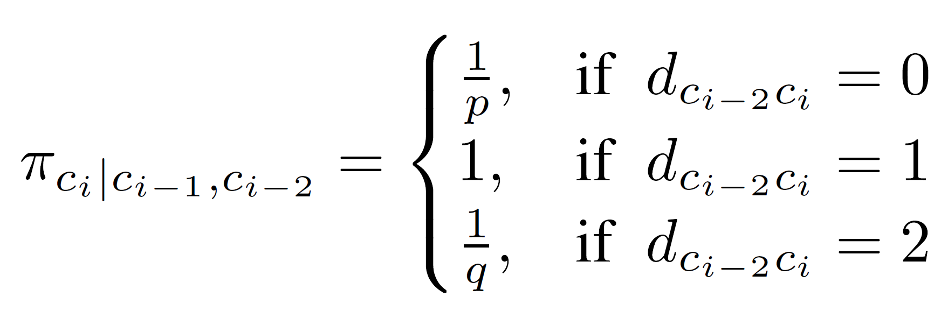

Second-order Random Walk
A random walker moves to next node based on the last two nodes.
Second Last Node
B
Last Node
A
Node
Grover et al., node2vec: Scalable feature learning for networks, KDD, 2016.

Slide 70
Second-order Random Walk
A random walker moves to next node based on the last two nodes.
Second Last Node
B
Last Node
A
Node
Grover et al., node2vec: Scalable feature learning for networks, KDD, 2016.

Slide 71

Second-order Random Walk
A random walker moves to next node based on the last two nodes.
Second Last Node
B
Last Node
A
Node
Grover et al., node2vec: Scalable feature learning for networks, KDD, 2016.

Slide 72
Biased Random Walks
Walker is at $w$. Where to go next?
  BFS-like walk: Low value of $p$
  DFS-like walk: Low value of $q$
$N_{S}(u)$ are the nodes visited by the walker
s₂
$$1$$
s₃
s₁
s₂
s₃
$$1/p$$
$$1$$
$$1/q$$
w
$w→$
$$1/q$$
u
s₁
$$1/p$$
Unnormalized
transition prob.

Slide 73
Random Walk Paths as Documents

Slide 74
Word Embedding Algorithm

Slide 75
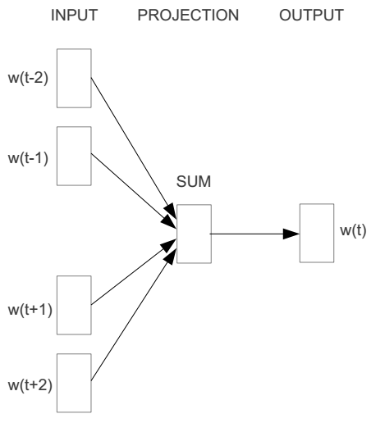
Word2vec – Continuous Bag of Word
E.g. “The cat sat on floor”
  Window size = 2
the
cat
sat
on
floor

Slide 76
Input layer
Index of cat in vocabulary
0
1
0
cat
0
Hidden layer
Output layer
0
0
0
0
0
0
…
0
0
0
one-hot
vector
0
sat
one-hot
vector
0
0
0
0
1
0
…
1
0
on
0
0
0
0
…
0

Slide 77



We must learn W and W’
Input layer
0
1
0
cat
0
$$W_{V×N}$$
Hidden layer
Output layer
0
0
0
0
0
0
V-dim
…
0
0
$${W′}_{N×V}$$
0
0
sat
0
0
0
0
1
0
$$W_{V×N}$$
N-dim
…
V-dim
1
0
on
0
0
0
0
V-dim
…
N will be the size of word vector
0

Slide 78
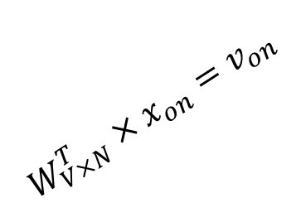

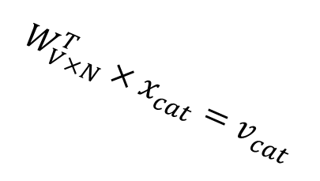



$$W_{V×N}^{T} ×x_{cat}=v_{cat}$$
0.1 | 2.4 | 1.6 | 1.8 | 0.5 | 0.9 | … | … | … | 3.2
0.5 | 2.6 | 1.4 | 2.9 | 1.5 | 3.6 | … | … | … | 6.1
… | … | … | … | … | … | … | … | … | …
… | … | … | … | … | … | … | … | … | …
0.6 | 1.8 | 2.7 | 1.9 | 2.4 | 2.0 | … | … | … | 1.2
0
2.4
2.6
…
…
1.8
Input layer
1
$$×$$
0
$$=$$
0
0
1
0
0
0
x_{cat}
0
0
Output layer
0
0
0
$$W_{V×N}^{T}×x_{cat}=v_{cat}$$
…
0
0
0
0
0
V-dim
…
0
0
$$\hat{v}=\frac{v_{cat}+v_{on}}{2}$$
0
+
0
sat
0
0
0
0
$$W_{V×N}^{T}×x_{on}=v_{on}$$
1
0
…
V-dim
1
Hidden layer
0
x_{on}
0
0
N-dim
0
0
V-dim
…
0

Slide 79

$$W_{V×N}^{T} ×x_{on}=v_{on}$$
0.1 | 2.4 | 1.6 | 1.8 | 0.5 | 0.9 | … | … | … | 3.2
0.5 | 2.6 | 1.4 | 2.9 | 1.5 | 3.6 | … | … | … | 6.1
… | … | … | … | … | … | … | … | … | …
… | … | … | … | … | … | … | … | … | …
0.6 | 1.8 | 2.7 | 1.9 | 2.4 | 2.0 | … | … | … | 1.2
0
1.8
2.9
…
…
1.9
Input layer
0
$$×$$
0
$$=$$
0
1
1
0
0
0
x_{cat}
0
0
Output layer
0
0
0
$$W_{V×N}^{T}×x_{cat}=v_{cat}$$
…
0
0
0
0
0
V-dim
…
0
0
$$\hat{v}=\frac{v_{cat}+v_{on}}{2}$$
0
+
0
sat
0
0
0
0
$$W_{V×N}^{T}×x_{on}=v_{on}$$
1
0
…
V-dim
1
Hidden layer
0
x_{on}
0
0
N-dim
0
0
V-dim
…
0

Slide 80






Input layer
0
1
0
cat
0
$$W_{V×N}$$
Hidden layer
Output layer
0
0
0
0
0
0
V-dim
…
0
0
$$W_{V×N}^{′}×\hat{v}=z$$
0
$$\hat{y}=softmax(z)$$
0
0
0
0
0
$$\hat{v}$$
1
0
$$W_{V×N}$$
…
1
N-dim
0
on
0
${\hat{y}}_{sat}$
0
0
V-dim
0
V-dim
…
N will be the size of word vector
0

Slide 81


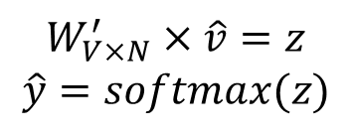
Input layer
0
We would prefer $\hat{y}$ close to ${\hat{y}}_{sat}$
1
0
cat
0
$$W_{V×N}$$
Hidden layer
Output layer
0
0
0
0
0.01
0.02
0.00
0.02
0.01
0.02
0.01
0.7
…
0.00
0
0
V-dim
…
0
0
$$W_{V×N}^{′}×\hat{v}=z$$
$$\hat{y}=softmax(z)$$
0
0
0
0
0
0
$$\hat{v}$$
1
0
$$W_{V×N}$$
…
1
N-dim
0
on
0
${\hat{y}}_{sat}$
0
0
V-dim
0
V-dim
…
N will be the size of word vector
$\hat{y}$
0

