Slide 1
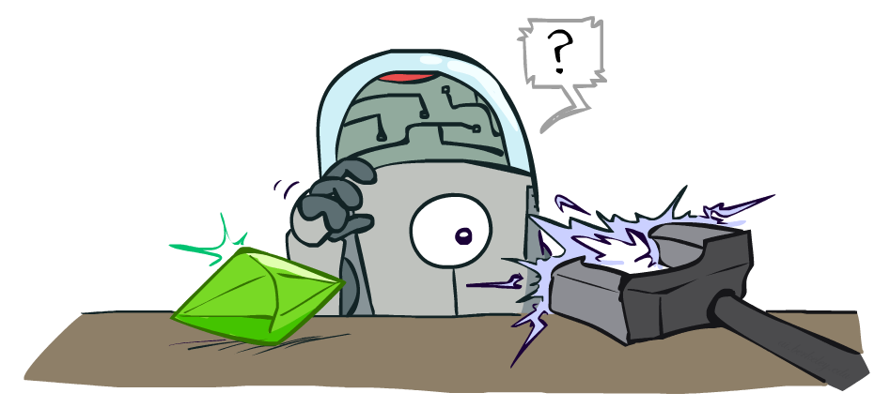
Artificial Intelligence
Reinforcement Learning
Notes:
Please retain proper attribution, including the reference to ai.berkeley.edu. Thanks!

Slide 2
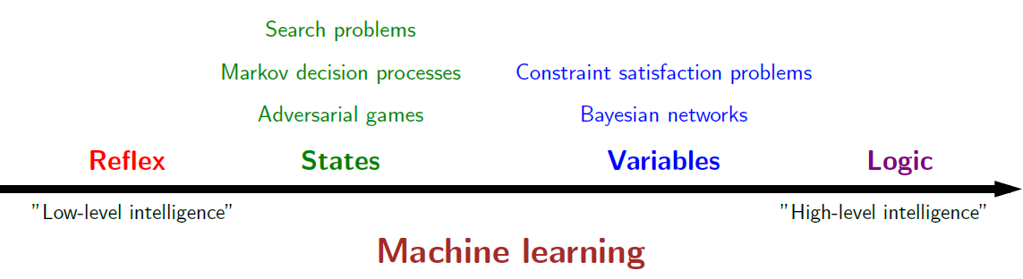
Course Topics

Slide 3




Markov Decision Processes
An MDP is defined by:
  A set of states s ∈ S
  A set of actions a ∈ A
  A transition function T(s, a, s’)
    Probability that a from s leads to s’, i.e., P(s’| s, a)
    Also called the model or the dynamics
  A reward function R(s, a, s’)
    Sometimes just R(s) or R(s’)
  A start state
  Maybe a terminal state
MDPs are non-deterministic search problems
  One way to solve them is with expectimax search
  We’ll have a new tool soon
Notes:
In search problems: did not talk about actions, but about successor functions --- now the information inside the successor function is unpacked into actions, transitions and reward
Write out S, A, example entry in T, entry in R
Reward function different from the book : R(s,a,s’)
In book simpler for equations, but not useful for the projects.
Need to modify expectimax a tiny little bit to account for rewards along the way, but that’s something you should be able to do, and so you can already solve MDP’s (not in most efficient way)

Slide 4

Value Iteration
Start with V₀(s) = 0: no time steps left means an expected reward sum of zero
Given vector of V_{k}(s) values, do one ply of expectimax from each state:
Repeat until convergence
Q-Value Iteration
V_{k+1}(s)
a
s, a
s,a,s’
V_{k}(s’)
Notes:
Discuss computational complexity: S * A * S times number of iterations
Note: updates not in place [if in place, it means something else and not even clear what it means]

Slide 5



Snapshot of Demo – Gridworld V Values
The value (utility) of a state s:
  V*(s) = expected utility starting in s and acting optimally
The value (utility) of a q-state (s,a):
  Q*(s,a) = expected utility starting out having taken action a from state s and (thereafter) acting optimally
The optimal policy:
  π*(s) = optimal action from state s
Noise = 0.2
Discount = 0.9
Notes:
This demo doesn’t show anything in action, it just shows the V and Q values.

Slide 6
The Story So Far: MDPs and RL
Known MDP: Offline Solution
Goal Technique
Compute V*, Q*, π* Value / policy iteration
Evaluate a fixed policy π Policy evaluation

Slide 7
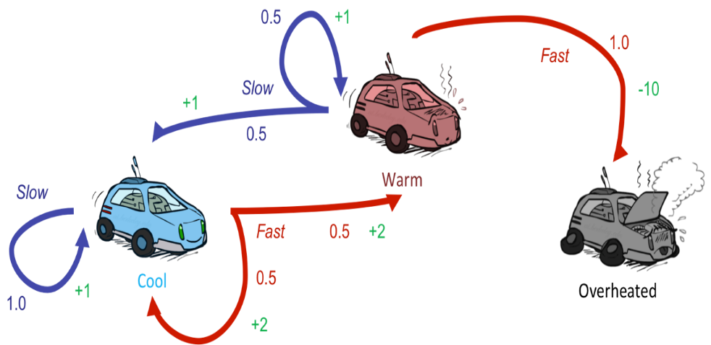
Reinforcement Learning
Still assume a Markov decision process (MDP):
  A set of states s ∈ S
  A set of actions (per state) A
  A model T(s,a,s’)
  A reward function R(s,a,s’)
Still looking for a policy π(s)
New twist: don’t know T or R
  I.e. we don’t know which states are good or what the actions do
  Must actually try actions and states out to learn

Slide 8
The Story So Far: MDPs and RL
Known MDP: Offline Solution
Goal Technique
Compute V*, Q*, π* Value / policy iteration
Evaluate a fixed policy π Policy evaluation
Unknown MDP: Model-Based
Unknown MDP: Model-Free
Goal Technique
Compute V*, Q*, π* VI/PI on approx. MDP
Evaluate a fixed policy π PE on approx. MDP
Goal Technique
Compute V*, Q*, π* Q-learning
Evaluate a fixed policy π Value Learning

Slide 9
Outline
Model-based learning
  Learn T(s,a,s’) and R(s,a,s’)
Model-free learning
  Passive Reinforcement Learning
    Direct evaluation
    Sample based policy evaluation
    Temporal Difference Learning
  Active Reinforcement Learning
    Q-learning

Slide 10
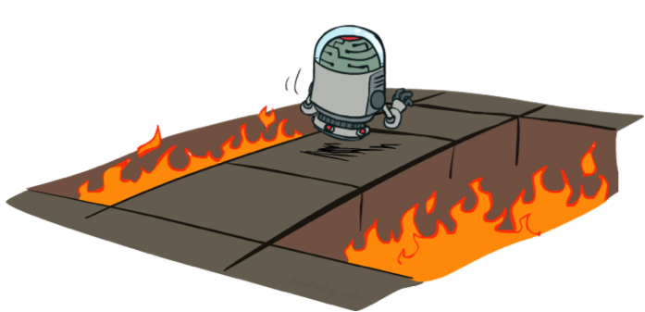
Active Reinforcement Learning
Full reinforcement learning: optimal policies (like value iteration)
  You don’t know the transitions T(s,a,s’)
  You don’t know the rewards R(s,a,s’)
  You choose the actions now
  Goal: learn the optimal policy / values
In this case:
  Learner makes choices!
  Fundamental tradeoff: exploration vs. exploitation
  This is NOT offline planning! You actually take actions in the world and find out what happens…

Slide 11

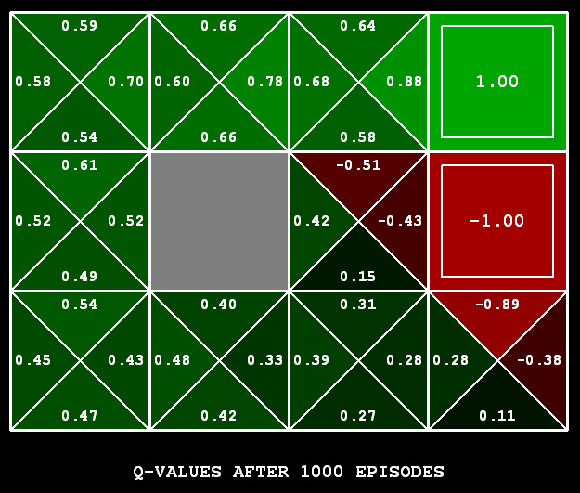
Q-Learning
Q-Learning: sample-based Q-value iteration
Learn Q(s,a) values as you go
  Receive a sample (s,a,s’,r)
  Consider your old estimate:
  Consider your new sample estimate:
  Incorporate the new estimate into a running average:

Slide 12

Q-Learning Properties
Amazing result: Q-learning converges to optimal policy -- even if you’re acting suboptimally!
This is called off-policy learning
Caveats:
  You have to explore enough
  You have to eventually make the learning rate
  small enough
  … but not decrease it too quickly
  Basically, in the limit, it doesn’t matter how you select actions (!)

Slide 13
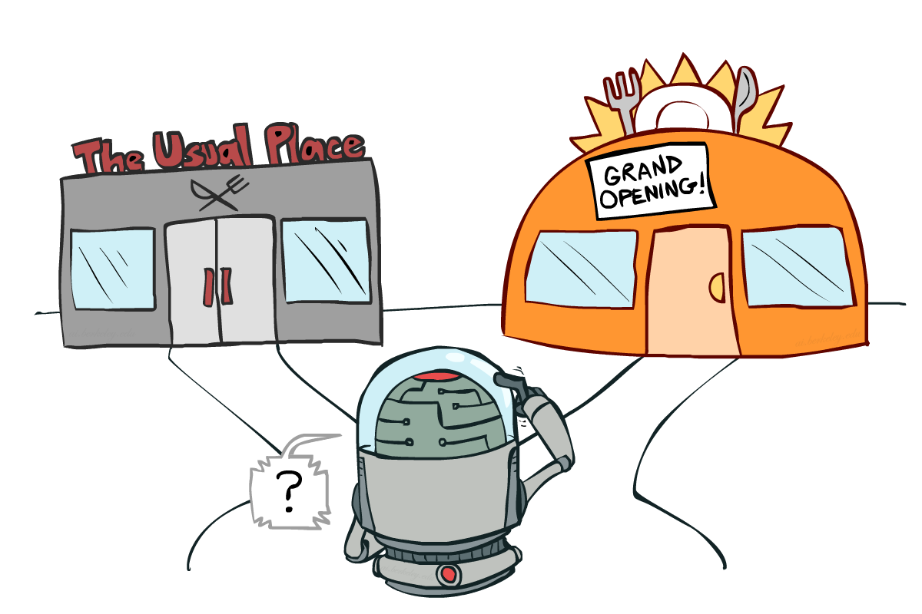
Exploration vs. Exploitation

Slide 14
Examples
Restaurant Selection
  Exploitation Go to your favorite restaurant
  Exploration Try a new restaurant
Online Banner Advertisements
  Exploitation Show the most successful advertisements
  Exploration Show a different advertisements
Oil Drilling
  Exploitation Drill at the best known location
  Exploration Drill at a new location
Game Playing
  Exploitation Play the move you believe is best
  Exploration Play an experimental move

Slide 15

How to Explore?
Several schemes for forcing exploration
  Simplest: random actions (ε-greedy)
    Every time step, flip a coin
    With (small) probability ε, act randomly
    With (large) probability 1-ε, act on current policy
  Problems with random actions?
    You do eventually explore the space, but keep thrashing around once learning is done
    One solution: lower ε over time
    Another solution: exploration functions
[Demo: Q-learning – manual exploration – bridge grid (L11D2)] [Demo: Q-learning – epsilon-greedy -- crawler (L11D3)]

Slide 16

Video of Demo Q-learning – Epsilon-Greedy – Crawler

Slide 17
Video of Demo Q-Learning Auto Cliff Grid

Slide 18
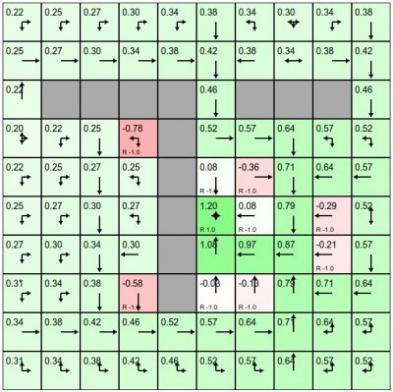
Demo
http://cs.stanford.edu/people/karpathy/reinforcejs/gridworld_td.html
Gridworld
  Actions: NSEW
  Deterministic: T(s,a,s’)=1
  Discount: 0.9
  Set your own rewards

Slide 19

Exploration Functions
When to explore?
  Random actions: explore a fixed amount
  Better idea: explore areas whose badness is not
  (yet) established, eventually stop exploring
Exploration function
  N(s’,a’): number of a’ has been tried in state, encourage unfamiliar actions a’
  This propagates the “bonus” back to states s that lead to unknown states s’ as well!
  E.g., takes a value estimate u and a visit count n, and returns an optimistic utility estimate R+, e.g.
Regular Q-Update:
Modified Q-Update:
k: parameter of trial times
try each action–state pair at least Ne times

Slide 20
Video of Demo Q-learning – Exploration Function – Crawler

Slide 21
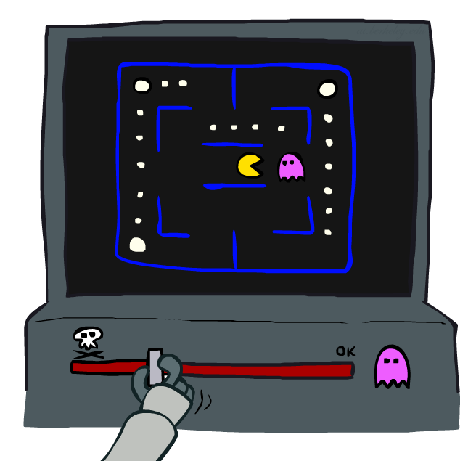
Approximate Q-Learning

Slide 22

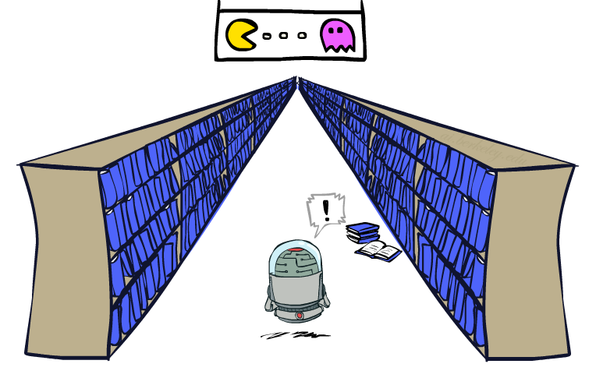
Generalizing Across States
Basic Q-Learning keeps a table of all q-values
In realistic situations, we cannot possibly learn about every single state!
  Too many states to visit them all in training
  Too many states to hold the q-tables in memory
Instead, we want to generalize:
  Learn about some small number of training states from experience
  Generalize that experience to new, similar situations
  This is a fundamental idea in machine learning, and we’ll see it over and over again
[demo – RL pacman]

Slide 23




Example: Pacman
Let’s say we discover through experience that this state is bad:
In naïve q-learning, we know nothing about this state:
Or even this one!
[Demo: Q-learning – pacman – tiny – watch all (L11D5)]
[Demo: Q-learning – pacman – tiny – silent train (L11D6)]
[Demo: Q-learning – pacman – tricky – watch all (L11D7)]

Slide 24
Demo Q-Learning Pacman – Tiny – Watch All

Slide 25
Demo Q-Learning Pacman – Tiny – Silent Train

Slide 26
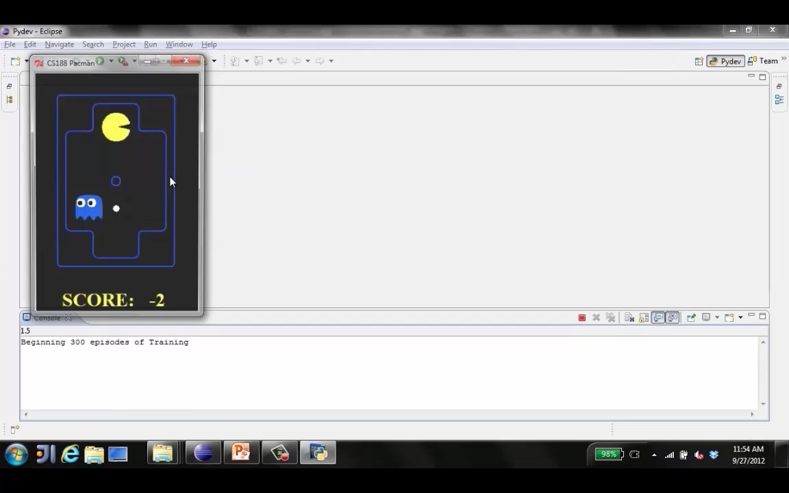
Demo: Q-learning – Pacman – Tricky – Watch all

Slide 27
Feature-Based Representations
Solution: describe a state using a vector of features (properties)
  Features are functions from states to real numbers (often 0/1) that capture important properties of the state
  Example features:
    Distance to closest ghost
    Distance to closest dot
    Number of ghosts
    1 / (dist to dot)²
    Is Pacman in a tunnel? (0/1)
    …… etc.
    Is it the exact state on this slide?
  Can also describe a q-state (s, a) with features (e.g. action moves closer to food)

Slide 28
Linear Value Functions
Using a feature representation, we can write a q function (or value function) for any state using a few weights:
Advantage: our experience is summed up in a few powerful numbers
Disadvantage: states may share features but actually be very different in value!

Slide 29
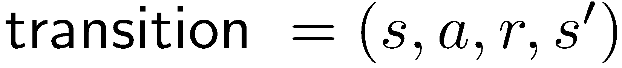

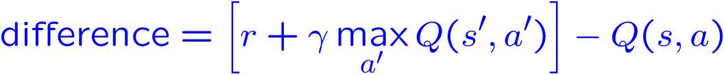
Approximate Q-Learning
Q-learning with linear Q-functions:
Intuitive interpretation:
  Adjust weights of active features
  E.g., if something unexpectedly bad happens, blame the features that were on: disprefer all states with that state’s features
Formal justification: online least squares
Exact Q’s
Approximate Q’s

Slide 30
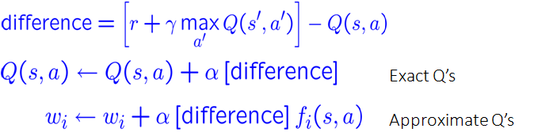

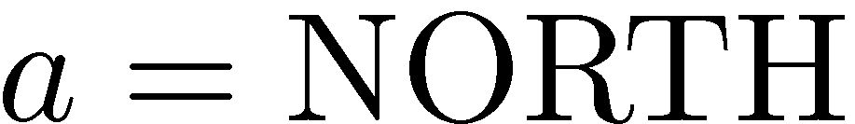
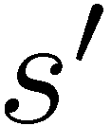
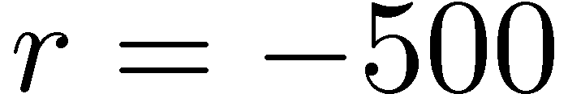


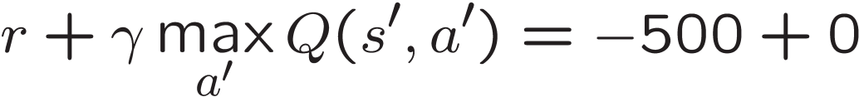
Example: Q-Pacman
[Demo: approximate Q-learning pacman (L11D10)]

Slide 31
Demo Approximate Q-Learning -- Pacman

Slide 32
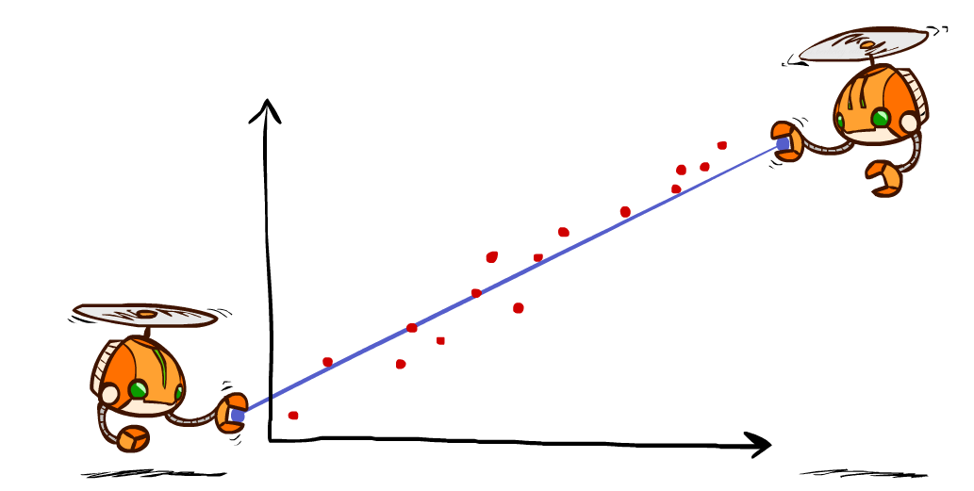
Q-Learning and Least Squares

Slide 33

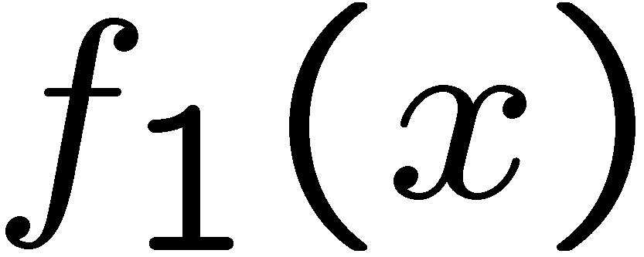
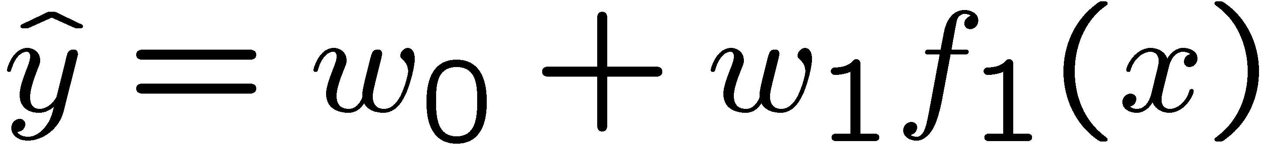
Linear Approximation: Regression*
40
26
20
24
22
20
30
0
0
20
20
40
30
10
20
0
10
0
Prediction:
Prediction:
Notes:
Figure 1: scatter(1:20,10+(1:20)+2*randn(1,20),'k','filled'); a=axis; a(3)=0; axis(a);

Slide 34
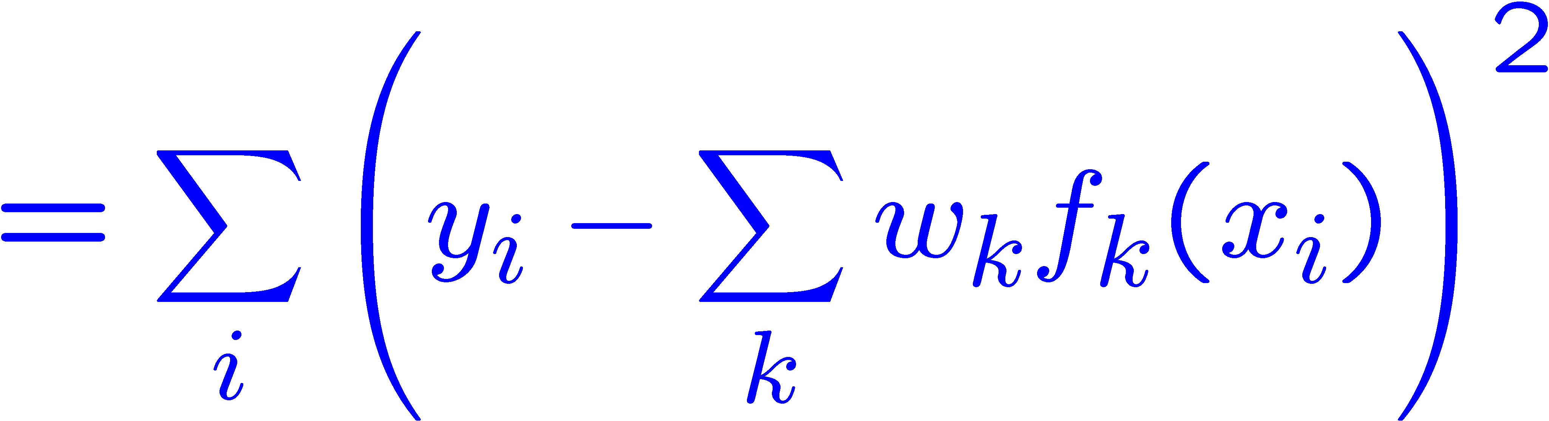
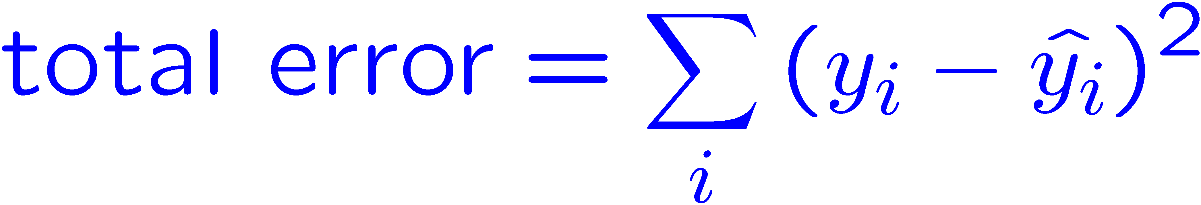
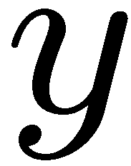


Optimization: Least Squares*
Error or “residual”
Observation
Prediction
0
0
20
Notes:
Figure 1: scatter(1:20,10+(1:20)+2*randn(1,20),'k','filled'); a=axis; a(3)=0; axis(a);

Slide 35
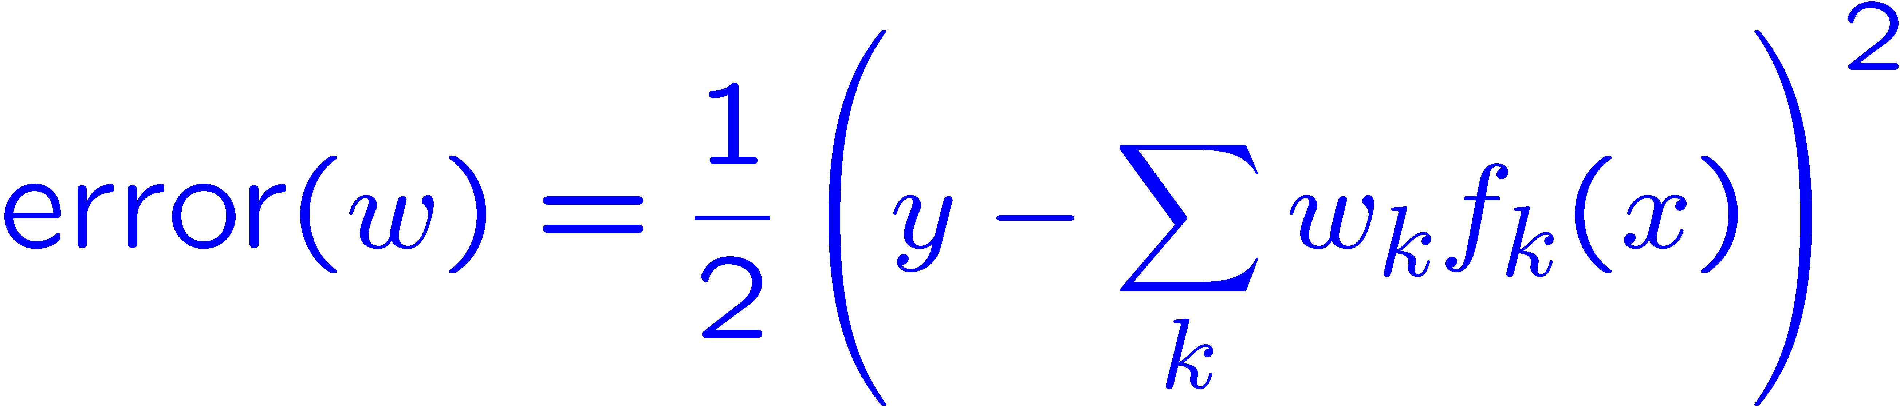
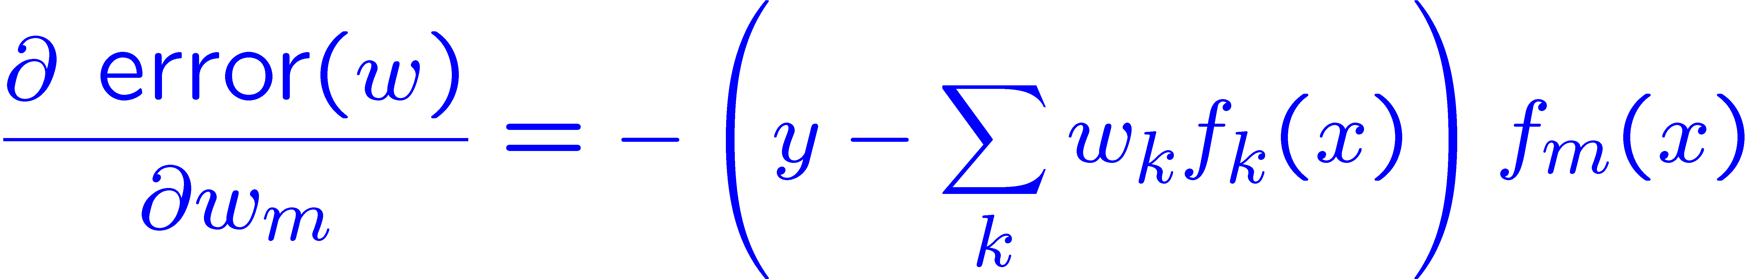
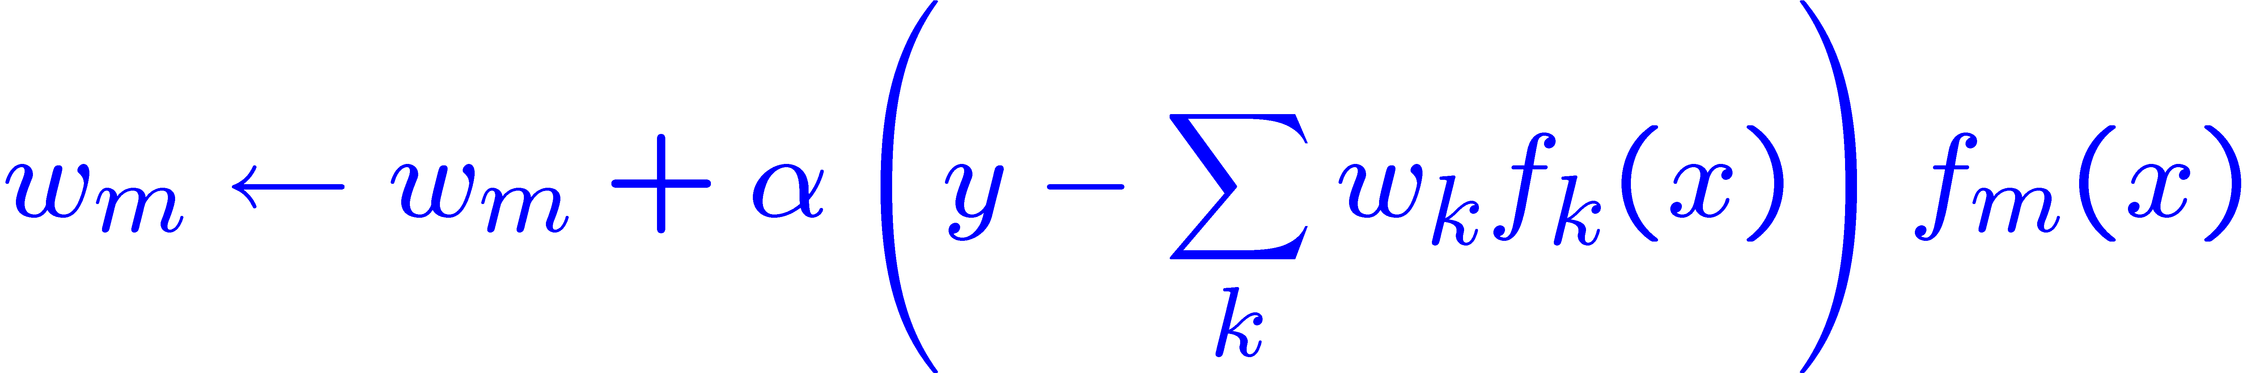
Minimizing Error*
Imagine we had only one point x, with features f(x), target value y, and weights w:
Approximate q update explained:
“target”
“prediction”

Slide 36
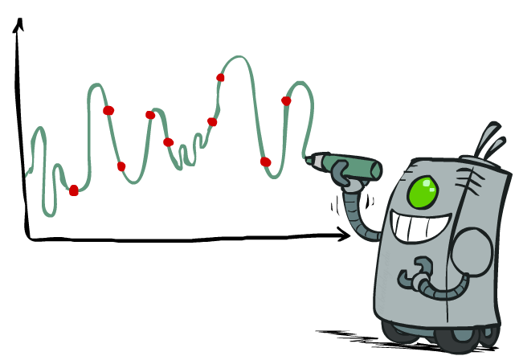
Overfitting: Why Limiting Capacity Can Help*
30
25
20
Degree 15 polynomial
15
10
5
0
-5
-10
-15
0
2
4
6
8
10
12
14
16
18
20

Slide 37

We’re done with Part I: States and Search
We’ve seen how AI methods can solve problems in:
  Search
  Games
  Markov Decision Problems
  Reinforcement Learning
Next up: Part II: Variables!

