Slide 1

Artificial Intelligence
Reinforcement Learning
Notes:
Please retain proper attribution, including the reference to ai.berkeley.edu. Thanks!

Slide 2
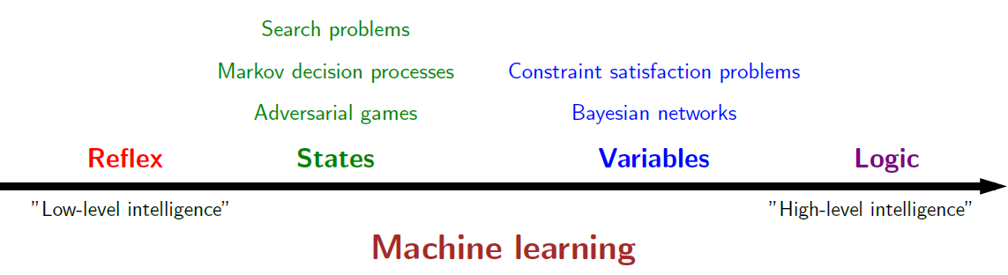
Course Topics

Slide 3





Example: Grid World
A maze-like problem
  The agent lives in a grid
  Walls block the agent’s path
Noisy movement: actions do not always go as planned
  80% of the time, the action North takes the agent North
  (if there is no wall there)
  10% of the time, North takes the agent West; 10% East
  If there is a wall in the direction the agent would have been taken, the agent stays put
The agent receives rewards each time step
  Small “living” reward each step (can be negative)
  Big rewards come at the end (good or bad)
Goal: maximize sum of rewards -- Utilities
Notes:
[cut demo of moving around in grid world program]

Slide 4
Markov Decision Processes
An MDP is defined by:
  A set of states s ∈ S
  A set of actions a ∈ A
  A transition function T(s, a, s’)
    Probability that a from s leads to s’, i.e., P(s’| s, a)
    Also called the model or the dynamics
  A reward function R(s, a, s’)
    Sometimes just R(s) or R(s’)
  A start state
  Maybe a terminal state
Notes:
In search problems: did not talk about actions, but about successor functions --- now the information inside the successor function is unpacked into actions, transitions and reward
Write out S, A, example entry in T, entry in R
Reward function different from the book : R(s,a,s’)
In book simpler for equations, but not useful for the projects.
Need to modify expectimax a tiny little bit to account for rewards along the way, but that’s something you should be able to do, and so you can already solve MDP’s (not in most efficient way)

Slide 5
Policies
In deterministic single-agent search problems, we wanted an optimal plan, or sequence of actions, from start to a goal
For MDPs, we want an optimal policy π*: S → A
  A policy π gives an action for each state
  An optimal policy is one that maximizes expected utility if followed
  An explicit policy defines a reflex agent
Expectimax didn’t compute entire policies
  It computed the action for a single state only
Optimal policy when R(s, a, s’) = -0.03 for all non-terminals s
Notes:
Dan has a DEMO for this.

Slide 6





MDP Search Trees
Each MDP state projects an expectimax-like search tree
s is a state
s
a
(s, a) is a q-state
(s, a) is a q-state
s, a
(s,a,s’) called a transition
T(s,a,s’) = P(s’|s,a)
R(s,a,s’)
s,a,s’
s’
Notes:
In MDP chance node represents uncertainty about what might happen based on (s,a) [as opposed to being a random adversary]
Q-state (s,a) is when you were in a state and took an action

Slide 7
Value Iteration
Start with V₀(s) = 0: no time steps left means an expected reward sum of zero
Given vector of V_{k}(s) values, do one ply of expectimax from each state:
Repeat until convergence
Complexity of each iteration: O(S²A)
V_{k+1}(s)
a
s, a
s,a,s’
V_{k}(s’)
Notes:
Discuss computational complexity: S * A * S times number of iterations
Note: updates not in place [if in place, it means something else and not even clear what it means]

Slide 8


Snapshot of Demo – Gridworld V Values
The value (utility) of a state s:
  V*(s) = expected utility starting in s and acting optimally
The value (utility) of a q-state (s,a):
  Q*(s,a) = expected utility starting out having taken action a from state s and (thereafter) acting optimally
The optimal policy:
  π*(s) = optimal action from state s
Noise = 0.2
Discount = 0.9
Notes:
This demo doesn’t show anything in action, it just shows the V and Q values.

Slide 9
Policy Iteration
Policy Evaluation: For fixed current policy π, find values with policy evaluation:
  Iterate until values converge:
Policy Improvement: For fixed values, get a better policy using policy extraction
  One-step look-ahead:
Compare with Value Iteration

Slide 10

Reinforcement Learning

Slide 11
Reinforcement Learning
Agent
State: s
Reward: r
Actions: a
Environment
Basic idea:
  Receive feedback in the form of rewards
  Agent’s utility is defined by the reward function
  Must (learn to) act so as to maximize expected rewards
  All learning is based on observed samples of outcomes!
Notes:
Show robot-soccer learning to walk videos (UT Austin):
? Show snake robot:

Slide 12
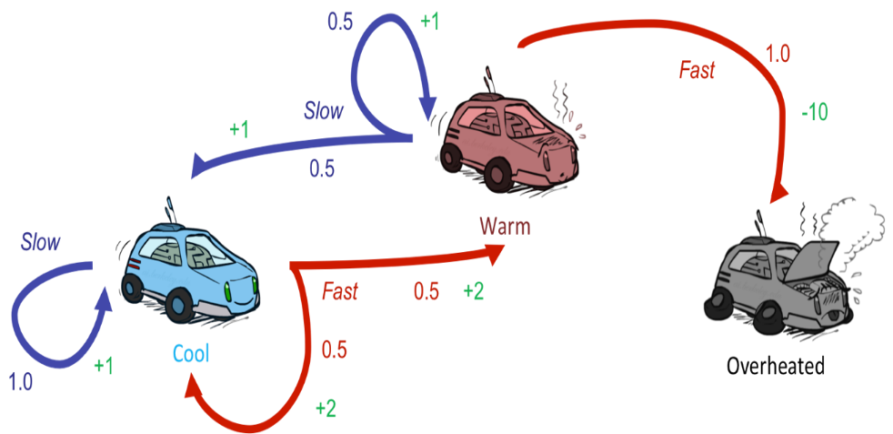
Reinforcement Learning
Still assume a Markov decision process (MDP):
  A set of states s ∈ S
  A set of actions (per state) A
  A model T(s,a,s’)
  A reward function R(s,a,s’)
Still looking for a policy π(s)
New twist: don’t know T or R
  I.e. we don’t know which states are good or what the actions do
  Must actually try actions and states out to learn

Slide 13

Example: Learning to Play
http://www.nature.com/nature/journal/v518/n7540/pdf/nature14236.pdf#videos
https://github.com/kuz/DeepMind-Atari-Deep-Q-Learner

Slide 14
More Examples
https://people.eecs.berkeley.edu/~svlevine/
https://www.youtube.com/watch?v=cXaic_k80uM&feature=youtu.be

Slide 15
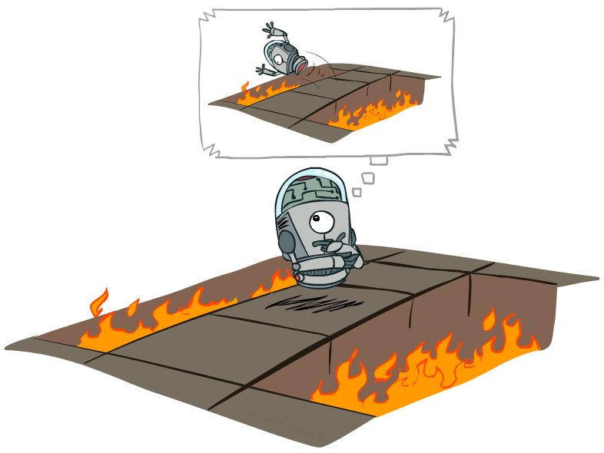
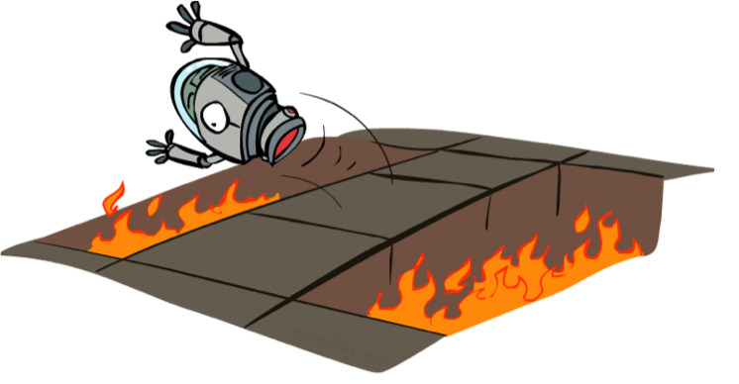
Offline (MDPs) vs. Online (RL)
Offline Solution
Online Learning

Slide 16
Outline
Model-based learning
  Learn T(s,a,s’) and R(s,a,s’)
Model-free learning
  Passive Reinforcement Learning
    Direct evaluation
    Sample based policy evaluation
    Temporal Difference Learning
  Active Reinforcement Learning
    Q-learning

Slide 17

Model-Based Learning

Slide 18




Model-Based Learning
Model-Based Idea:
  Learn an approximate model based on experiences
  Solve for values as if the learned model were correct
Step 1: Learn empirical MDP model
  Count outcomes s’ for each s, a
  Normalize to give an estimate of
  Discover each when we experience (s, a, s’)
Step 2: Solve the learned MDP
  For example, use value iteration, as before

Slide 19
Example: Model-Based Learning
Input Policy π
Observed Episodes (Training)
Learned Model
Episode 1
Episode 2
T(s,a,s’).
T(B, east, C) = 1.00
T(C, east, D) = 0.75
T(C, east, A) = 0.25
…
R(s,a,s’).
R(B, east, C) = -1
R(C, east, D) = -1
R(D, exit, x) = +10
…
 | A
B | C | D
 | E
B, east, C, -1
C, east, D, -1
D, exit, x, +10
B, east, C, -1
C, east, D, -1
D, exit, x, +10
Episode 3
Episode 4
E, north, C, -1
C, east, D, -1
D, exit, x, +10
E, north, C, -1
C, east, A, -1
A, exit, x, -10
Assume: γ = 1

Slide 20
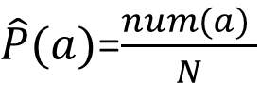
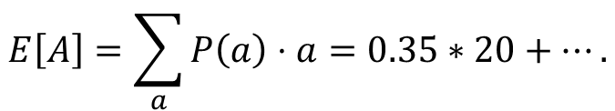


Example: Expected Age
Goal: Compute expected age of students
Known P(A)
$$E\left[A\right]=\sum_{a}{P\left(a\right)⋅a=0.35∗20+….}$$
Without P(A), instead collect samples [a₁, a₂, … a_{N}]
Unknown P(A): “Model Based”
Unknown P(A): “Model Free”
Why does this work? Because eventually you learn the right model.
Why does this work? Because samples appear with the right frequencies.
$\hat{P}(a)$=$\frac{num(a) }{N}$
$$E\left[A\right]≈\frac{1}{N}\sum_{a}{a}$$
$$E\left[A\right]≈\sum_{a}{\hat{P}\left(a\right)⋅a}$$

Slide 21
Outline
Model-based learning
  Learn T(s,a,s’) and R(s,a,s’)
Model-free learning
  Passive Reinforcement Learning
    Direct evaluation
    Sample based policy evaluation
    Temporal Difference Learning
  Active Reinforcement Learning
    Q-learning

Slide 22
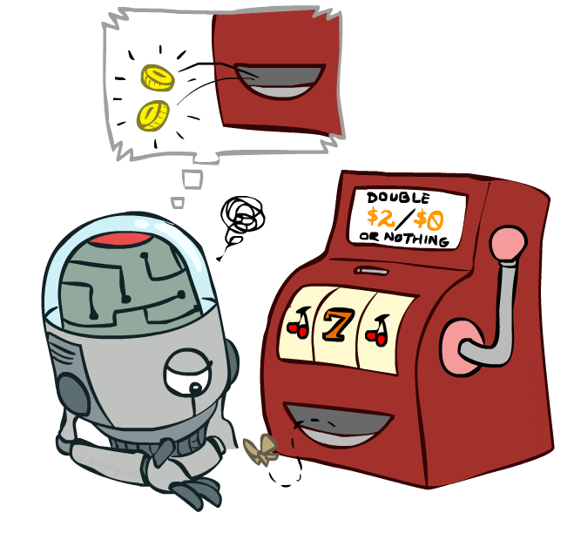
Model-Free Learning

Slide 23
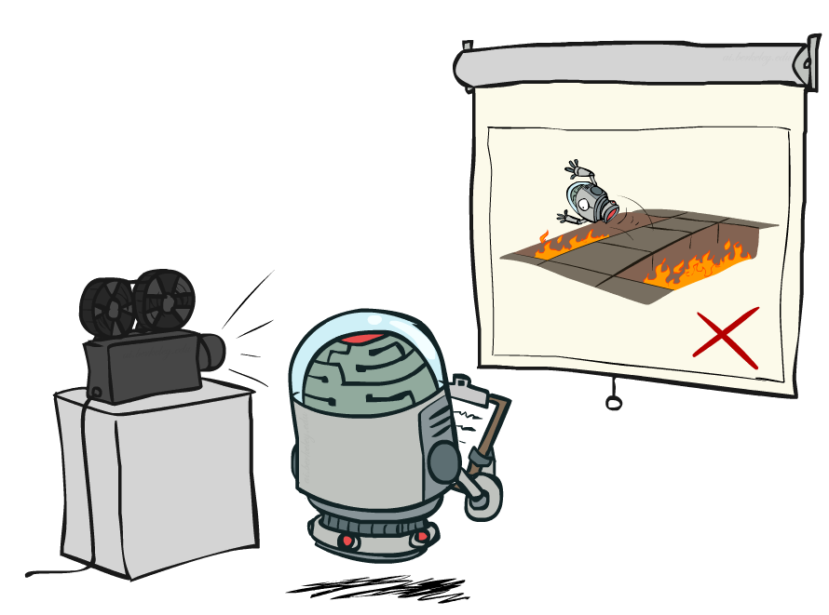
Passive Reinforcement Learning

Slide 24

Passive Reinforcement Learning
Simplified task: policy evaluation
  Input: a fixed policy π(s)
  You don’t know the transitions T(s,a,s’)
  You don’t know the rewards R(s,a,s’)
  Goal: learn the state values
In this case:
  Learner is “along for the ride”
  No choice about what actions to take
  Just execute the policy and learn from experience
  This is NOT offline planning! You actually take actions in the world.

Slide 25
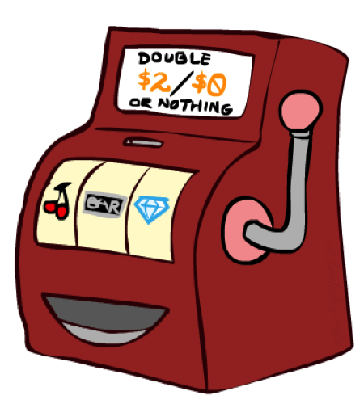
Direct Evaluation
Goal: Compute values for each state under π
Idea: Average together observed sample values
  Act according to π
  Every time you visit a state, write down what the sum of discounted rewards turned out to be
  Average those samples
This is called direct evaluation

Slide 26
Example: Direct Evaluation
Input Policy π
Observed Episodes (Training)
Output Values
Episode 1
Episode 2
-10
 | A
B | C | D
 | E
B, east, C, -1
C, east, D, -1
D, exit, x, +10
B, east, C, -1
C, east, D, -1
D, exit, x, +10
 | A
B | C | D
 | E
+8
+4
+10
Episode 3
Episode 4
-2
E, north, C, -1
C, east, D, -1
D, exit, x, +10
E, north, C, -1
C, east, A, -1
A, exit, x, -10
Assume: γ = 1
Model Free!

Slide 27
Problems with Direct Evaluation
What’s good about direct evaluation?
  It’s easy to understand
  It doesn’t require any knowledge of T, R
  It eventually computes the correct average values, using just sample transitions
What bad about it?
  It wastes information about state connections
  Each state must be learned separately
  So, it takes a long time to learn
Output Values
-10
 | A
B | C | D
 | E
+8
+4
+10
-2
If B and E both go to C under this policy, how can their values be different?
--Does not re-use C’s value!

Slide 28
Outline
Model-based learning
  Learn T(s,a,s’) and R(s,a,s’)
Model-free learning
  Passive Reinforcement Learning
    Direct evaluation
    Sample based policy evaluation
    Temporal Difference Learning
  Active Reinforcement Learning
    Q-learning

Slide 29

Why Not Use Policy Evaluation?
Simplified Bellman updates calculate V for a fixed policy:
  Each round, replace V with a one-step-look-ahead layer over V
  This approach fully exploited the connections between the states
  Unfortunately, we need T and R to do it!
Key question: how can we do this update to V without knowing T and R?
  In other words, how to we take a weighted average without knowing the weights?
s
π(s)
s, π(s)
s, π(s),s’
s’

Slide 30
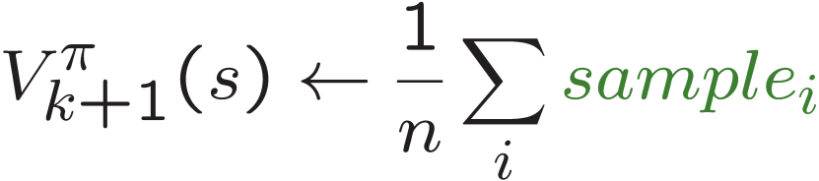
Sample-Based Policy Evaluation?
We want to improve our estimate of V by computing these averages:
Idea: Take samples of outcomes s’ (by doing the action!) and average
s
π(s)
s, π(s)
s, π(s),s’
s'
s₂'
s₁'
s₃'
Almost! Still not online learning.
We can’t rewind time to get sample after sample from state s.

Slide 31
Outline
Model-based learning
  Learn T(s,a,s’) and R(s,a,s’)
Model-free learning
  Passive Reinforcement Learning
    Direct evaluation
    Sample based policy evaluation
    Temporal Difference Learning
  Active Reinforcement Learning
    Q-learning

Slide 32
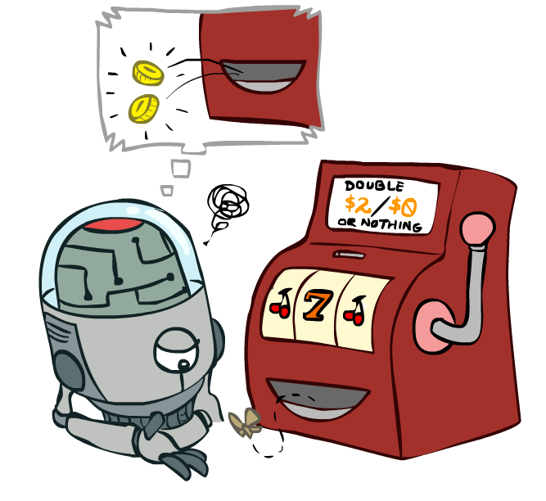
Temporal Difference Learning

Slide 33
Temporal Difference Learning
Big idea: learn from every experience!
  Update V(s) each time we experience a transition (s, a, s’, r)
  Likely outcomes s’ will contribute updates more often
Temporal difference learning of values
  Policy still fixed, still doing evaluation!
  Move values toward value of whatever successor occurs: running average
  Better estimate of the future after running more times of RL
    Slowly forget the past
s
π(s)
s, π(s)
s’
Sample of V(s):
Update to V(s):
error
Same update:
What actually happened
What we thought

Slide 34
Example: Temporal Difference Learning
States
Observed Transitions
B, east, C, -2
C, east, D, -2
 | A
B | C | D
 | E
 | 0
0 | 0 | 8
 | 0
 | 0
-1 | 0 | 8
 | 0
 | 0
-1 | 3 | 8
 | 0
Assume:
γ = 1,
α = 1/2

Slide 35
Outline
Model-based learning
  Learn T(s,a,s’) and R(s,a,s’)
Model-free learning
  Passive Reinforcement Learning
    Direct evaluation
    Sample based policy evaluation
    Temporal Difference Learning
  Active Reinforcement Learning
    Q-learning

Slide 36
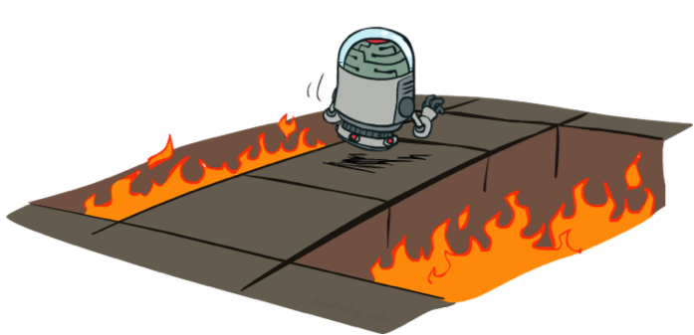
Active Reinforcement Learning
Full reinforcement learning: optimal policies (like value iteration)
  You don’t know the transitions T(s,a,s’)
  You don’t know the rewards R(s,a,s’)
  You choose the actions now
  Goal: learn the optimal policy / values
In this case:
  Learner makes choices!
  Fundamental tradeoff: exploration vs. exploitation
  This is NOT offline planning! You actually take actions in the world and find out what happens…

Slide 37
Detour: Q-Value Iteration
Value iteration: find successive (depth-limited) values
  Start with V₀(s) = 0, which we know is right
  Given V_{k}, calculate the depth k+1 values for all states:
But Q-values are more useful, so compute them instead
  Start with Q₀(s,a) = 0, which we know is right
  Given Q_{k}, calculate the depth k+1 q-values for all q-states:

Slide 38
Snapshot of Demo – Gridworld V Values
The value (utility) of a state s:
  V*(s) = expected utility starting in s and acting optimally
The value (utility) of a q-state (s,a):
  Q*(s,a) = expected utility starting out having taken action a from state s and (thereafter) acting optimally
The optimal policy:
  π*(s) = optimal action from state s
Noise = 0.2
Discount = 0.9
Notes:
This demo doesn’t show anything in action, it just shows the V and Q values.

Slide 39

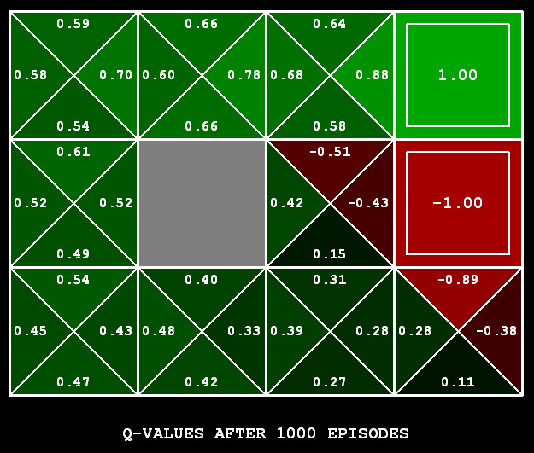
Q-Learning
Q-Learning: sample-based Q-value iteration
Learn Q(s,a) values as you go
  Receive a sample (s,a,s’,r)
  Consider your old estimate:
  Consider your new sample estimate:
  Incorporate the new estimate into a running average:
Compare:

Slide 40

Video of Demo Q-Learning -- Gridworld

Slide 41
Video of Demo Crawler Bot

Slide 42
Video of Demo Q-Learning -- Crawler

Slide 43

Q-Learning Properties
Amazing result: Q-learning converges to optimal policy -- even if you’re acting suboptimally!
This is called off-policy learning
Caveats:
  You have to explore enough
  You have to eventually make the learning rate
  small enough
  … but not decrease it too quickly
  Basically, in the limit, it doesn’t matter how you select actions (!)

Slide 44
The Story So Far: MDPs and RL
Known MDP: Offline Solution
Goal Technique
Compute V*, Q*, π* Value / policy iteration
Evaluate a fixed policy π Policy evaluation
Unknown MDP: Model-Based
Unknown MDP: Model-Free
Goal Technique
Compute V*, Q*, π* VI/PI on approx. MDP
Evaluate a fixed policy π PE on approx. MDP
Goal Technique
Compute V*, Q*, π* Q-learning
Evaluate a fixed policy π Value Learning

