Slide 1

Artificial Intelligence
Markov Decision Processes
Notes:
Please retain proper attribution, including the reference to ai.berkeley.edu. Thanks!

Slide 2
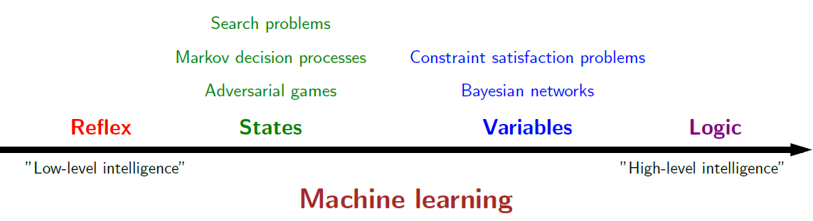
Course Topics

Slide 3





Example: Grid World
A maze-like problem
  The agent lives in a grid
  Walls block the agent’s path
Noisy movement: actions do not always go as planned
  80% of the time, the action North takes the agent North
  (if there is no wall there)
  10% of the time, North takes the agent West; 10% East
  If there is a wall in the direction the agent would have been taken, the agent stays put
The agent receives rewards each time step
  Small “living” reward each step (can be negative)
  Big rewards come at the end (good or bad)
Goal: maximize sum of rewards -- Utilities
Notes:
[cut demo of moving around in grid world program]

Slide 4
Markov Decision Processes
An MDP is defined by:
  A set of states s ∈ S
  A set of actions a ∈ A
  A transition function T(s, a, s’)
    Probability that a from s leads to s’, i.e., P(s’| s, a)
    Also called the model or the dynamics
  A reward function R(s, a, s’)
    Sometimes just R(s) or R(s’)
  A start state
  Maybe a terminal state
MDPs are non-deterministic search problems
  One way to solve them is with expectimax search
  We’ll have a new tool soon
Notes:
In search problems: did not talk about actions, but about successor functions --- now the information inside the successor function is unpacked into actions, transitions and reward
Write out S, A, example entry in T, entry in R
Reward function different from the book : R(s,a,s’)
In book simpler for equations, but not useful for the projects.
Need to modify expectimax a tiny little bit to account for rewards along the way, but that’s something you should be able to do, and so you can already solve MDP’s (not in most efficient way)

Slide 5
Policies
In deterministic single-agent search problems, we wanted an optimal plan, or sequence of actions, from start to a goal
For MDPs, we want an optimal policy π*: S → A
  A policy π gives an action for each state
  An optimal policy is one that maximizes expected utility if followed
  An explicit policy defines a reflex agent
Expectimax didn’t compute entire policies
  It computed the action for a single state only
Optimal policy when R(s, a, s’) = -0.03 for all non-terminals s
Notes:
Dan has a DEMO for this.

Slide 6



MDP Search Trees
Each MDP state projects an expectimax-like search tree
s is a state
s
(s, a) is a q-state
a
(s, a) is a q-state
s, a
(s,a,s’) called a transition
T(s,a,s’) = P(s’|s,a)
R(s,a,s’)
s,a,s’
s’
Notes:
In MDP chance node represents uncertainty about what might happen based on (s,a) [as opposed to being a random adversary]
Q-state (s,a) is when you were in a state and took an action

Slide 7

Solving MDPs

Slide 8
Optimal Quantities
The value (utility) of a state s:
  V*(s) = expected utility starting in s and acting optimally
The value (utility) of a q-state (s,a):
  Q*(s,a) = expected utility starting out having taken action a from state s and (thereafter) acting optimally
The optimal policy:
  π*(s) = optimal action from state s
s
s is a state
a
(s, a) is a q-state
s, a
s,a,s’
(s,a,s’) is a transition
s’
Notes:
[Note: this demo doesn’t show anything in action, just pops up V and Q values.]

Slide 9


Values of States
Fundamental operation: compute the (expectimax) value of a state
Recursive definition of value:
  Expected utility under optimal action
  Average sum of (discounted) rewards
  This is just what expectimax computed!
s
s is a state
a
(s, a) is a q-state
(s, a) is a q-state
s, a
(s,a,s’) called a transition
T(s,a,s’) = P(s’|s,a)
R(s,a,s’)
s,a,s’
s’

Slide 10


Snapshot of Demo – Gridworld V Values
The value (utility) of a state s:
  V*(s) = expected utility starting in s and acting optimally
The value (utility) of a q-state (s,a):
  Q*(s,a) = expected utility starting out having taken action a from state s and (thereafter) acting optimally
Noise = 0.2
Discount = 0.9
Notes:
This demo doesn’t show anything in action, it just shows the V and Q values.

Slide 11

Value Iteration

Slide 12
The Bellman Equation
Bellman equations characterize the optimal values:
Value iteration computes them:
Value iteration is just a fixed point solution method
  … though the V_{k} vectors are also interpretable as time-limited values
V(s)
a
s, a
s,a,s’
V(s’)
Notes:
Discuss computational complexity: S * A * S times number of iterations
Note: updates not in place [if in place, it means something else and not even clear what it means]

Slide 13
Value Iteration
Start with V₀(s) = 0: no time steps left means an expected reward sum of zero
Given vector of V_{k}(s) values, do one ply of expectimax from each state:
Repeat until convergence
Complexity of each iteration: O(S²A)
V_{k+1}(s)
a
s, a
s,a,s’
V_{k}(s’)
Notes:
Discuss computational complexity: S * A * S times number of iterations
Note: updates not in place [if in place, it means something else and not even clear what it means]

Slide 14




Racing Search Tree
We’re doing way too much work with expectimax!
Problem: States are repeated
  Idea: Only compute needed quantities once
Problem: Tree goes on forever
  Idea: Do a depth-limited computation, but with increasing depths until change is small
  Note: deep parts of the tree eventually don’t matter if γ < 1

Slide 15





Time-Limited Values
Key idea: time-limited values
Define V_{k}(s) to be the optimal value of s if the game ends in k more time steps
  Equivalently, it’s what a depth-k expectimax would give from s
Notes:
This demo generates the time-limited values for gridworld as snapshotted onto the next slides.

Slide 16





Computing Time-Limited Values

Slide 17
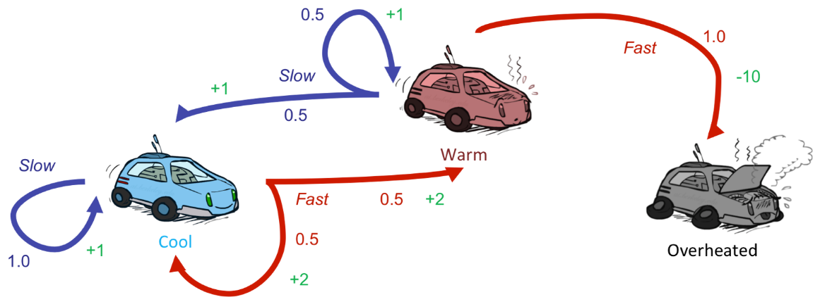






Example: Value Iteration
3.5 2.5 0
Assume no discount!
2 1 0
0 0 0

Slide 18


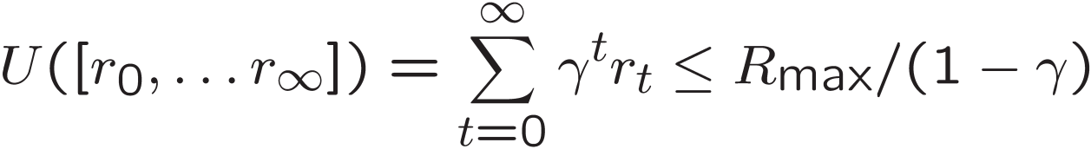
Convergence*
How do we know the V_{k} vectors are going to converge?
Case 1: If the tree has maximum depth M, then V_{M} holds the actual untruncated values
Case 2: If the discount is less than 1
  Sketch: For any state V_{k} and V_{k+1} can be viewed as depth k+1 expectimax results in nearly identical search trees
  The difference is that on the bottom layer, V_{k+1} has actual rewards while V_{k} has zeros
  That last layer is at best all R_{MAX}
  It is at worst R_{MIN}
  But everything is discounted by γ^{k} that far out
  So V_{k} and V_{k+1} are at most γ^{k} max|R| different
  So as k increases, the values converge

Slide 19

k=0
Noise = 0.2
Discount = 0.9
Living reward = 0
Notes:
Assuming zero living reward

Slide 20

k=1
Noise = 0.2
Discount = 0.9
Living reward = 0
Notes:
Assuming zero living reward

Slide 21

k=2
Noise = 0.2
Discount = 0.9
Living reward = 0
Notes:
Assuming zero living reward

Slide 22

k=5
Noise = 0.2
Discount = 0.9
Living reward = 0
Notes:
Assuming zero living reward

Slide 23

k=10
Noise = 0.2
Discount = 0.9
Living reward = 0
Notes:
Assuming zero living reward

Slide 24

k=11
Noise = 0.2
Discount = 0.9
Living reward = 0
Notes:
Assuming zero living reward

Slide 25

k=12
Noise = 0.2
Discount = 0.9
Living reward = 0
Notes:
Assuming zero living reward

Slide 26

k=100
Noise = 0.2
Discount = 0.9
Living reward = 0
Notes:
Assuming zero living reward

Slide 27
Recap So Far
We have defined MDPs
We have formalized solving MDP using search tree
Given a defined MDP, we can
  Compute expected values for every state
    Value iteration
  Find the corresponding optimal policy
s
s is a state
a
(s, a) is a q-state
s, a
s,a,s’
(s,a,s’) is a transition
s’

Slide 28

Policy Methods

Slide 29

Policy Evaluation

Slide 30
Fixed Policies
Do the optimal action
Do what π says to do
s
s
a
π(s)
s, a
s, π(s)
s,a,s’
s, π(s),s’
s’
s’
Expectimax trees max over all actions to compute the optimal values
If we fixed some policy π(s), then the tree would be simpler – only one action per state
  … though the tree’s value would depend on which policy we fixed

Slide 31
Utilities for a Fixed Policy
Another basic operation: compute the utility of a state s under a fixed (generally non-optimal) policy
Define the utility of a state s, under a fixed policy π:
  V^{π}(s) = expected total discounted rewards starting in s and following π
Recursive relation (one-step look-ahead / Bellman equation):
For comparison, previously we have:
s
π(s)
s, π(s)
s, π(s),s’
s’

Slide 32
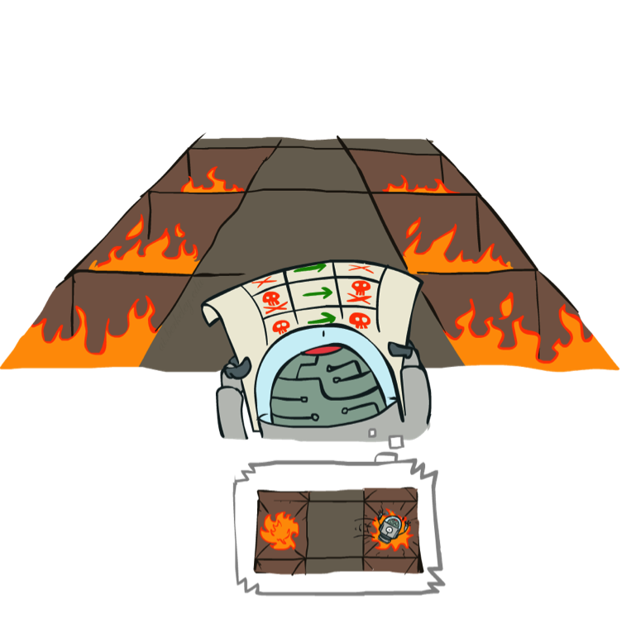
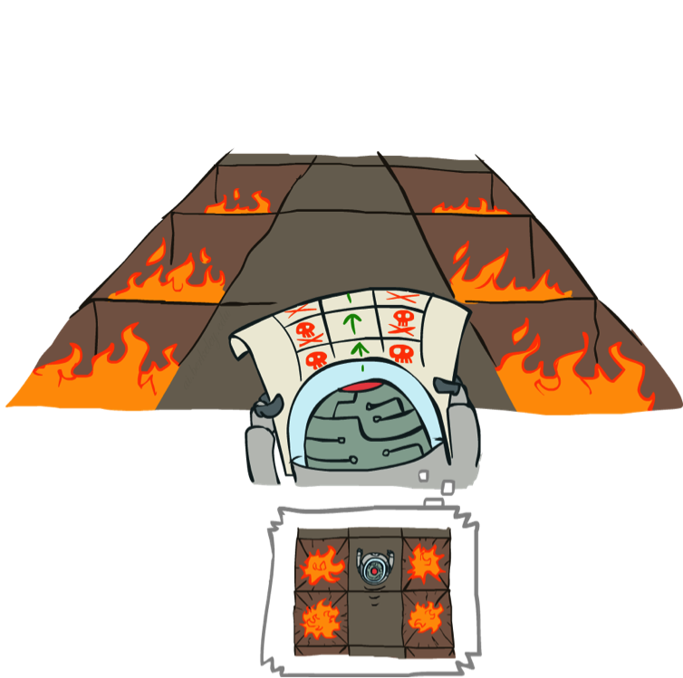
Example: Policy Evaluation
Always Go Right
Always Go Forward

Slide 33
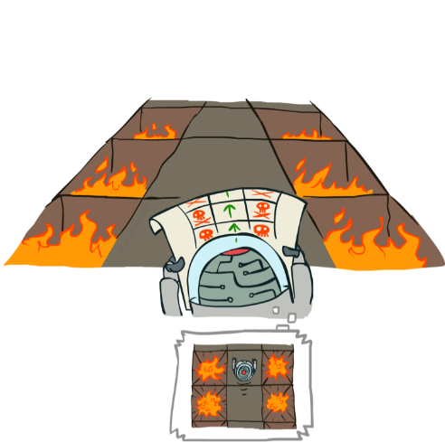
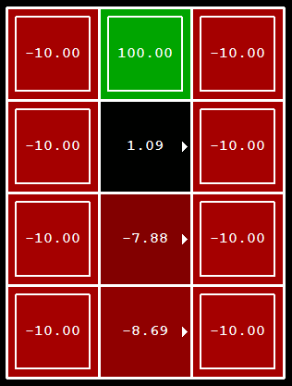
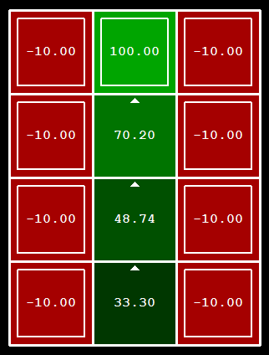
Example: Policy Evaluation
Always Go Right
Always Go Forward

Slide 34


Policy Evaluation
How do we calculate the V’s for a fixed policy π?
Idea 1: Turn recursive Bellman equations into updates
(like value iteration)
Efficiency: O(S²) per iteration
Idea 2: Without the maxes, the Bellman equations are just a linear system
  $V=R+γTV$
s
π(s)
s, π(s)
s, π(s),s’
s’

Slide 35
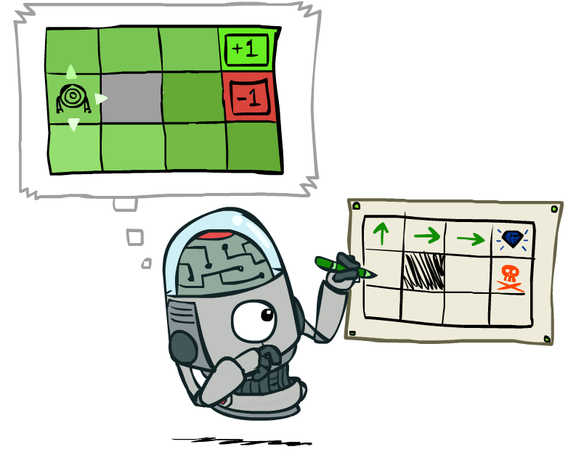
Policy Extraction

Slide 36
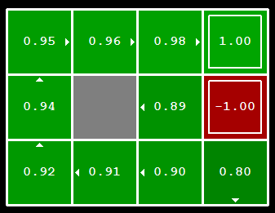


Computing Actions from Values
Let’s imagine we have the optimal values V*(s)
How should we act?
  It’s not obvious!
We need to do a mini-expectimax (one step)
This is called policy extraction, since it gets the policy implied by the values

Slide 37
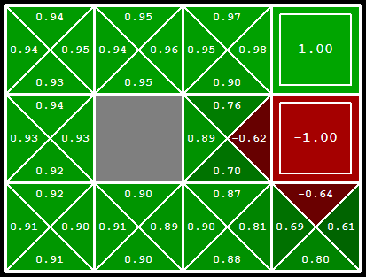
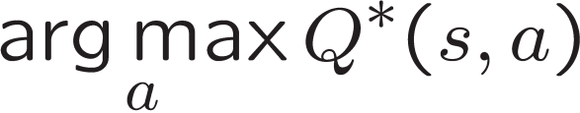
Computing Actions from Q-Values
Let’s imagine we have the optimal q-values:
How should we act?
  Completely trivial to decide!
Important lesson: actions are easier to select from q-values than values!

Slide 38

Policy Iteration

Slide 39
Problems with Value Iteration
Value iteration repeats the Bellman updates:
Problem 1: It’s slow – O(S²A) per iteration
Problem 2: The “max” at each state rarely changes
Problem 3: The policy often converges long before the values
s
a
s, a
s,a,s’
s’
[Demo: value iteration (L9D2)]
Notes:
Demo steps through value iteration; snapshots of values shown on next slides.

Slide 40
Policy Iteration
Alternative approach for optimal values:
  Step 1: Policy evaluation: calculate utilities for some fixed policy (not optimal utilities!) until convergence
  Step 2: Policy improvement: update policy using one-step look-ahead with resulting converged (but not optimal!) utilities as future values
  Repeat steps until policy converges
This is policy iteration
  It’s still optimal!
  Can converge (much) faster under some conditions

Slide 41
Policy Iteration
Policy Evaluation: For fixed current policy π, find values with policy evaluation:
  Iterate until values converge:
Policy Improvement: For fixed values, get a better policy using policy extraction
  One-step look-ahead:

Slide 42
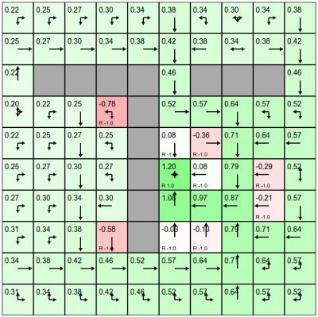
Demo
http://cs.stanford.edu/people/karpathy/reinforcejs/gridworld_dp.html
Gridworld
  Actions: NSEW
  Deterministic: T(s,a,s’)=1
  Discount: 0.9
  Set your own rewards

Slide 43
Comparison
Both value iteration and policy iteration compute the same thing (all optimal values)
In value iteration:
  Every iteration updates both the values and (implicitly) the policy
  We don’t track the policy, but taking the max over actions implicitly recomputes it
In policy iteration:
  We do several passes that update utilities with fixed policy (each pass is fast because we consider only one action, not all of them)
  After the policy is evaluated, a new policy is chosen (slow like a value iteration pass)
  The new policy will be better (or we’re done)
Both are dynamic programs for solving MDPs

Slide 44
Summary: MDP Algorithms
So you want to….
  Compute optimal values: use value iteration or policy iteration
  Compute values for a particular policy: use policy evaluation
  Turn your values into a policy: use policy extraction (one-step lookahead)
These all look the same!
  They basically are – they are all variations of Bellman updates
  They all use one-step lookahead expectimax fragments
  They differ only in whether we plug in a fixed policy or max over actions

Slide 45
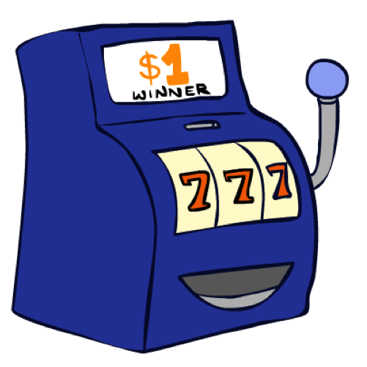
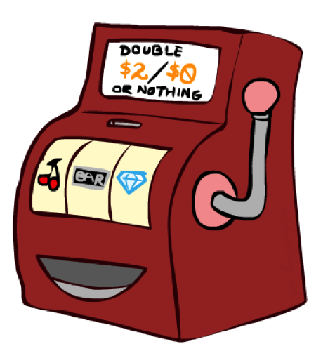

Double Bandits

Slide 46
Double-Bandit MDP
Actions: Blue, Red
States: Win, Lose
No discount
100 time steps
Both states have the same value
0.25 $0
0.75 $2
W
L
0.25 $0
$1 1.0
0.75 $2
$1 1.0

Slide 47
Offline Planning
Solving MDPs is offline planning
  You determine all quantities through computation
  You need to know the details of the MDP
  You do not actually play the game!
No discount
100 time steps
Both states have the same value
0.25 $0
Value
0.75
$2
W
0.25
$0
Play Red
150
L
Play Blue
100
$1
1.0
0.75 $2
$1 1.0

Slide 48
Let’s Play!
$2
$2
$0
$2
$2
$2
$2
$0
$0
$0

Slide 49
Online Planning
Rules changed! Red’s win chance is different.
?? $0
?? $2
W
L
?? $0
$1 1.0
?? $2
$1 1.0

Slide 50
Let’s Play!
$0
$0
$0
$2
$0
$2
$0
$0
$0
$0

Slide 51

What Just Happened?
That wasn’t planning, it was learning!
  Specifically, reinforcement learning
  There was an MDP, but you couldn’t solve it with just computation
  You needed to actually act to figure it out
Important ideas in reinforcement learning that came up
  Exploration: you have to try unknown actions to get information
  Exploitation: eventually, you have to use what you know
  Regret: even if you learn intelligently, you make mistakes
  Sampling: because of chance, you have to try things repeatedly
  Difficulty: learning can be much harder than solving a known MDP

Slide 52
Next Time: Reinforcement Learning!

