Slide 1

Artificial Intelligence
Markov Decision Processes
Notes:
Please retain proper attribution, including the reference to ai.berkeley.edu. Thanks!

Slide 2
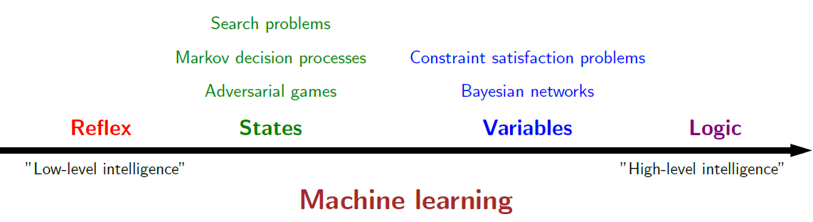
Course Topics

Slide 3
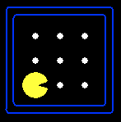
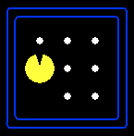
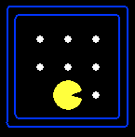
State Space Graphs
State space graph: A mathematical representation of a search problem
  Nodes are (abstracted) world configurations
  Arcs represent successors (action results)
  The goal test is a set of goal nodes (maybe only one)
In a state space graph, each state occurs only once!
We can rarely build this full graph in memory (it’s too big), but it’s a useful idea
  World states?120x(2³⁰)x(12²)x4

Slide 4
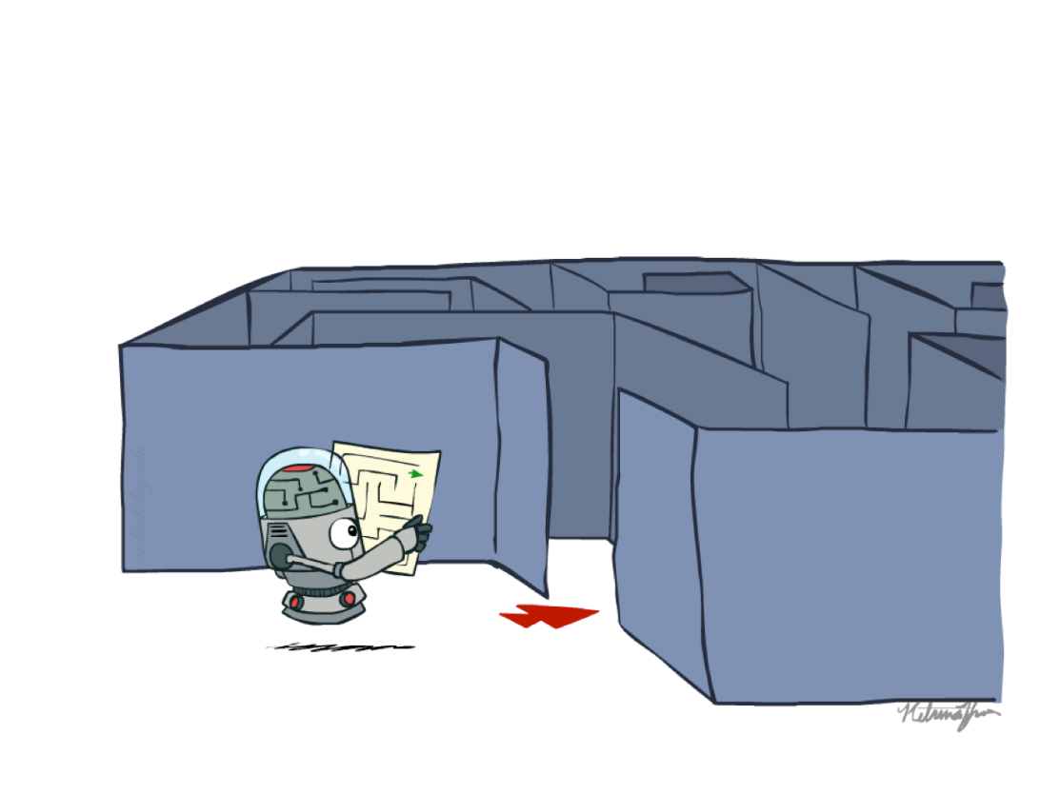
Recap: Search
Search problem:
  States (configurations of the world)
  Actions and costs
  Successor function (world dynamics)
  Start state and goal test
Search tree:
  Nodes: represent plans for reaching states
  Plans have costs (sum of action costs)
Search algorithm:
  Systematically builds a search tree
  Chooses an ordering of the fringe (unexplored nodes)
  Optimal: finds least-cost plans

Slide 5
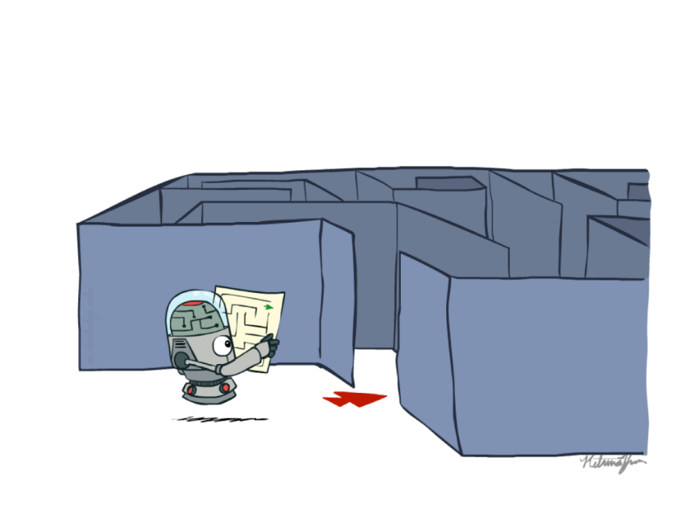
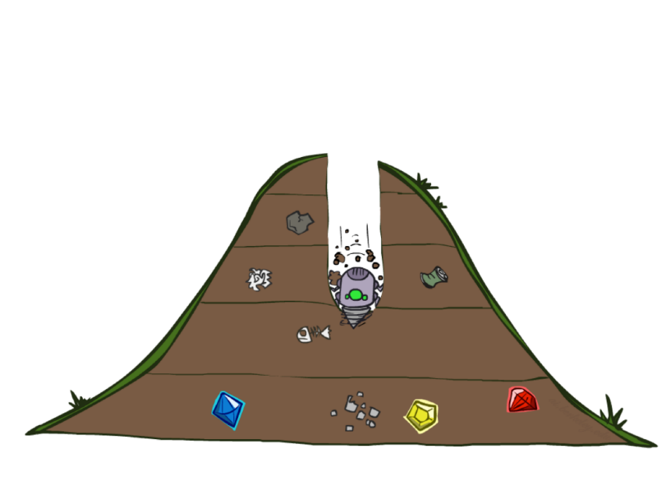
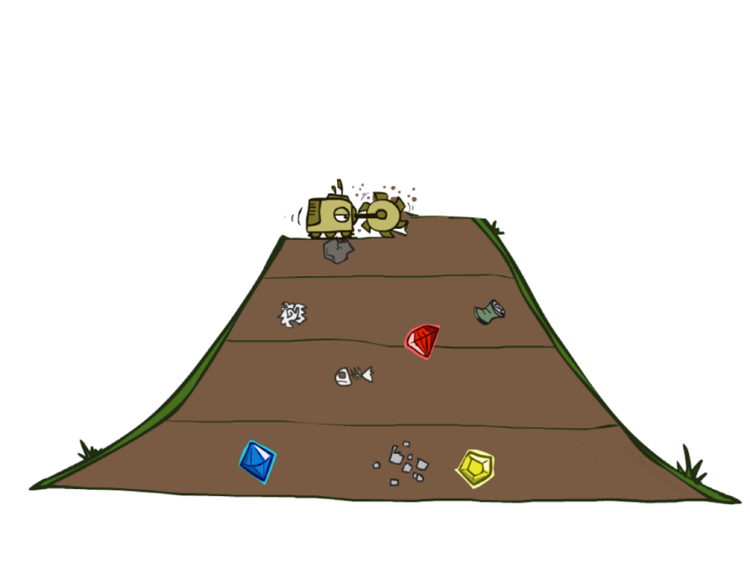
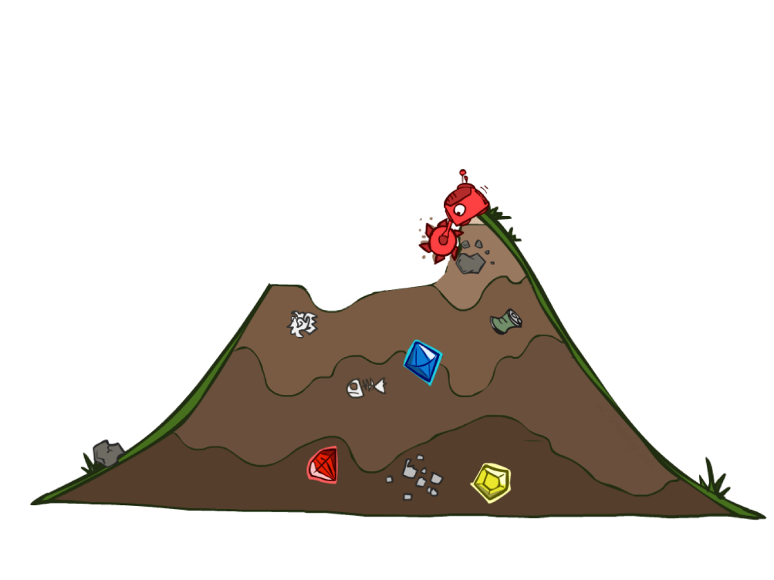
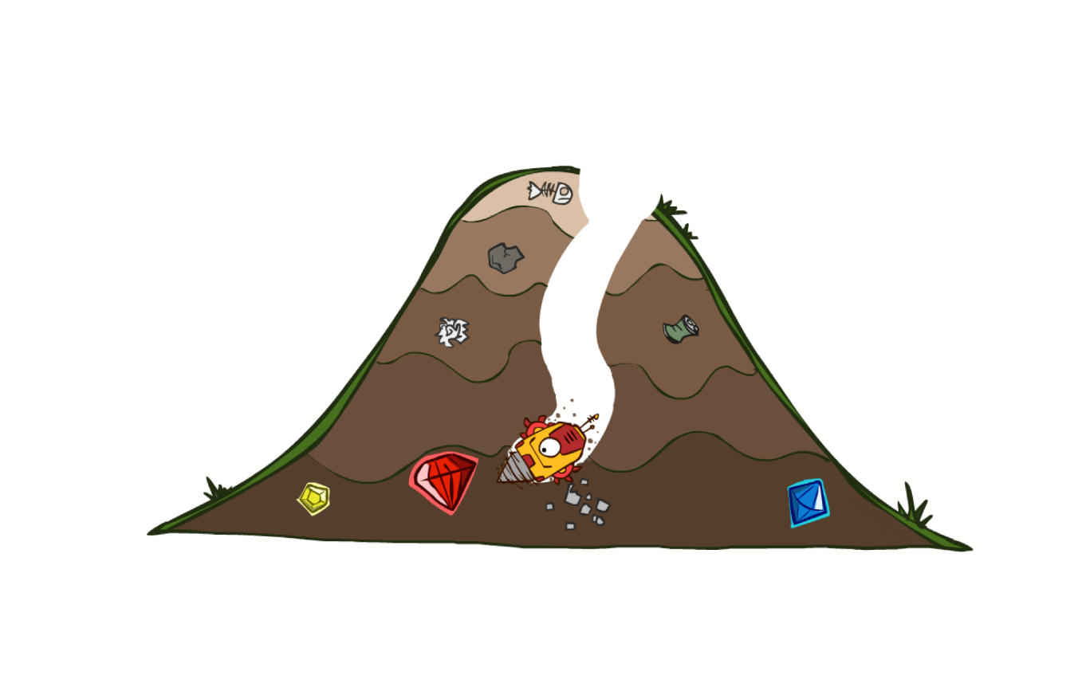

Slide 6
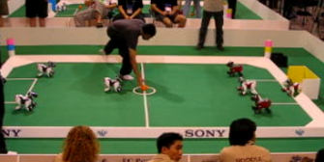


Non-Deterministic Search

Slide 7





Example: Grid World
A maze-like problem
  The agent lives in a grid
  Walls block the agent’s path
Noisy movement: actions do not always go as planned
  80% of the time, the action North takes the agent North
  (if there is no wall there)
  10% of the time, North takes the agent West; 10% East
  If there is a wall in the direction the agent would have been taken, the agent stays put
The agent receives rewards each time step
  Small “living” reward each step (can be negative)
  Big rewards come at the end (good or bad)
Goal: maximize sum of rewards -- Utilities
Notes:
[cut demo of moving around in grid world program]

Slide 8



Grid World Actions
Deterministic Grid World
Stochastic Grid World

Slide 9

Video of Demo Gridworld Manual Intro

Slide 10
Markov Decision Processes
An MDP is defined by:
  A set of states s ∈ S
  A set of actions a ∈ A
  A transition function T(s, a, s’)
    Probability that a from s leads to s’, i.e., P(s’| s, a)
    Also called the model or the dynamics
  A reward function R(s, a, s’)
    Sometimes just R(s) or R(s’)
  A start state
  Maybe a terminal state
MDPs are non-deterministic search problems
  One way to solve them is with expectimax search
  We’ll have a new tool soon
Notes:
In search problems: did not talk about actions, but about successor functions --- now the information inside the successor function is unpacked into actions, transitions and reward
Write out S, A, example entry in T, entry in R
Reward function different from the book : R(s,a,s’)
In book simpler for equations, but not useful for the projects.
Need to modify expectimax a tiny little bit to account for rewards along the way, but that’s something you should be able to do, and so you can already solve MDP’s (not in most efficient way)

Slide 11


What is Markov about MDPs?
“Markov” generally means that given the present state, the future and the past are independent
For Markov decision processes, “Markov” means action outcomes depend only on the current state
This is just like search, where the successor function could only depend on the current state (not the history)
Andrey Markov (1856-1922)
Notes:
Like search: successor function only depended on current state
Can make this happen by stuffing more into the state;
Very similar to search problems: when solving a maze with food pellets, we stored which food pellets were eaten

Slide 12

Policies
In deterministic single-agent search problems, we wanted an optimal plan, or sequence of actions, from start to a goal
For MDPs, we want an optimal policy π*: S → A
  A policy π gives an action for each state
  An optimal policy is one that maximizes expected utility if followed
  An explicit policy defines a reflex agent
Expectimax didn’t compute entire policies
  It computed the action for a single state only
Optimal policy when R(s, a, s’) = -0.03 for all non-terminals s
Notes:
Dan has a DEMO for this.

Slide 13
Optimal Policies
R(s) = -0.01
R(s) = -0.03
R(s) = -0.4
R(s) = -2.0
Notes:
R(s) = the “living reward”

Slide 14
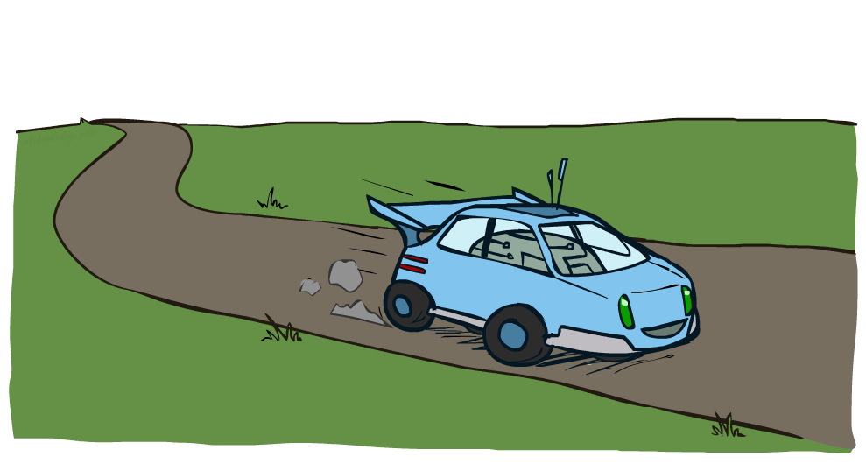
Example: Racing

Slide 15



Example: Racing
A robot car wants to travel far, quickly
Three states: Cool, Warm, Overheated
Two actions: Slow, Fast
Going faster gets double reward
0.5
+1
Fast
1.0
+1
Slow
-10
0.5
Slow
Warm
Fast
0.5
+2
Cool
0.5
Overheated
1.0
+1
+2

Slide 16
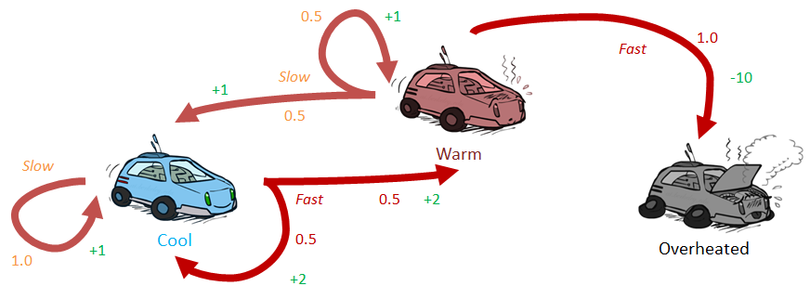



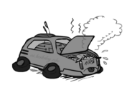
Racing Search Tree

Slide 17


MDP Search Trees
Each MDP state projects an expectimax-like search tree
s is a state
s
(s, a) is a q-state
a
(s, a) is a q-state
s, a
(s,a,s’) called a transition
T(s,a,s’) = P(s’|s,a)
R(s,a,s’)
s,a,s’
s’
Notes:
In MDP chance node represents uncertainty about what might happen based on (s,a) [as opposed to being a random adversary]
Q-state (s,a) is when you were in a state and took an action

Slide 18

Utilities of Sequences

Slide 19
Utilities of Sequences
What preferences should an agent have over reward sequences?
More or less?
Now or later?
[1, 2, 2]
or
[2, 3, 4]
[0, 0, 1]
or
[1, 0, 0]

Slide 20




Discounting
It’s reasonable to maximize the sum of rewards
It’s also reasonable to prefer rewards now to rewards later
One solution: values of rewards decay exponentially
R(s) = -0.01
R(s) = 0
Worth Now
Worth Next Step
Worth In Two Steps

Slide 21

Discounting
How to discount?
  Each time we descend a level, we multiply in the discount once
Why discount?
  Sooner rewards probably do have higher utility than later rewards
  Also helps our algorithms converge
Example: discount of 0.5
  U([1,2,3]) = 1*1 + 0.5*2 + 0.25*3
  U([1,2,3]) < U([3,2,1])
R(s) = -0.01
R(s) = 0
Notes:
Rewards in the future (deeper in the tree) matter less
Interesting: running expectimax, if having to truncate the search, then not losing much; e.g., less then \gamma^d / (1-\gamma)

Slide 22

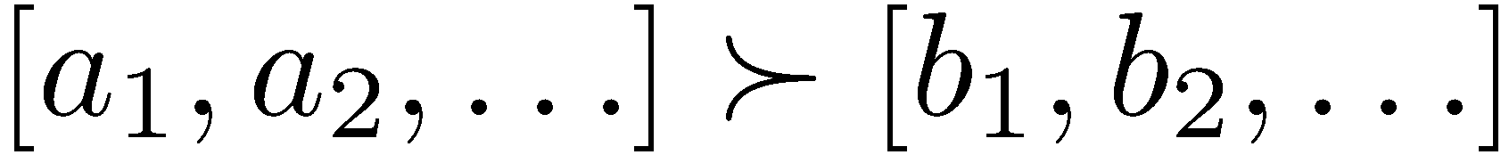
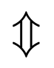
Stationary Preferences
Stationary sequences
  if you prefer one future to another starting tomorrow, then you should still prefer that future if it were to start today instead
Theorem: if we assume stationary preferences:
Then: there are only two ways to define utilities
  Additive utility:
  Discounted utility:

Slide 23
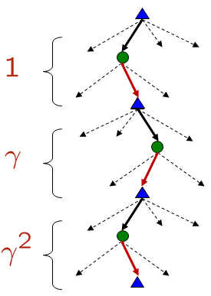


Quiz: Discounting
Given:
  Actions: East, West, and Exit (only available in exit states a, e)
  Transitions: deterministic
  Assume we have instant rewards: get it when hitting to the grid
Quiz 1: For γ = 1, what is the optimal policy?
Quiz 2: For γ = 0.1, what is the optimal policy?
Quiz 3: For which γ are West and East equally good when in state d?
What if we have delayed reward?
  Get the reward when moving out the grid

Slide 24

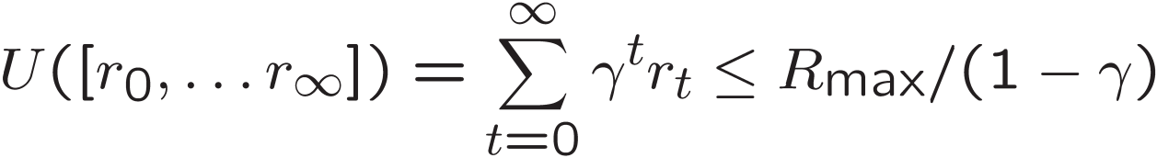
Infinite Utilities?!
Problem: What if the game lasts forever? Do we get infinite rewards?
Solutions:
  Finite horizon: (similar to depth-limited search)
    Terminate episodes after a fixed T steps (e.g. life)
    Gives nonstationary policies (π depends on time left)
  Discounting: use 0 < γ < 1
    Smaller γ means smaller “horizon” – shorter term focus
  Absorbing state: guarantee that for every policy, a terminal state will eventually be reached (like “overheated” for racing)

Slide 25
Recap: Defining MDPs
Markov decision processes:
  Set of states S
  Start state s₀
  Set of actions A
  Transitions P(s’|s,a) (or T(s,a,s’))
  Rewards R(s,a,s’) (and discount γ)
MDP quantities so far:
  Policy = Choice of action for each state
  Utility = sum of (discounted) rewards
s
a
s, a
s,a,s’
s’

Slide 26
Solving MDPs

Slide 27
Optimal Quantities
The value (utility) of a state s:
  V*(s) = expected utility starting in s and acting optimally
The value (utility) of a q-state (s,a):
  Q*(s,a) = expected utility starting out having taken action a from state s and (thereafter) acting optimally
The optimal policy:
  π*(s) = optimal action from state s
s
s is a state
a
(s, a) is a q-state
s, a
s,a,s’
(s,a,s’) is a transition
s’
Notes:
[Note: this demo doesn’t show anything in action, just pops up V and Q values.]

Slide 28


Values of States
Fundamental operation: compute the (expectimax) value of a state
Recursive definition of value:
  Expected utility under optimal action
  Average sum of (discounted) rewards
  This is just what expectimax computed!
s
s is a state
a
(s, a) is a q-state
(s, a) is a q-state
s, a
(s,a,s’) called a transition
T(s,a,s’) = P(s’|s,a)
R(s,a,s’)
s,a,s’
s’

Slide 29
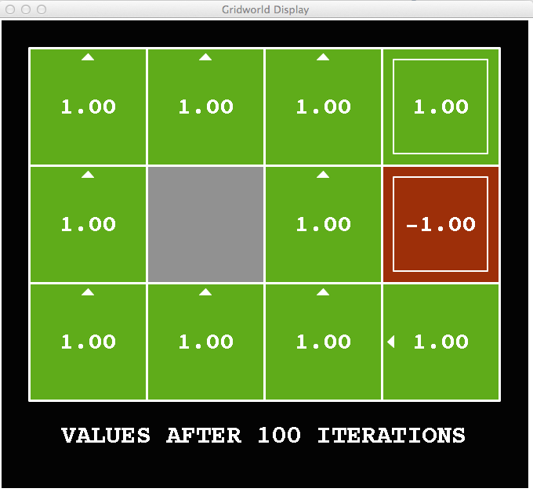
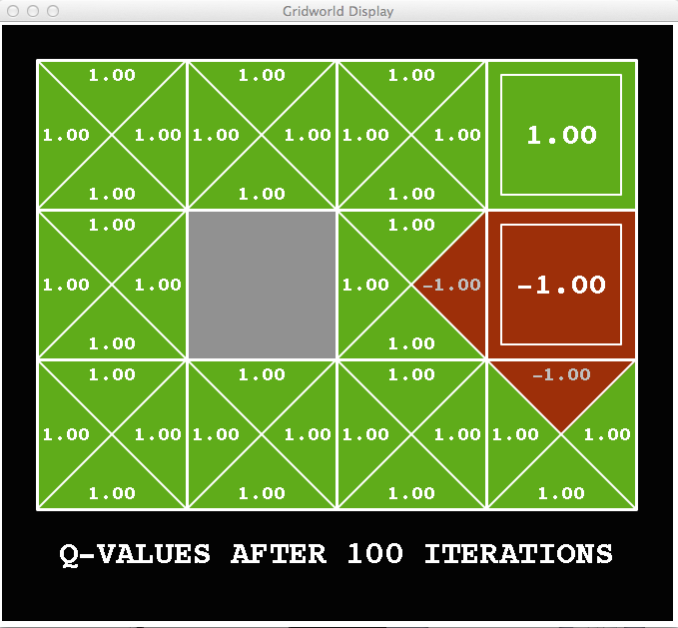
Snapshot of Demo – Gridworld V Values
The value (utility) of a state s:
  V*(s) = expected utility starting in s and acting optimally
The value (utility) of a q-state (s,a):
  Q*(s,a) = expected utility starting out having taken action a from state s and (thereafter) acting optimally
Noise = 0
Discount = 1
Notes:
This demo doesn’t show anything in action, it just shows the V and Q values.

Slide 30

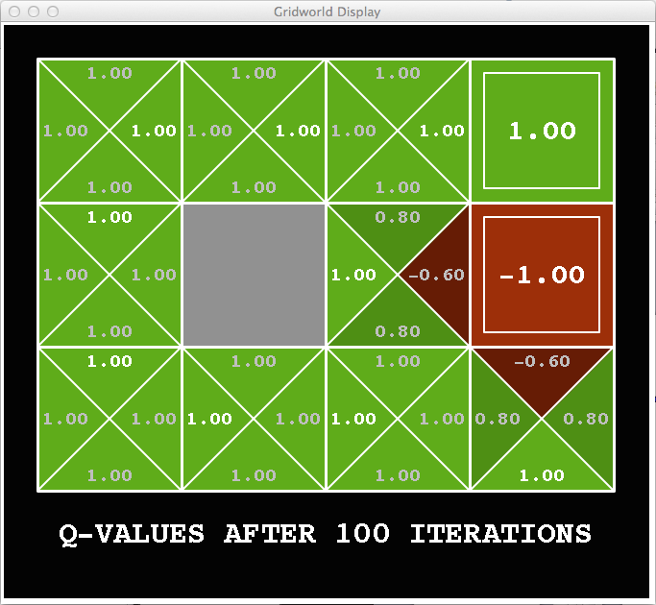
Snapshot of Demo – Gridworld V Values
The value (utility) of a state s:
  V*(s) = expected utility starting in s and acting optimally
The value (utility) of a q-state (s,a):
  Q*(s,a) = expected utility starting out having taken action a from state s and (thereafter) acting optimally
Noise = 0.2
Discount = 1
Notes:
This demo doesn’t show anything in action, it just shows the V and Q values.

Slide 31


Snapshot of Demo – Gridworld V Values
The value (utility) of a state s:
  V*(s) = expected utility starting in s and acting optimally
The value (utility) of a q-state (s,a):
  Q*(s,a) = expected utility starting out having taken action a from state s and (thereafter) acting optimally
Noise = 0.2
Discount = 0.9
Notes:
This demo doesn’t show anything in action, it just shows the V and Q values.

Slide 32

Value Iteration

Slide 33
The Bellman Equation
Bellman equations characterize the optimal values:
Value iteration computes them:
Value iteration is just a fixed point solution method
  … though the V_{k} vectors are also interpretable as time-limited values
V(s)
a
s, a
s,a,s’
V(s’)
Notes:
Discuss computational complexity: S * A * S times number of iterations
Note: updates not in place [if in place, it means something else and not even clear what it means]

Slide 34
Value Iteration
Start with V₀(s) = 0: no time steps left means an expected reward sum of zero
Given vector of V_{k}(s) values, do one ply of expectimax from each state:
Repeat until convergence
Complexity of each iteration: O(S²A)
V_{k+1}(s)
a
s, a
s,a,s’
V_{k}(s’)
Notes:
Discuss computational complexity: S * A * S times number of iterations
Note: updates not in place [if in place, it means something else and not even clear what it means]

Slide 35




Racing Search Tree
We’re doing way too much work with expectimax!
Problem: States are repeated
  Idea: Only compute needed quantities once
Problem: Tree goes on forever
  Idea: Do a depth-limited computation, but with increasing depths until change is small
  Note: deep parts of the tree eventually don’t matter if γ < 1

Slide 36





Time-Limited Values
Key idea: time-limited values
Define V_{k}(s) to be the optimal value of s if the game ends in k more time steps
  Equivalently, it’s what a depth-k expectimax would give from s
Notes:
This demo generates the time-limited values for gridworld as snapshotted onto the next slides.

Slide 37





Computing Time-Limited Values

Slide 38
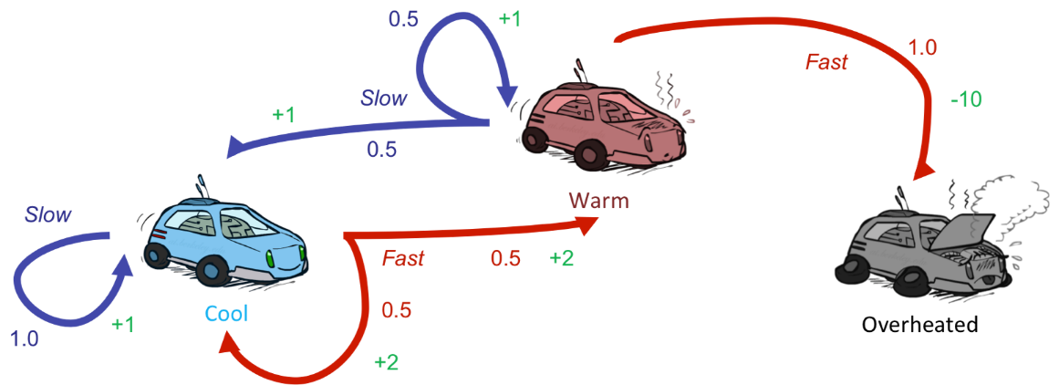






Example: Value Iteration
3.5 2.5 0
Assume no discount!
2 1 0
0 0 0

Slide 39


Convergence*
How do we know the V_{k} vectors are going to converge?
Case 1: If the tree has maximum depth M, then V_{M} holds the actual untruncated values
Case 2: If the discount is less than 1
  Sketch: For any state V_{k} and V_{k+1} can be viewed as depth k+1 expectimax results in nearly identical search trees
  The difference is that on the bottom layer, V_{k+1} has actual rewards while V_{k} has zeros
  That last layer is at best all R_{MAX}
  It is at worst R_{MIN}
  But everything is discounted by γ^{k} that far out
  So V_{k} and V_{k+1} are at most γ^{k} max|R| different
  So as k increases, the values converge

Slide 40

k=0
Noise = 0.2
Discount = 0.9
Living reward = 0
Notes:
Assuming zero living reward

Slide 41

k=1
Noise = 0.2
Discount = 0.9
Living reward = 0
Notes:
Assuming zero living reward

Slide 42

k=2
Noise = 0.2
Discount = 0.9
Living reward = 0
Notes:
Assuming zero living reward

Slide 43

k=10
Noise = 0.2
Discount = 0.9
Living reward = 0
Notes:
Assuming zero living reward

Slide 44

k=11
Noise = 0.2
Discount = 0.9
Living reward = 0
Notes:
Assuming zero living reward

Slide 45

k=12
Noise = 0.2
Discount = 0.9
Living reward = 0
Notes:
Assuming zero living reward

Slide 46

k=100
Noise = 0.2
Discount = 0.9
Living reward = 0
Notes:
Assuming zero living reward

Slide 47
Next Time: Policy-Based Methods

