Slide 1
Statistical Learning Models for Text and Graph Data
Sequence to Sequence Learning
Yangqiu Song
Slides credits: Richard Socher, Vagelis Hristidis, Jacob Devlin, Phạm Quang Nhật Minh

Slide 2
Sequence-to-sequence is everywhere!
Sequence-to-sequence is useful for more than just MT
Many NLP tasks can be phrased as sequence-to-sequence:
  Summarization (long text → short text)
  Dialogue (previous utterances → next utterance)
  Parsing (input text → output parse as sequence)
  Code generation (natural language → Python code)

Slide 3
Grammar as a Foreign Language
Vinyals et al., 2015

Slide 4
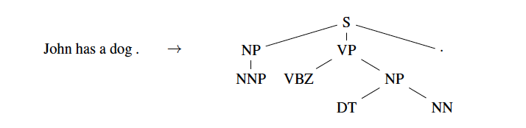
Grammar as a Foreign Language
Parsing tree

Slide 5
Grammar as a Foreign Language
Parsing tree

Slide 6
Grammar as a Foreign Language
Parsing tree

Slide 7
Grammar as a Foreign Language
Parsing tree

Slide 8
Grammar as a Foreign Language
Parsing tree
John has a dog .

Slide 9
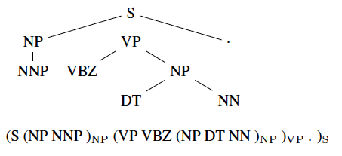
Grammar as a Foreign Language
Converting tree to sequence

Slide 10
Grammar as a Foreign Language
Converting tree to sequence

Slide 11
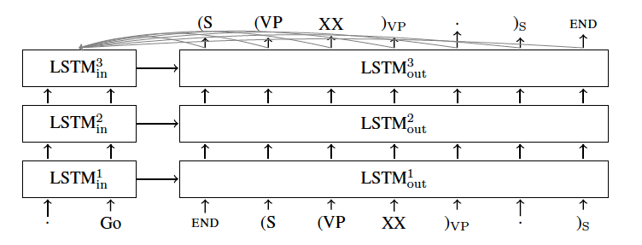
Grammar as a Foreign Language
Model

Slide 12
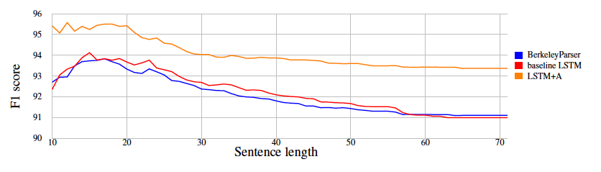
Grammar as a Foreign Language
Results

Slide 13
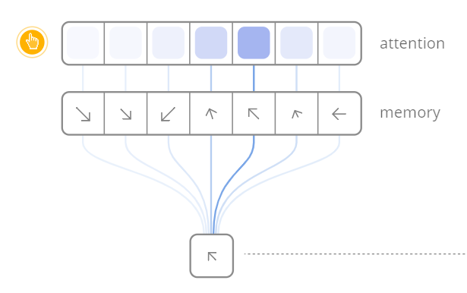
Attention is a general Deep Learning technique
More general definition of attention
  Given a set of vector values, and a vector query, attention is a technique to compute a weighted sum of the values, dependent on the query.
  We sometimes say that the query attends to the values
  For example, in the seq2seq + attention model, each decoder hidden state attends to the encoder hidden states
https://distill.pub/2016/augmented-rnns/

Slide 14
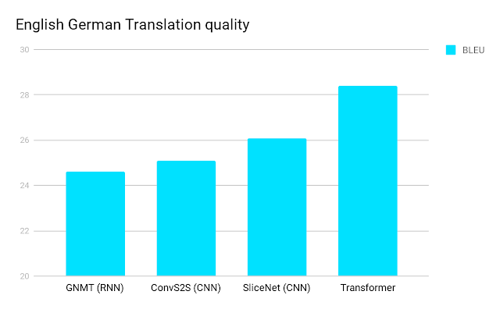
Attention is all you need?
– Transformer Networks
https://ai.googleblog.com/2017/08/transformer-novel-neural-network.html

Slide 15
Problems with RNNs = Motivation for Transformers
Recurrent models typically factor computation along the symbol positions of the input and output sequences
  Sequential computation prevents parallelization
  Critical at longer sequence lengths, as memory constraints limit batching across examples
Despite advanced RNNs like LSTMs, RNNs still need attention mechanism to deal with long range dependencies – path length for codependent computation between states grows with sequence
But if attention gives us access to any state… maybe we don’t need the RNN?

Slide 16
Transformer Overview
Sequence-to-sequence
Encoder-Decoder
Task: machine translation with parallel corpus
Predict each translated word
Final cost/error function is standard cross-entropy error on top of a softmax classifier
https://arxiv.org/pdf/1706.03762.pdf

Slide 17
Transformer Basics
Let’s define the basic building blocks of transformer networks first: new attention layers!

Slide 18
Dot-Product Attention (Extending our previous def.)
Inputs: a query q and a set of key-value (k-v) pairs to an output
  Query, keys, values, and output are all vectors
Output is weighted sum of values, where
  Weight of each value is computed by an inner product of query and corresponding key
  Queries and keys have same dimensionality

Slide 19
Dot-Product Attention – Matrix notation
When we have multiple queries q, we stack them in a matrix Q:
Becomes:

Slide 20
Scaled Dot-Product Attention
Problem: As $d_{k}$ gets large, the variance of $q^{T}k$ increases → some values inside the softmax get large → the softmax gets very peaked → hence its gradient gets smaller.
Solution: Scale by length of query/key vectors:

Slide 21
Self-attention and Multi-head attention
The input word vectors could be the queries, keys and values
  In other words: the word vectors themselves select each other
  Word vector stack = Q = K = V
Problem: Only one way for words to interact with one-another
Solution: Multi-head attention
  First map Q, K, V into h many lower dimensional spaces via W matrices
  Then apply attention, then concatenate outputs and pipe through linear layer

Slide 22
Self-Attention
(example and picture from David Talbot)

Slide 23
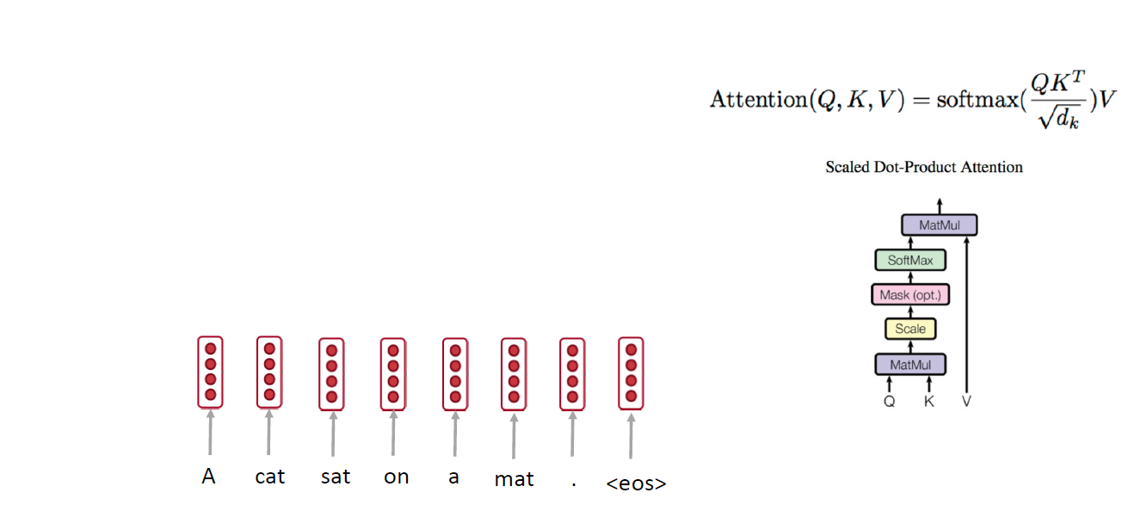
Self-attention: A Running Example

Slide 24
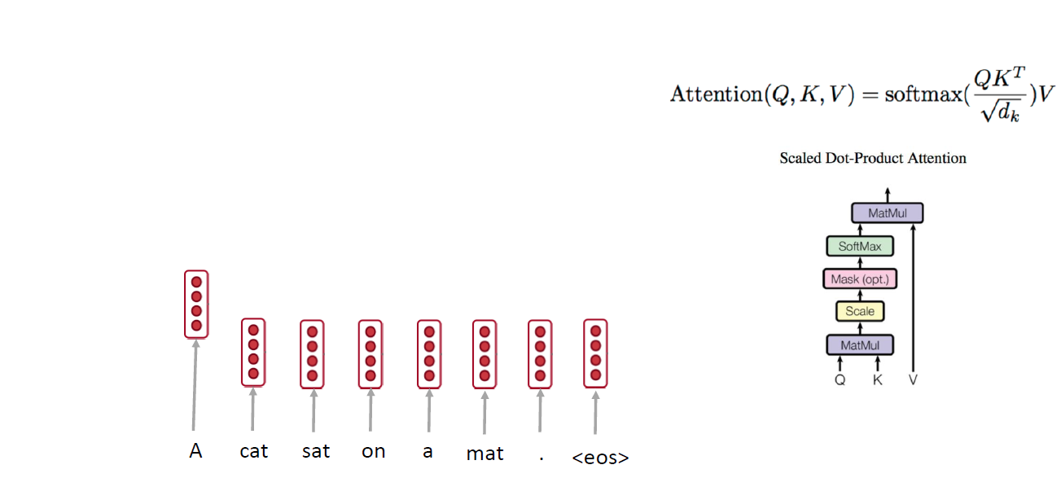
Self-attention: A Running Example

Slide 25
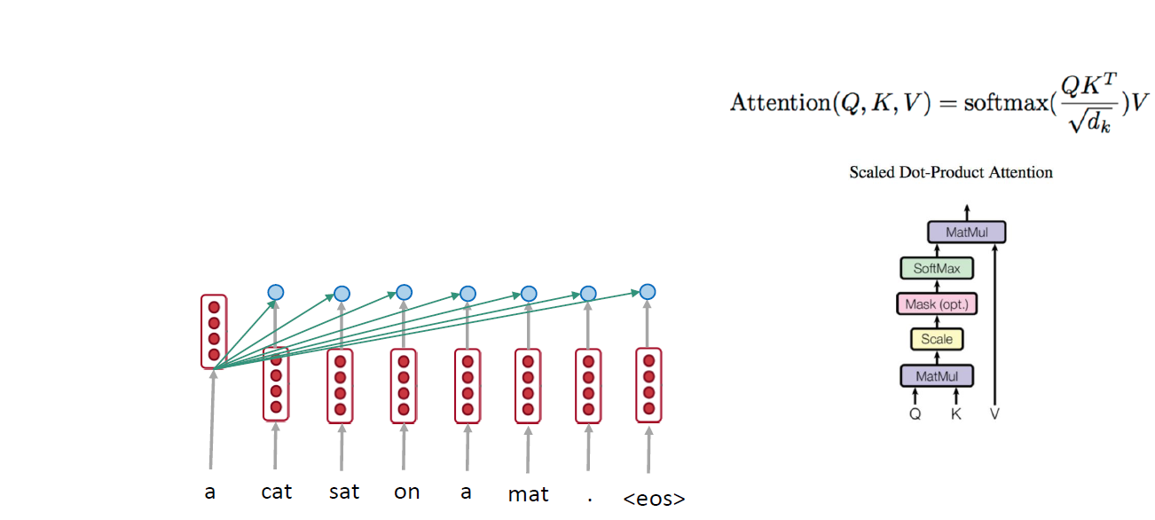
Self-attention: A Running Example

Slide 26
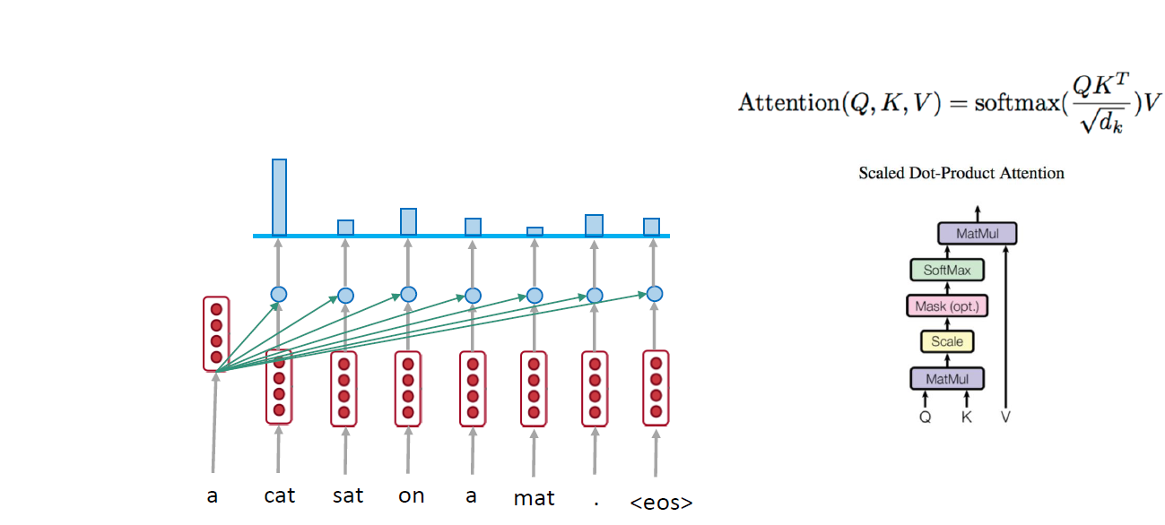
Self-attention: A Running Example

Slide 27
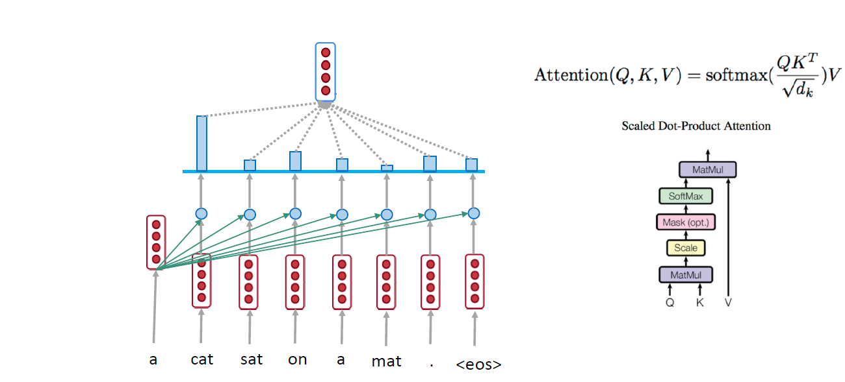
Self-attention: A Running Example

Slide 28
Self-attention: A Running Example

Slide 29
Self-attention: A Running Example

Slide 30
Self-attention: A Running Example

Slide 31
Self-attention: A Running Example

Slide 32
Self-attention: A Running Example

Slide 33
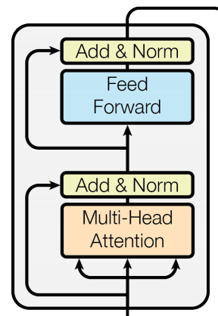
Complete transformer block
Each block has two “sublayers”
  1. Multihead attention
  2. 2 layer feed-forward Nnet (with relu)
Each of these two steps also has:
  Residual (short-circuit) connection and LayerNorm:
  LayerNorm(x + Sublayer(x))
    Layernorm changes input to have mean 0 and variance 1, per layer and per training point (and adds two more parameters)
Layer Normalization by Ba, Kiros and Hinton, https://arxiv.org/pdf/1607.06450.pdf

Slide 34
Blocks are repeated N=6 times

Slide 35
Encoder Input
Actual word representations are byte-pair encodings
  Rico Sennrich, Barry Haddow, and Alexandra Birch. Neural Machine Translation of Rare Words with Subword Units. ACL 2016.
Added is a positional encoding so same words at different locations have different overall representations:
pos is the position of a word
i is the dimension index

Slide 36
Self Attention Visualization in Layer 5
Words start to pay attention to other words in sensible ways

Slide 37
Transformer Decoder
2 sublayer changes in decoder
Masked decoder self-attention
  Only depends on previous words
Encoder-Decoder Attention
  Queries come from previous decoder layer and keys and values come from output of encoder

Slide 38
Advantages
No recurrence: parallel encoding
Fast training: both encoder and decoder are parallel
No long range problem: O(1) for all tokens direct connections
Three attentions: the model does not have to remember too much
Multi-head attention allows to pay attention to different aspects
Why self-attention and CNN is better than RNN on NMT is still under investigation
A comparison of RNN, CNN, and self-attention
http://aclweb.org/anthology/D18-1458

Slide 39

Transformer Networks Visualization
https://ai.googleblog.com/2017/08/transformer-novel-neural-network.html

Slide 40
Google’s BERT
Training of BERT-BASE was performed on 4 Cloud TPUs in Pod configuration (16 TPU chips total).
Training of BERT-LARGE was performed on 16 Cloud TPUs (64 TPU chips total).
Each pre-training took 4 days to complete.
https://ai.googleblog.com/2018/11/open-sourcing-bert-state-of-art-pre.html
https://arxiv.org/pdf/1810.04805.pdf

Slide 41
BERT: Pre-training of Deep Bidirectional Transformers for Language Understanding

Slide 42
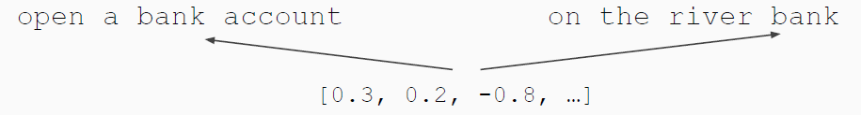
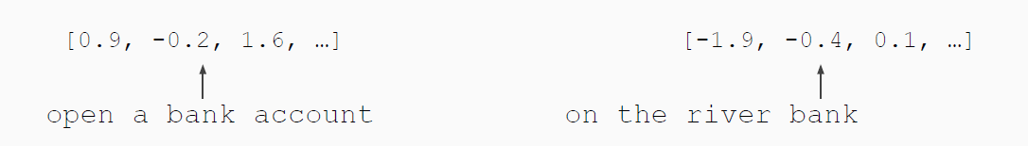
Pre-training in NLP
Word embeddings are the basis of deep learning for NLP
Word embeddings (word2vec, GloVe) are often pre-trained on text corpus from co-occurrence statistics
Problem: Word embeddings are applied in a context free manner
Solution: Train contextual representations on text corpus

Slide 43
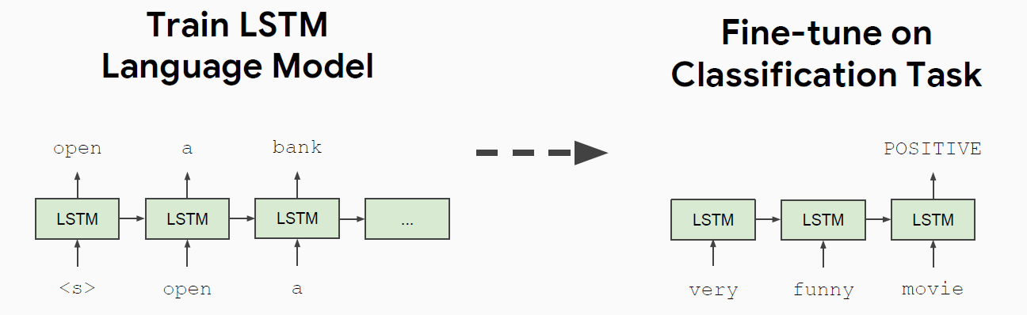
History of Contextual Representations
Semi-Supervised Sequence Learning, Google, 2015

Slide 44
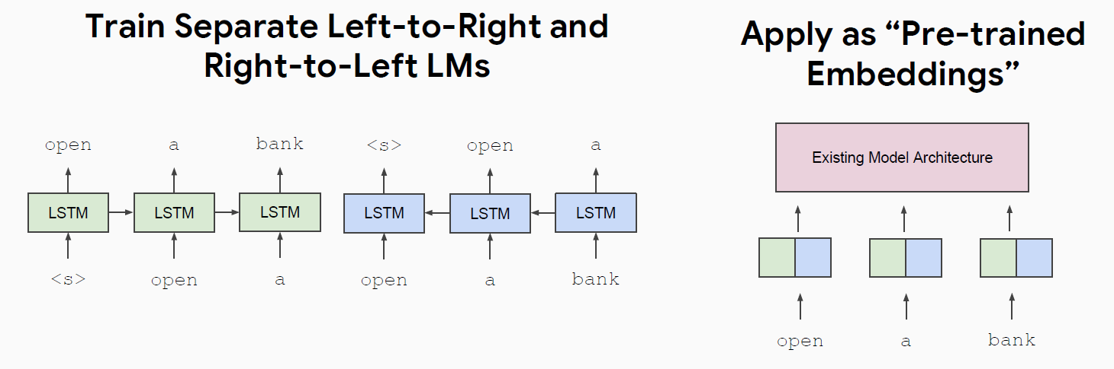
History of Contextual Representations
ELMo: Deep Contextual Word Embeddings, AI2 & University of Washington, 2017

Slide 45
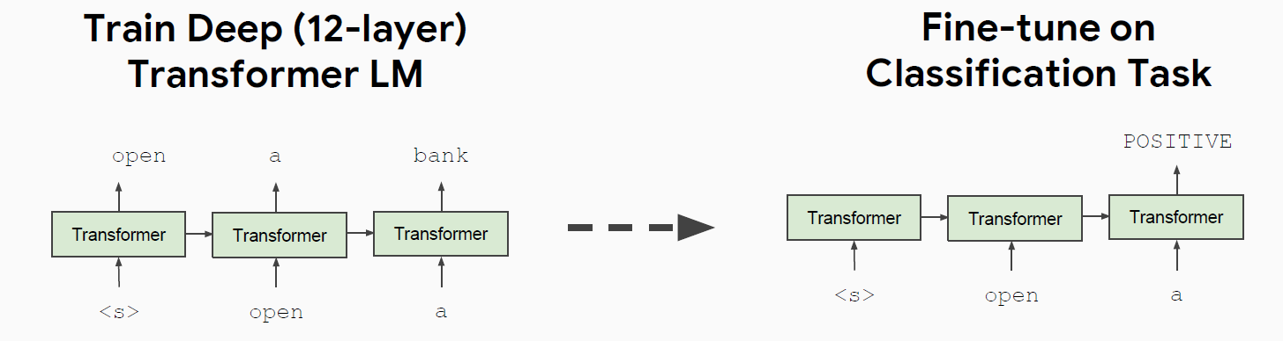
Improving Language Understanding by Generative Pre-Training, OpenAI, 2018 (GPT)

Slide 46
Problem with Previous Methods
Problem: Language models only use left context or right context, but language understanding is bidirectional.
Why are LMs unidirectional?
  Reason 1: Directionality is needed to generate a well-formed probability distribution.
    We don’t care about this.
  Reason 2: Words can “see themselves” in a bidirectional encoder.

Slide 47
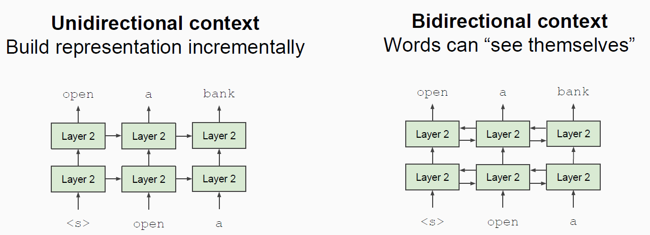
Unidirectional vs. Bidirectional Models

Slide 48
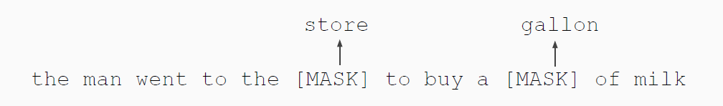
Masked LM
Solution: Mask out k% of the input words, and then predict the masked words
  We always use k = 15%
Too little masking: Too expensive to train
Too much masking: Not enough context

Slide 49
Masked LM
Problem: Mask token never seen at fine-tuning
Solution: 15% of the words to predict, but don’t replace with [MASK] 100% of the time. Instead:
  80% of the time, replace with [MASK]
    went to the store → went to the [MASK]
  10% of the time, replace random word
    went to the store → went to the running
  10% of the time, keep same
    went to the store → went to the store

Slide 50
Next Sentence Prediction
To learn relationships between sentences, predict whether Sentence B is actual sentence that proceeds Sentence A, or a random sentence

Slide 51
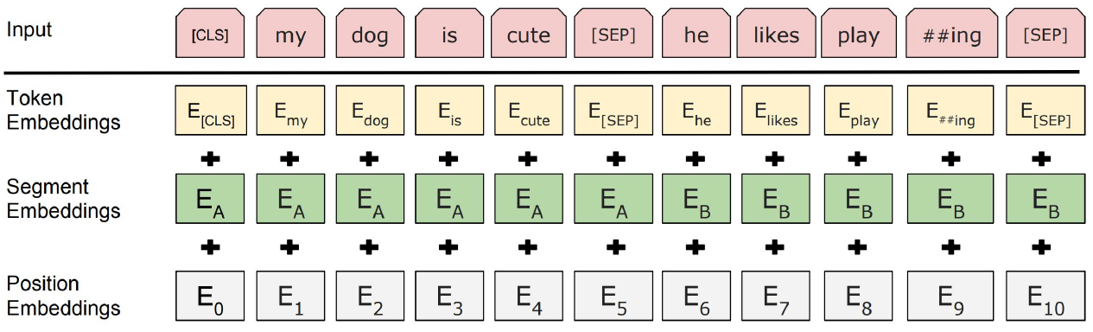
Input Representation
Use 30,000 WordPiece vocabulary on input.
Each token is sum of three embeddings
Single sequence is much more efficient

Slide 52
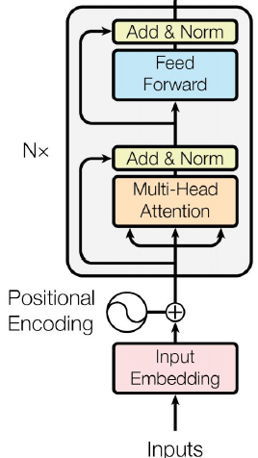
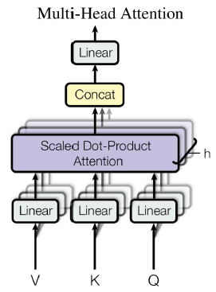
Model Architecture
Transformer encoder

Slide 53
Model Details
Data: Wikipedia (2.5B words) + BookCorpus (800M words)
Batch Size: 131,072 words (1024 sequences * 128 length or 256 sequences * 512 length)
Training Time: 1M steps (~40 epochs)
Optimizer: Adam, 1e-4 learning rate, linear decay
BERT-Base: 12-layer, 768-hidden, 12-head,
  Total Parameters=110M
BERT-Large: 24-layer, 1024-hidden, 16-head
  Total Parameters=340M
Trained on 4x4 or 8x8 TPU slice for 4 days

Slide 54
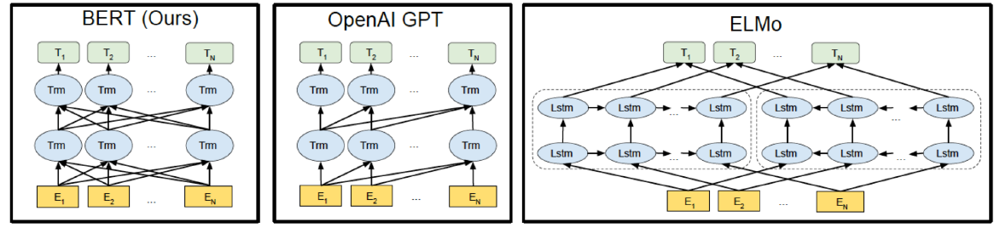
Differences in pre-training model architectures: BERT,OpenAI GPT, and ELMo

Slide 55
Fine-tuning procedure
For sequence-level classification task
  Obtain the representation of the input sequence by using the final hidden state (hidden state at the position of the special token [CLS])
Just add a classification layer and use softmax to calculate label probabilities.

Slide 56
Fine-tuning procedure
For sequence-level classification task
  All of the parameters of BERT and W are fine-tuned jointly
Most model hyper-parameters are the same as in pre-training
  except the batch size, learning rate, and number of training epochs

Slide 57
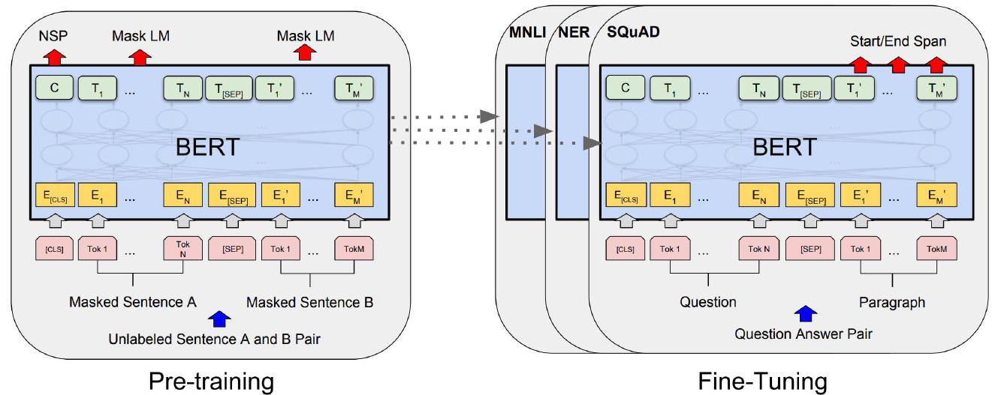
Fine-Tuning Procedure
Span-level task: SQuAD v1.1
Represent the input question and paragraph as a single packed sequence
  The question uses the A embedding and the paragraph uses the B embedding

Slide 58
Experiments
GLUE (General Language Understanding Evaluation)benchmark
  Distribute canonical Train, Dev and Test splits
  Labels for Test set are not provided
Datasets in GLUE:
  MNLI: Multi-Genre Natural Language Inference
  QQP: Quora Question Pairs
  QNLI: Question Natural Language Inference
  SST-2: Stanford Sentiment Treebank
  CoLA: The corpus of Linguistic Acceptability
  STS-B: The Semantic Textual Similarity Benchmark
  MRPC: Microsoft Research Paraphrase Corpus
  RTE: Recognizing Textual Entailment
  WNLI: Winograd NLI

Slide 59
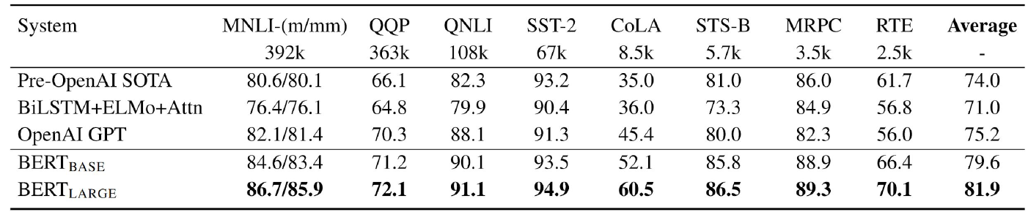
GLUE Results

Slide 60
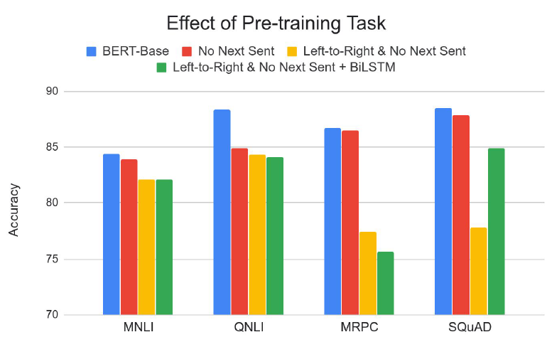
Effect of Pre-training Task
Masked LM (compared to left-to-right LM) is very important on some tasks, Next Sentence Prediction is important on other tasks.
Left-to-right model does very poorly on word-level task (SQuAD), although this is mitigated by BiLSTM

Slide 61
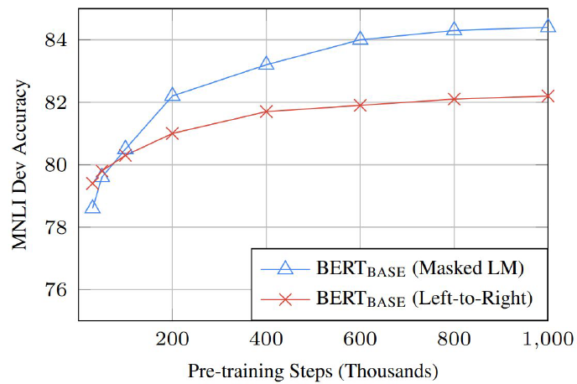
Effect of Directionality and Training Time
Masked LM takes slightly longer to converge because we only predict 15% instead of 100%
But absolute results are much better almost immediately

Slide 62
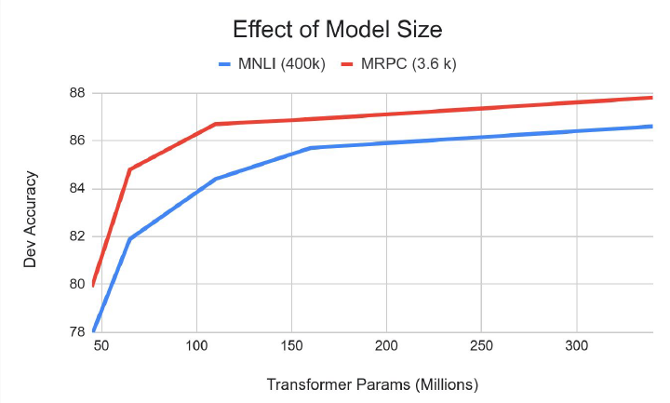
Effect of Model Size
Big models help a lot
Going from 110M -> 340M params helps even on datasets with 3,600 labeled examples
Improvements have not asymptoted

Slide 63
Other Improvement
GPT-2 (OpenAI, Feb. 2019)
  https://d4mucfpksywv.cloudfront.net/better-language-models/language_models_are_unsupervised_multitask_learners.pdf
  No large model released yet

Slide 64
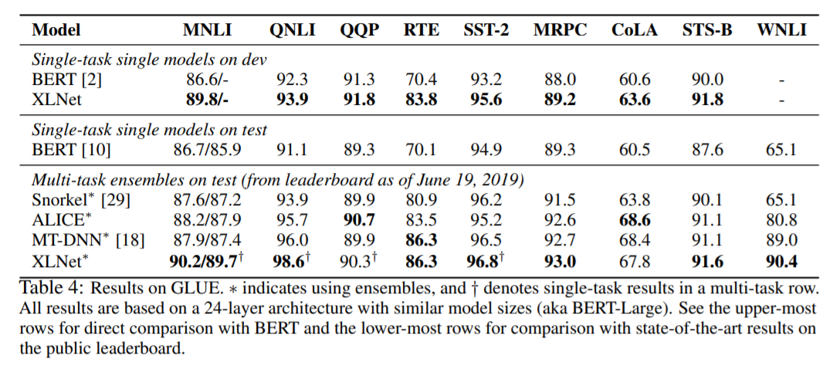
Other Improvement
XLNet (CMU and Google Brain, June 2019)
  https://arxiv.org/abs/1906.08237
  Go back to language models but add some permutation of input

Slide 65
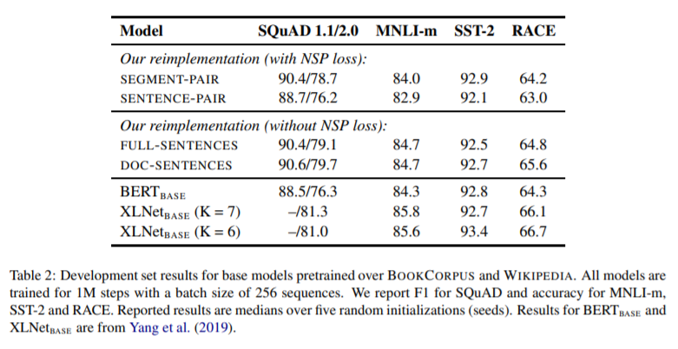
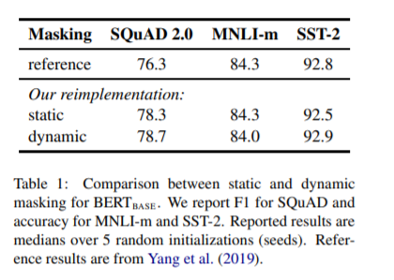
Other Improvement
RoBERTa (FAIR, July 2019)
  https://arxiv.org/abs/1907.11692
  present a replication study of BERT pretraining
  find that BERT was significantly undertrained, and can match or exceed the performance of every model published after it.

Slide 66
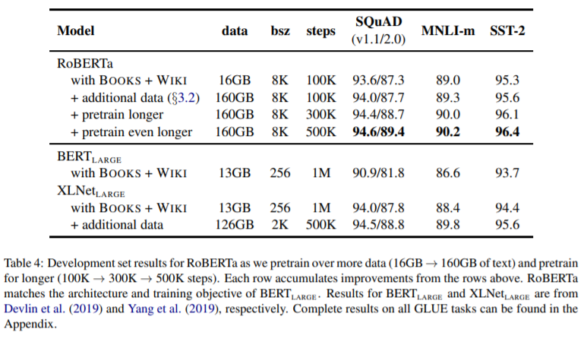
Other Improvement
RoBERTa (FAIR, July 2019)
  https://arxiv.org/abs/1907.11692

Slide 67
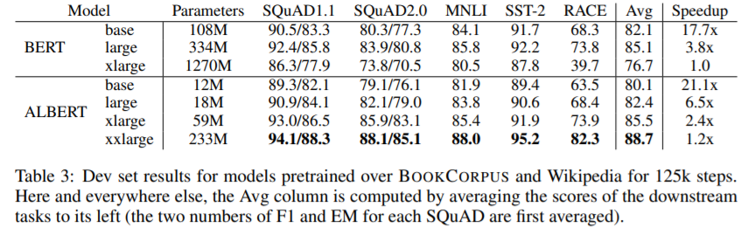
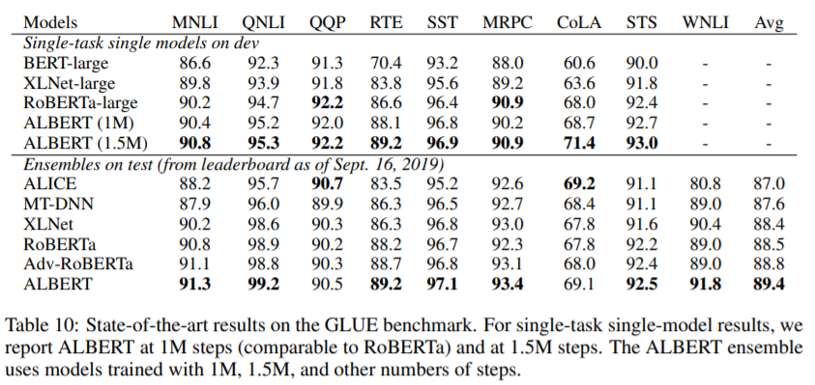
Other Improvement
Albert: A LITE BERT (Sept. 2019, ?)
  https://openreview.net/pdf?id=H1eA7AEtvS
  https://arxiv.org/abs/1904.00962

