Slide 1
Statistical Learning Models for Text and Graph Data
Sequence to Sequence Learning
Yangqiu Song
Slides credits: Richard Socher, Vagelis Hristidis, Abigail See, Elena Voita

Slide 2
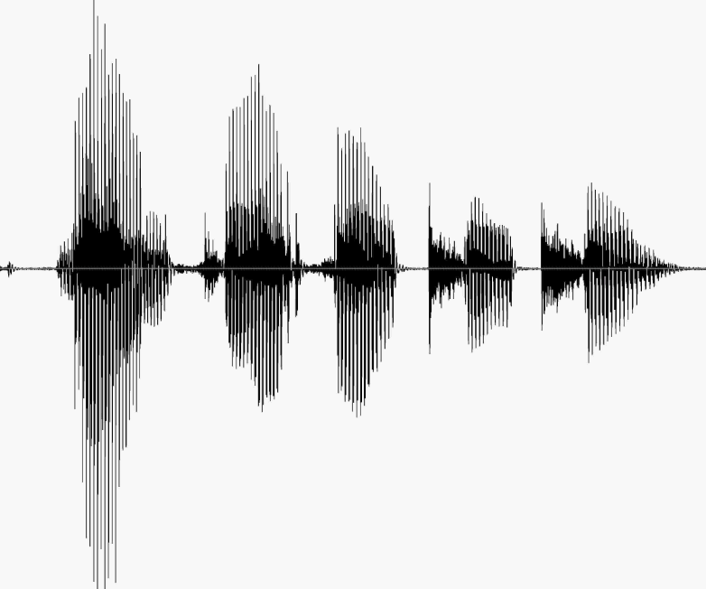
Sequence to Sequence
Speech recognition
http://nlp.stanford.edu/courses/lsa352/

Slide 3

Sequence to Sequence
Question answering

Slide 4
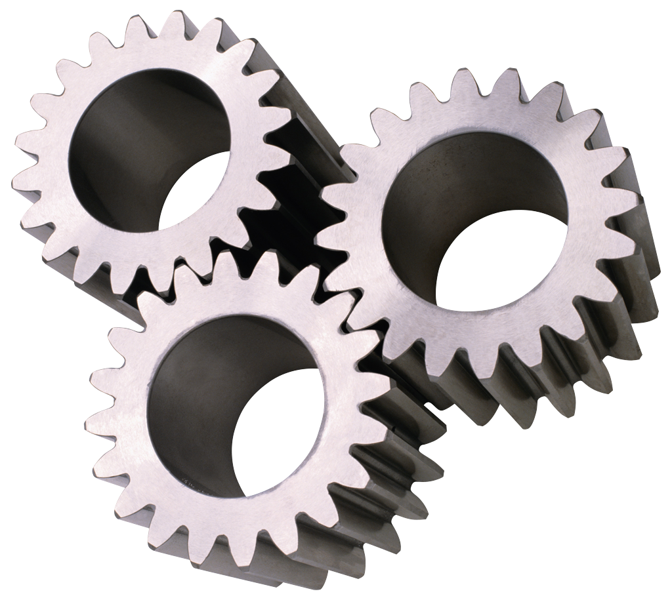
Sequence to Sequence
Machine translation
مرحبا بكم في درس التعلم العميق
Welcome to the deep learning class

Slide 5
7 billion people, 7000 languages

Slide 6
Machine Translation
Machine Translation (MT) is the task of translating a sentence x from one language (the source language) to a sentence y in another language (the target language).
1950s: Early Machine Translation
  Mostly Russian → English (motivated by the Cold War!)
  Systems were mostly rule-based, using a bilingual dictionary to map Russian words to their English counterparts
Source: https://youtu.be/K-HfpsHPmvw

Slide 7
1990s-2010s: Statistical Machine Translation
Core idea: Learn a probabilistic model from data
Suppose we’re translating Language X → English.
We want to find best English sentence y, given Language X sentence x
Use Bayes Rule to break this down into two components to be learnt separately:
Translation Model
Models how words and phrases
should be translated.
Learnt from parallel data.
Language Model
Models how to write good English.
Learnt from monolingual data.

Slide 8
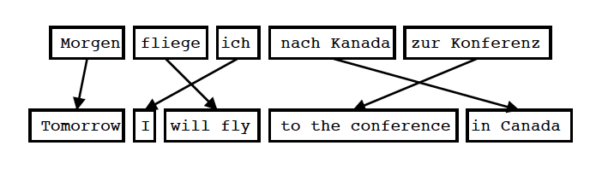
Statistical Machine Translation
Translation model
Input is Segmented in Phrases
Each Phrase is Translated into English
Phrases are Reordered
Koehn 2004

Slide 9
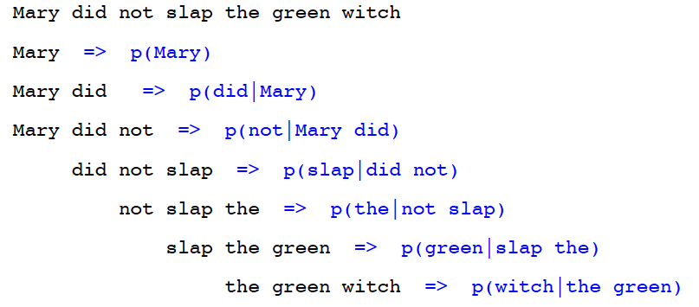
Statistical Machine Translation
Language Model
Goal of the Language Model: Detect good English
For Example: Trigram Model
Knight and Koehn 2003

Slide 10
1990s-2010s: Statistical Machine Translation
We could enumerate every possible y and calculate the probability? → Too expensive!
Answer: Use a heuristic search algorithm to gradually build up the translation, discarding hypotheses that are too low probability
Question:
How to compute
this argmax?
Translation Model
Language Model

Slide 11
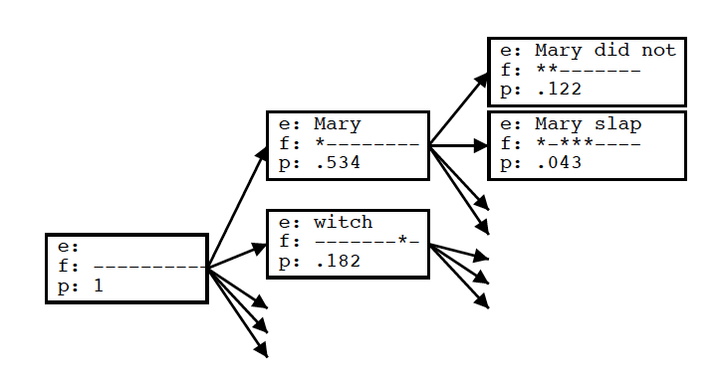
Statistical Machine Translation
Decoding
Goal of the decoding algorithm: Put models to work, perform the actual translation
Koehn 2004

Slide 12
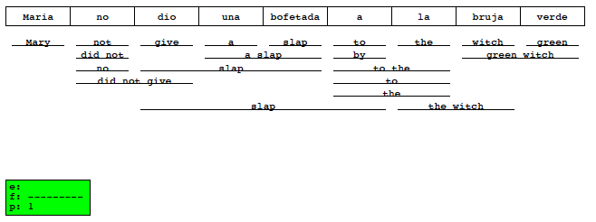
Statistical Machine Translation
Decoding
Goal of the decoding algorithm: Put models to work, perform the actual translation
Koehn 2004

Slide 13
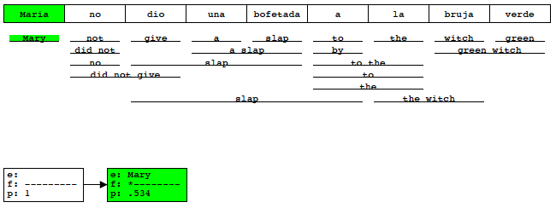
Statistical Machine Translation
Decoding
Goal of the decoding algorithm: Put models to work, perform the actual translation
Koehn 2004

Slide 14
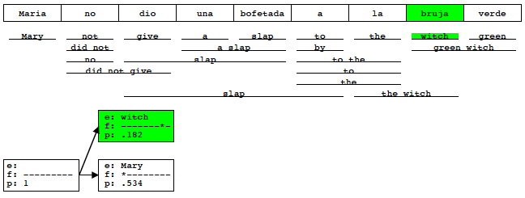
Statistical Machine Translation
Decoding
Goal of the decoding algorithm: Put models to work, perform the actual translation
Koehn 2004

Slide 15
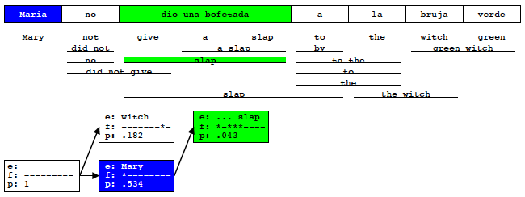
Statistical Machine Translation
Decoding
Goal of the decoding algorithm: Put models to work, perform the actual translation
Koehn 2004

Slide 16
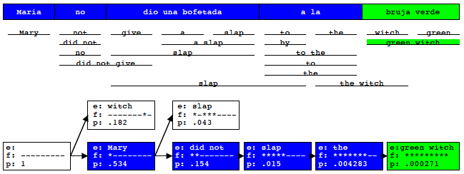
Statistical Machine Translation
Decoding
Goal of the decoding algorithm: Put models to work, perform the actual translation
Koehn 2004

Slide 17
Decoding
Global solution: Dynamic programming
Approximate solutions: Beam inference
  At each position keep the top k complete sequences
  Extend each sequence in each local way
  The extensions compete for the k slots at the next position
Advantages
  Fast; beam sizes of 3-5 are almost as good as exact inference in many cases
  Easy to implement (no dynamic programming required)
Disadvantage
  Inexact: the globally best sequence can fall off the beam

Slide 18
1990s-2010s: Statistical Machine Translation
SMT is a huge research field
The best systems are extremely complex
  Hundreds of important details we haven’t mentioned here
  Systems have many separately-designed subcomponents
  Lots of feature engineering
    Need to design features to capture particular language phenomena
  Require compiling and maintaining extra resources
    Like tables of equivalent phrases
  Lots of human effort to maintain
    Repeated effort for each language pair!

Slide 19
Neural Machine Translation
Neural Machine Translation (NMT) is a way to do Machine Translation with a single neural network
The neural network architecture is called sequence-to-sequence (aka seq2seq) and it involves two RNNs.
Sutskever et al.,2014
Sequence to Sequence Learning with Neural Networks

Slide 20
Neural Machine Translation
Model
W X Y Z
A B C

Slide 21
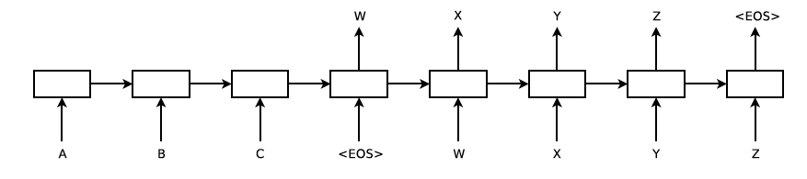
Neural Machine Translation
Model
Sutskever et al. 2014

Slide 22
Neural Machine Translation (NMT)
The sequence-to-sequence model is an example of a Conditional Language Model.
  Language Model because the decoder is predicting the next word of the target sentence y
  Conditional because its predictions are also conditioned on the source sentence x
NMT directly calculates
Question: How to train a NMT system?
Answer: Get a big parallel corpus…
Probability of next target word, given
target words so far and source sentence x

Slide 23
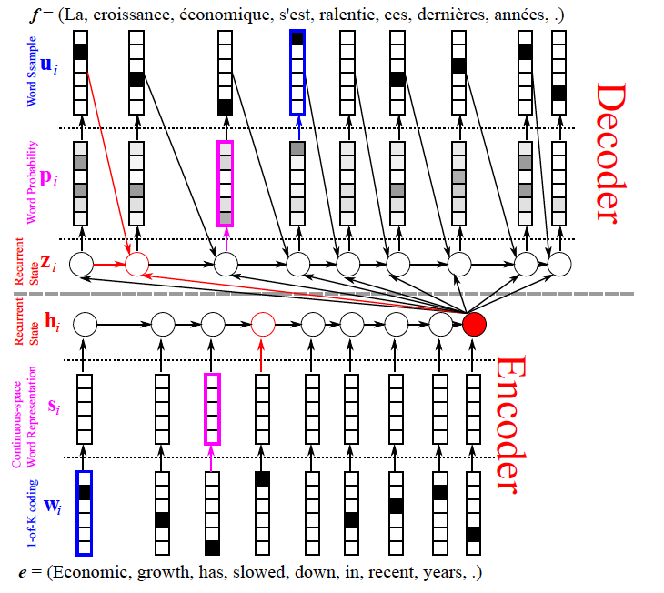
Neural Machine Translation
Model
Cho: From Sequence Modeling to Translation

Slide 24
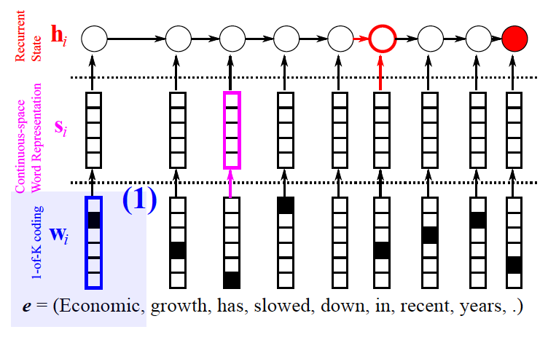
Neural Machine Translation
Model- encoder
Cho: From Sequence Modeling to Translation

Slide 25
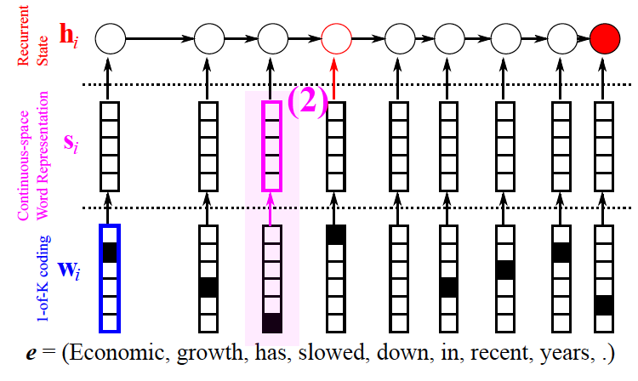
Neural Machine Translation
Model- encoder
Cho: From Sequence Modeling to Translation

Slide 26
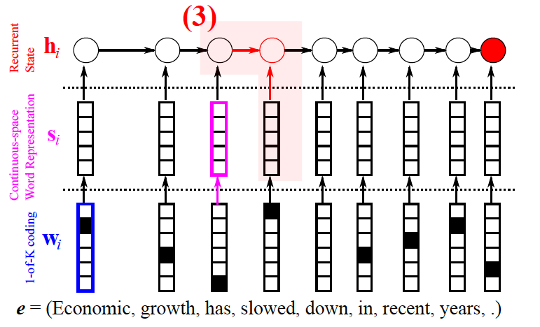
Neural Machine Translation
Model- encoder
Cho: From Sequence Modeling to Translation

Slide 27
Neural Machine Translation
Model- encoder
Cho: From Sequence Modeling to Translation

Slide 28
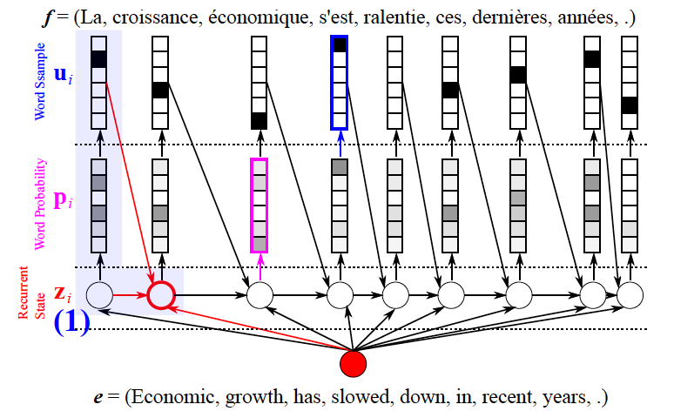
Neural Machine Translation
Model- decoder
Cho: From Sequence Modeling to Translation

Slide 29
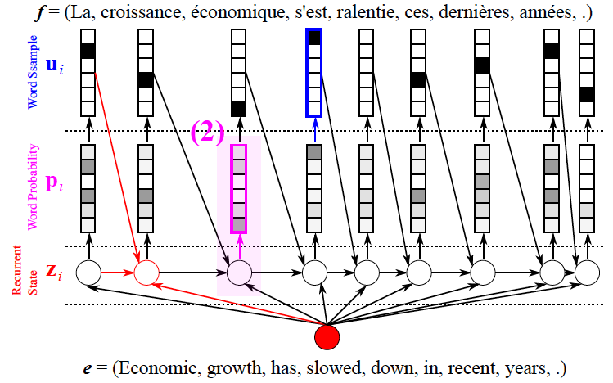
Neural Machine Translation
Model- decoder
Cho: From Sequence Modeling to Translation

Slide 30
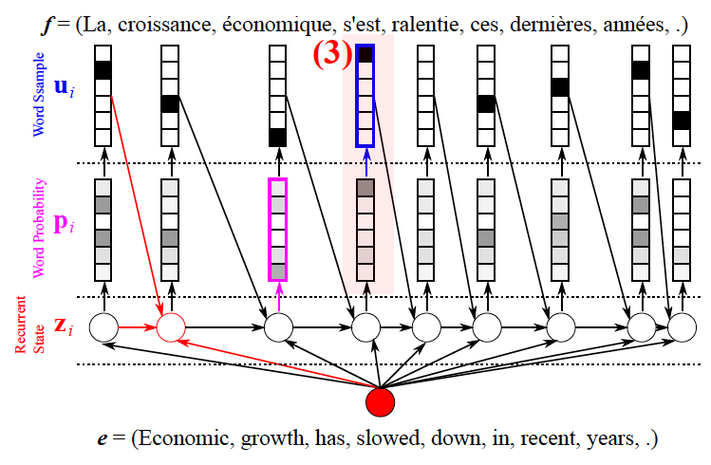
Neural Machine Translation
Model- decoder
Cho: From Sequence Modeling to Translation

Slide 31
Training a Neural Machine Translation system
Seq2seq is optimized as a single system.
Backpropagation operates “end to end”.

Slide 32
Advantages of NMT
Compared to SMT, NMT has many advantages:
Better performance
  More fluent
  Better use of context
  Better use of phrase similarities
A single neural network to be optimized end-to-end
  No subcomponents to be individually optimized
Requires much less human engineering effort
  No feature engineering
  Same method for all language pairs

Slide 33
Disadvantages of NMT?
Compared to SMT:
NMT is less interpretable
  Hard to debug
NMT is difficult to control
  For example, can’t easily specify rules or guidelines for translation
  Safety concerns!

Slide 34
Evaluation (Machine Translation)
BLEU (bilingual evaluation understudy) (Papineni et al. (2002))
  BLEU compares the machine-written translation to one or several human-written translation(s), and computes a similarity score based on:
    n-gram precision (usually up to 3 or 4-grams)
    Penalty for too-short system translations
  BLEUs output is always a number between 0 and 1
    1 means identical to the reference translations

Slide 35
BLEU is useful but imperfect
  BLEU was one of the first metrics to claim a high correlation with human judgements of quality, and remains one of the most popular automated and inexpensive metrics
There are many valid ways to translate a sentence
So a good translation can get a poor BLEU score because it has low n-gram overlap with the human translation L

Slide 36
MT progress over time
[Edinburgh En-De WMT newstest2013 Cased BLEU; NMT 2015 from U. Montréal]
Source: http://www.meta-net.eu/events/meta-forum-2016/slides/09_sennrich.pdf

Slide 37
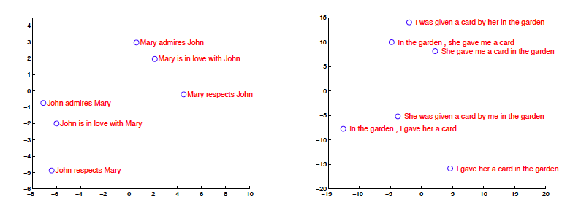
NMT Analysis
Model Analysis
Sutskever et al. 2014

Slide 38
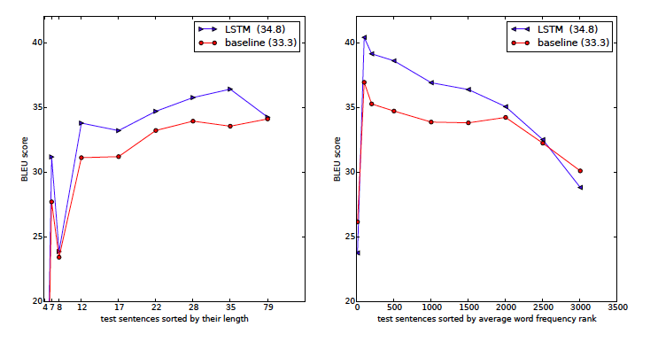
NMT Analysis
Long sentences
Sutskever et al. 2014

Slide 39
NMT: the biggest success story of NLP Deep Learning
Neural Machine Translation went from a fringe research activity in 2014 to the leading standard method in 2016
  2014: First seq2seq paper published
  2016: Google Translate switches from SMT to NMT
This is amazing!
  SMT systems, built by hundreds of engineers over many years, outperformed by NMT systems trained by a handful of engineers in a few months

Slide 40
So is Machine Translation solved?
Nope!
Many difficulties remain:
  Out-of-vocabulary words
  Domain mismatch between train and test data
  Maintaining context over longer text
  Low-resource language pairs
(Old) Bad Examples
  http://languagelog.ldc.upenn.edu/nll/?p=35120#more-35120
  https://hackernoon.com/bias-sexist-or-this-is-the-way-it-should-be-ce1f7c8c683c

Slide 41
NMT research continues
NMT is the flagship task for NLP Deep Learning
  NMT research has pioneered many of the recent innovations of NLP Deep Learning
Researchers have found many, many improvements to the “vanilla” seq2seq NMT system we’ve presented today

Slide 42
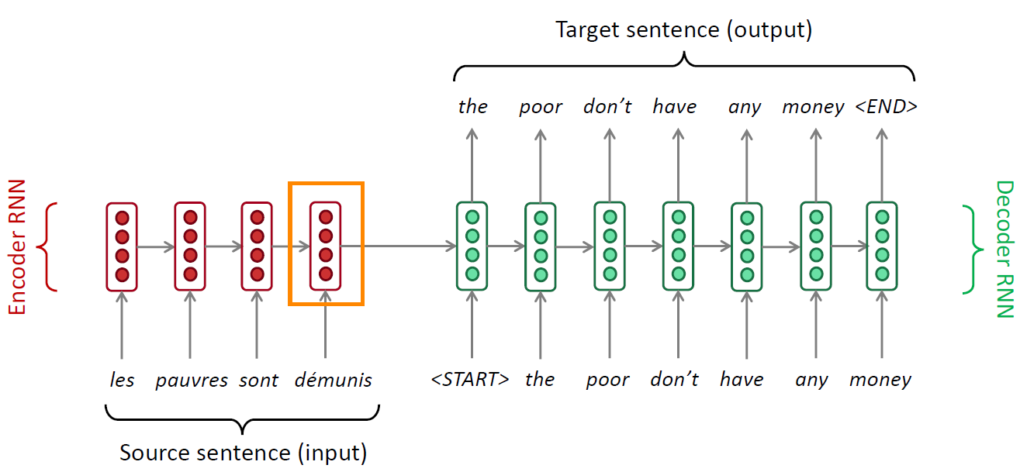
Sequence-to-sequence: the bottleneck problem
Encoding of the
source sentence.

Slide 43
Sequence-to-sequence: the bottleneck problem
Encoding of the
source sentence.
This needs to capture all
information about the
source sentence.
Information bottleneck!

Slide 44
Attention
Attention provides a solution to the bottleneck problem.
Core idea: on each step of the decoder, focus on a particular part of the source sequence

Slide 45
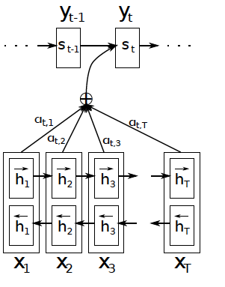
Jointly Learning to Align and Translate
Attention mechanism
$$p\left(y_{t} | y_{t−1},…,y_{1},x\right)=f(y_{t−1},s_{t},c_{t})$$

Slide 46
Jointly Learning to Align and Translate
Attention mechanism
$$p\left(y_{t} | y_{t−1},…,y_{1},x\right)=f(y_{t−1},s_{t},c_{t})$$

Slide 47
Jointly Learning to Align and Translate
Attention mechanism
$$p\left(y_{t} | y_{t−1},…,y_{1},x\right)=f(y_{t−1},s_{t},c_{t})$$

Slide 48
Jointly Learning to Align and Translate
Attention mechanism
$$p\left(y_{t} | y_{t−1},…,y_{1},x\right)=f(y_{t−1},s_{t},c_{t})$$

Slide 49
Jointly Learning to Align and Translate
Attention mechanism
$$p\left(y_{t} | y_{t−1},…,y_{1},x\right)=f(y_{t−1},s_{t},c_{t})$$
$$c_{t}=\sum_{j=1}^{T}{α_{t,j}h_{j}}$$

Slide 50
Jointly Learning to Align and Translate
Attention mechanism
$$p\left(y_{t} | y_{t−1},…,y_{1},x\right)=f(y_{t−1},s_{t},c_{t})$$
$$c_{t}=\sum_{j=1}^{T}{α_{t,j}h_{j}}$$
$$α_{t,j}=\frac{exp⁡(e_{t,j})}{\sum_{k=1}^{T}{exp⁡(e_{t,k})}}$$
$$e_{t,j}=a\left(s_{t−1},h_{j}\right)$$

Slide 51
Jointly Learning to Align and Translate
Attention mechanism
$$p\left(y_{t} | y_{t−1},…,y_{1},x\right)=f(y_{t−1},s_{t},c_{t})$$
$$c_{t}=\sum_{j=1}^{T}{α_{t,j}h_{j}}$$
$$α_{t,j}=\frac{exp⁡(e_{t,j})}{\sum_{k=1}^{T}{exp⁡(e_{t,k})}}$$
$$e_{t,j}=a\left(s_{t−1},h_{j}\right)$$

Slide 52

Attention variants
$$p\left(y_{t} | y_{t−1},…,y_{1},x\right)=f(y_{t−1},s_{t},c_{t})$$
$$c_{t}=\sum_{j=1}^{T}{α_{t,j}h_{j}}$$
$$α_{t,j}=\frac{exp⁡(e_{t,j})}{\sum_{k=1}^{T}{exp⁡(e_{t,k})}}$$
$$e_{t,j}=a\left(s_{t−1},h_{j}\right)$$
Basic dot-product attention
$$e_{tj}=s_{t−1}^{T}h_{j}$$

Slide 53

Attention variants
$$p\left(y_{t} | y_{t−1},…,y_{1},x\right)=f(y_{t−1},s_{t},c_{t})$$
$$c_{t}=\sum_{j=1}^{T}{α_{t,j}h_{j}}$$
$$α_{t,j}=\frac{exp⁡(e_{t,j})}{\sum_{k=1}^{T}{exp⁡(e_{t,k})}}$$
$$e_{t,j}=a\left(s_{t−1},h_{j}\right)$$
Multiplicative attention .
(bilinear model)
$$e_{tj}=s_{t−1}^{T}Wh_{j}$$

Slide 54

Attention variants
$$p\left(y_{t} | y_{t−1},…,y_{1},x\right)=f(y_{t−1},s_{t},c_{t})$$
$$c_{t}=\sum_{j=1}^{T}{α_{t,j}h_{j}}$$
$$α_{t,j}=\frac{exp⁡(e_{t,j})}{\sum_{k=1}^{T}{exp⁡(e_{t,k})}}$$
$$e_{t,j}=a\left(s_{t−1},h_{j}\right)$$
Additive attention
$$e_{tj}=v^{T}\tanh{(W_{1}s_{t−1}^{T}+W_{2}h_{j})}$$

Slide 55
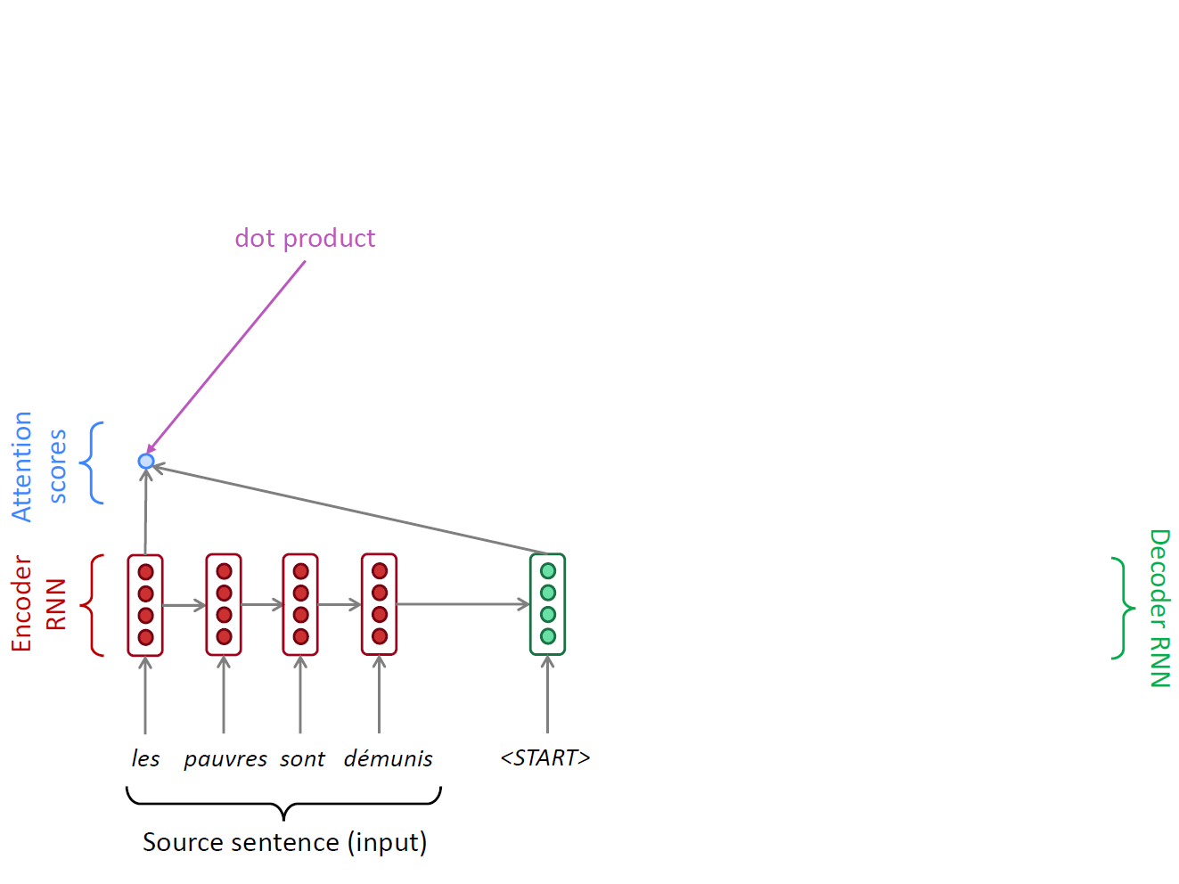
A Running Example
$$α_{t,j}=\frac{exp⁡(e_{t,j})}{\sum_{k=1}^{T}{exp⁡(e_{t,k})}}$$
$$e_{t,j}=a\left(s_{t−1},h_{j}\right)$$

Slide 56
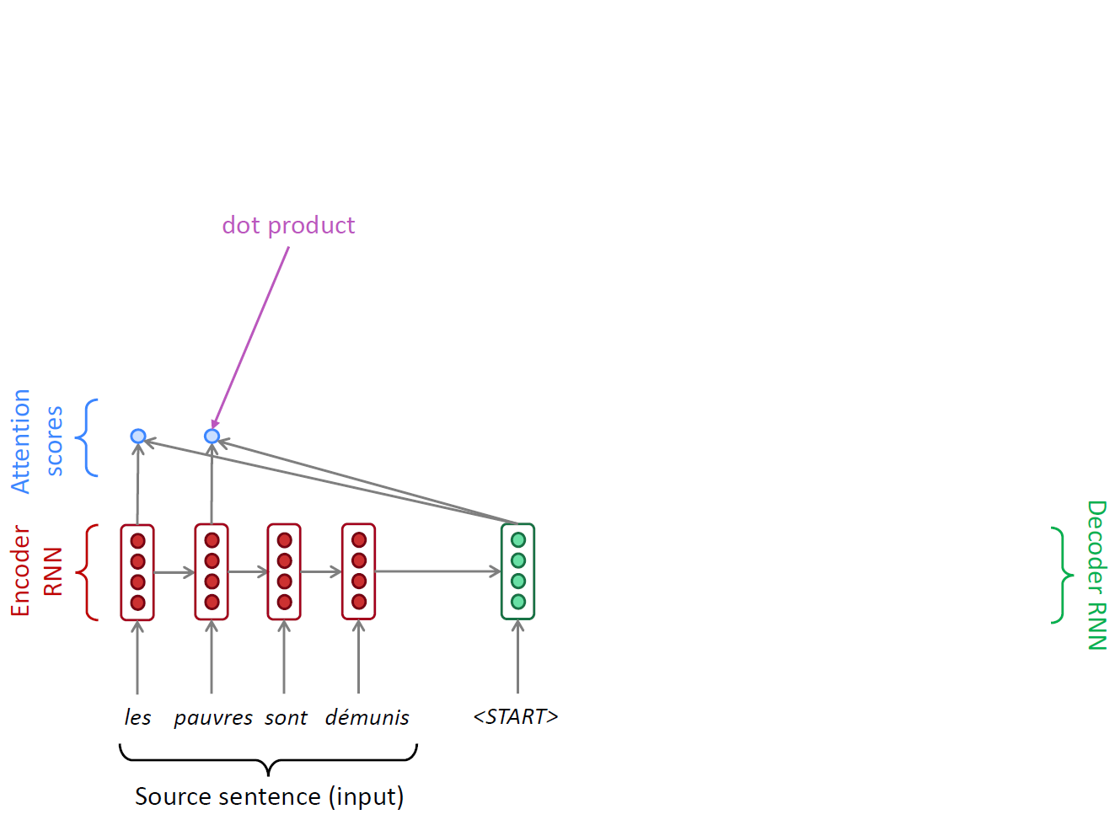
A Running Example
$$α_{t,j}=\frac{exp⁡(e_{t,j})}{\sum_{k=1}^{T}{exp⁡(e_{t,k})}}$$
$$e_{t,j}=a\left(s_{t−1},h_{j}\right)$$

Slide 57
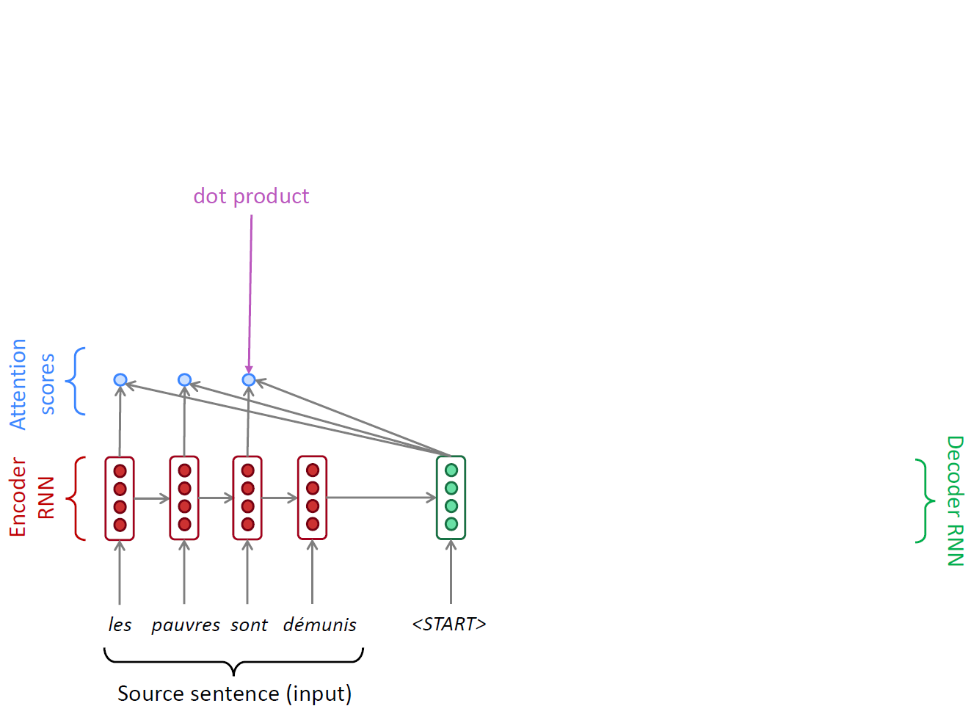
A Running Example
$$α_{t,j}=\frac{exp⁡(e_{t,j})}{\sum_{k=1}^{T}{exp⁡(e_{t,k})}}$$
$$e_{t,j}=a\left(s_{t−1},h_{j}\right)$$

Slide 58
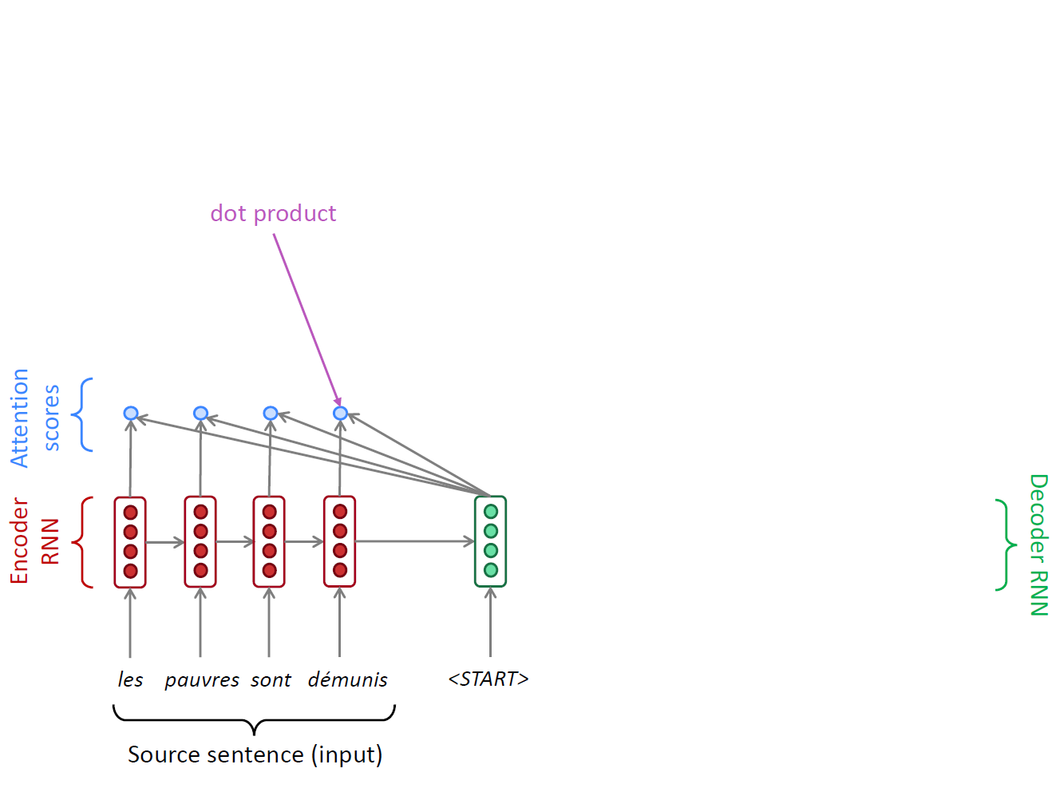
A Running Example
$$α_{t,j}=\frac{exp⁡(e_{t,j})}{\sum_{k=1}^{T}{exp⁡(e_{t,k})}}$$
$$e_{t,j}=a\left(s_{t−1},h_{j}\right)$$

Slide 59
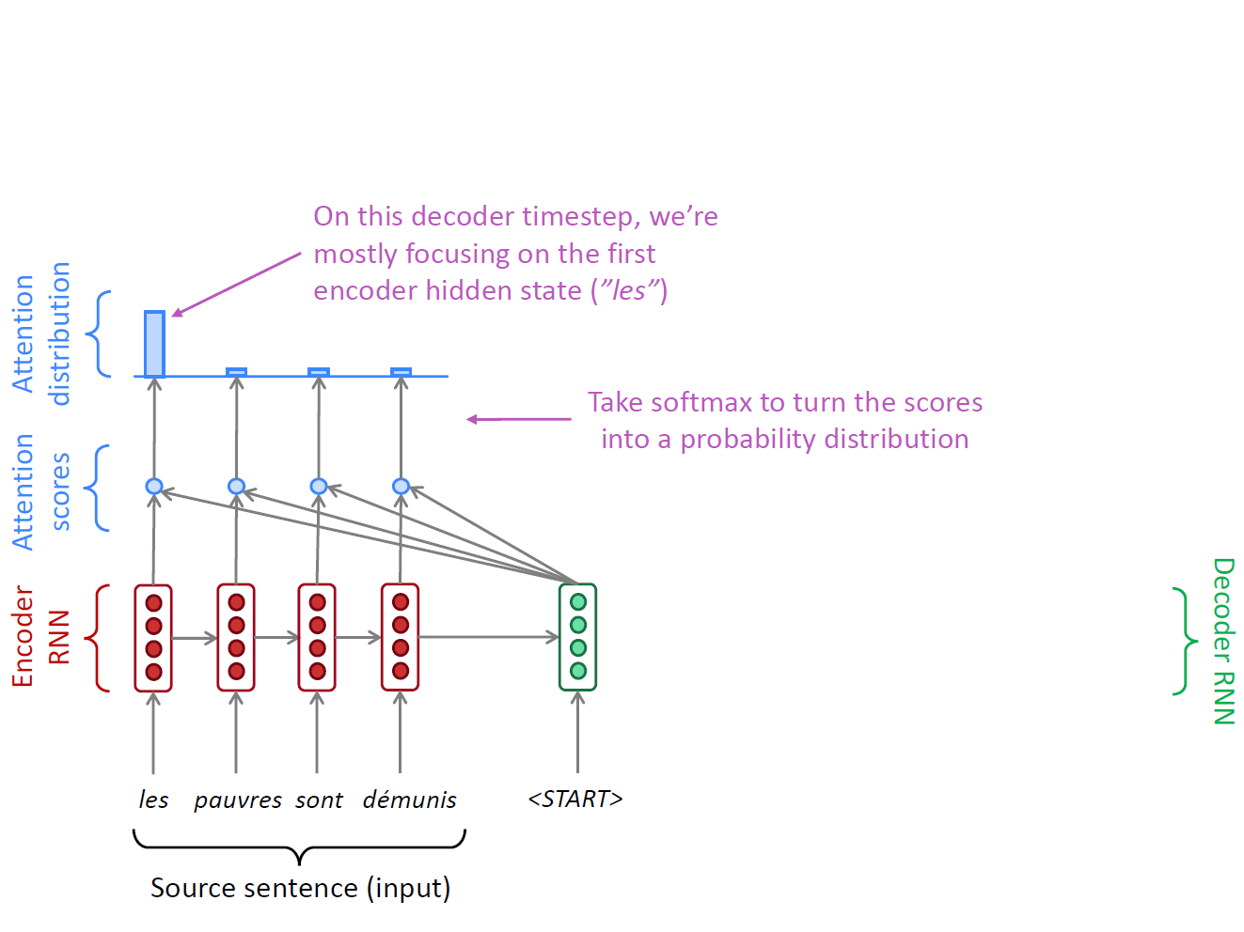
A Running Example
$$α_{t,j}=\frac{exp⁡(e_{t,j})}{\sum_{k=1}^{T}{exp⁡(e_{t,k})}}$$
$$e_{t,j}=a\left(s_{t−1},h_{j}\right)$$

Slide 60
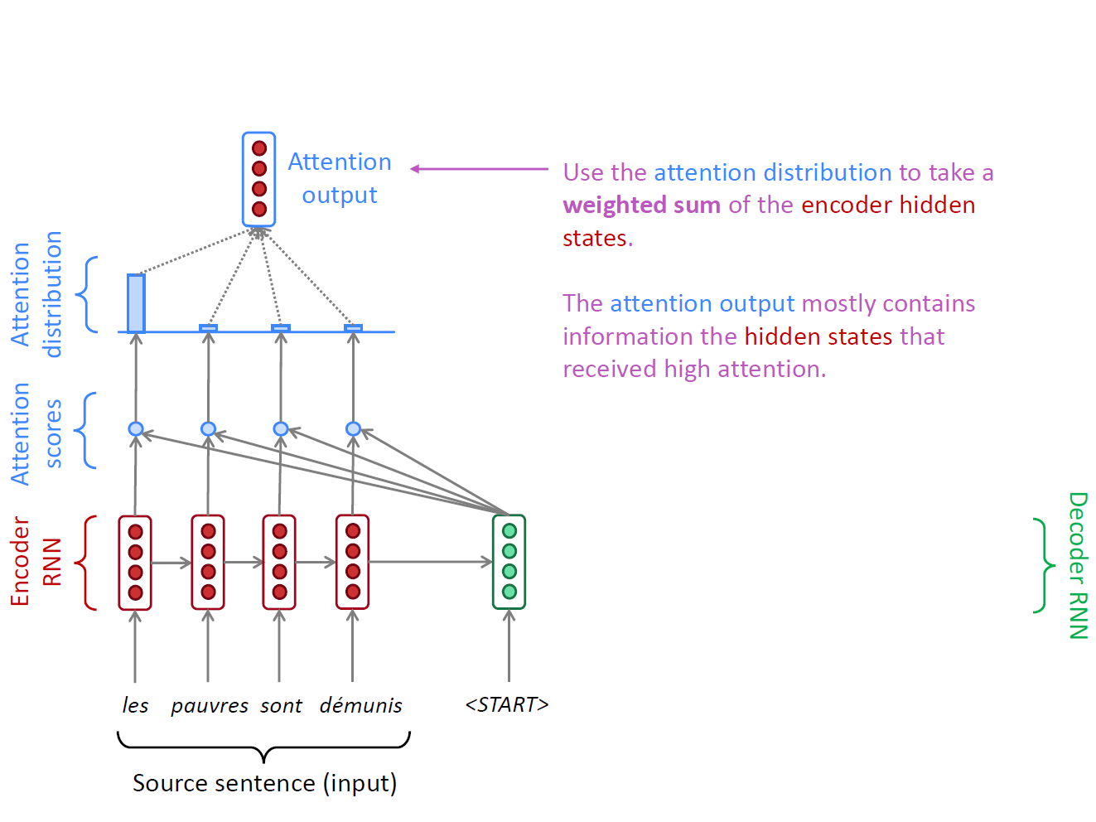
A Running Example
$$α_{t,j}=\frac{exp⁡(e_{t,j})}{\sum_{k=1}^{T}{exp⁡(e_{t,k})}}$$
$$c_{t}=\sum_{j=1}^{T}{α_{t,j}h_{j}}$$
$$e_{t,j}=a\left(s_{t−1},h_{j}\right)$$

Slide 61
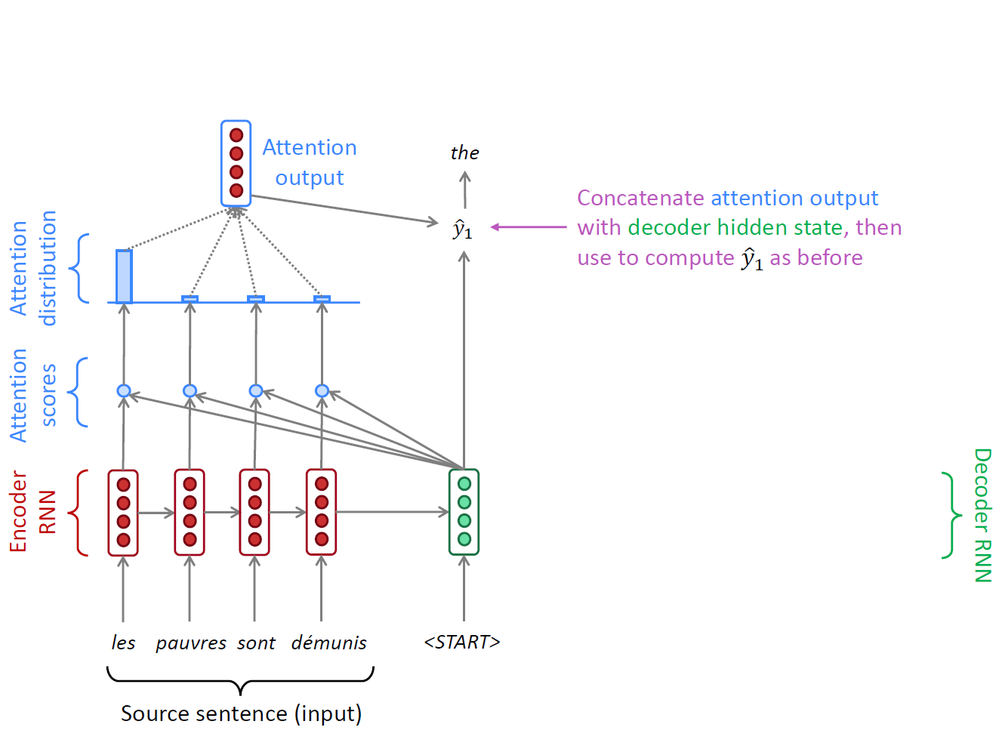
A Running Example
$$α_{t,j}=\frac{exp⁡(e_{t,j})}{\sum_{k=1}^{T}{exp⁡(e_{t,k})}}$$
$$c_{t}=\sum_{j=1}^{T}{α_{t,j}h_{j}}$$
$$p\left(y_{t} | y_{t−1},…,y_{1},x\right)=f(y_{t−1},s_{t},c_{t})$$
$$e_{t,j}=a\left(s_{t−1},h_{j}\right)$$

Slide 62
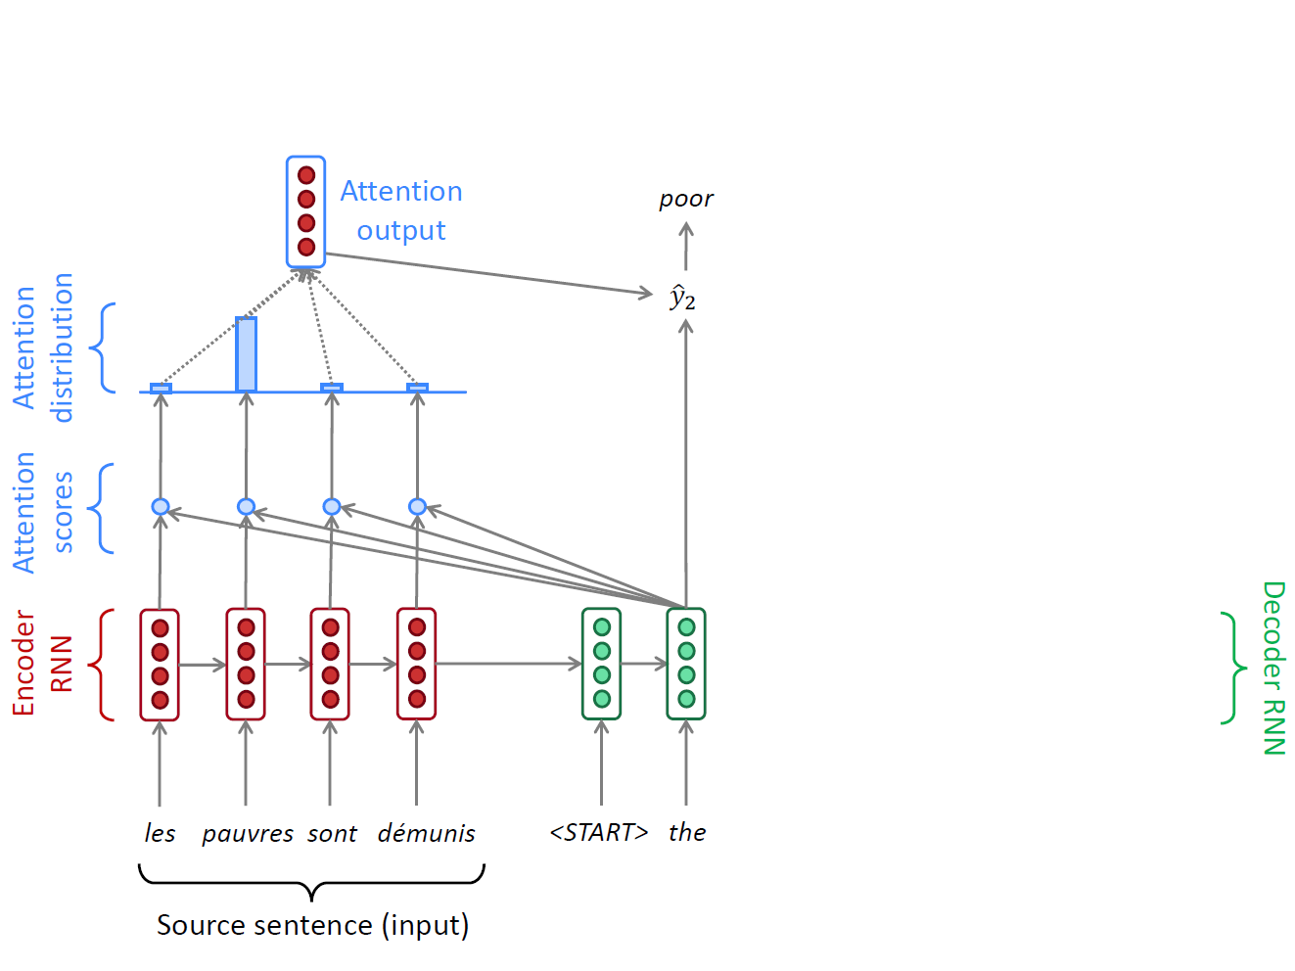
A Running Example
$$α_{t,j}=\frac{exp⁡(e_{t,j})}{\sum_{k=1}^{T}{exp⁡(e_{t,k})}}$$
$$c_{t}=\sum_{j=1}^{T}{α_{t,j}h_{j}}$$
$$p\left(y_{t} | y_{t−1},…,y_{1},x\right)=f(y_{t−1},s_{t},c_{t})$$
$$e_{t,j}=a\left(s_{t−1},h_{j}\right)$$

Slide 63
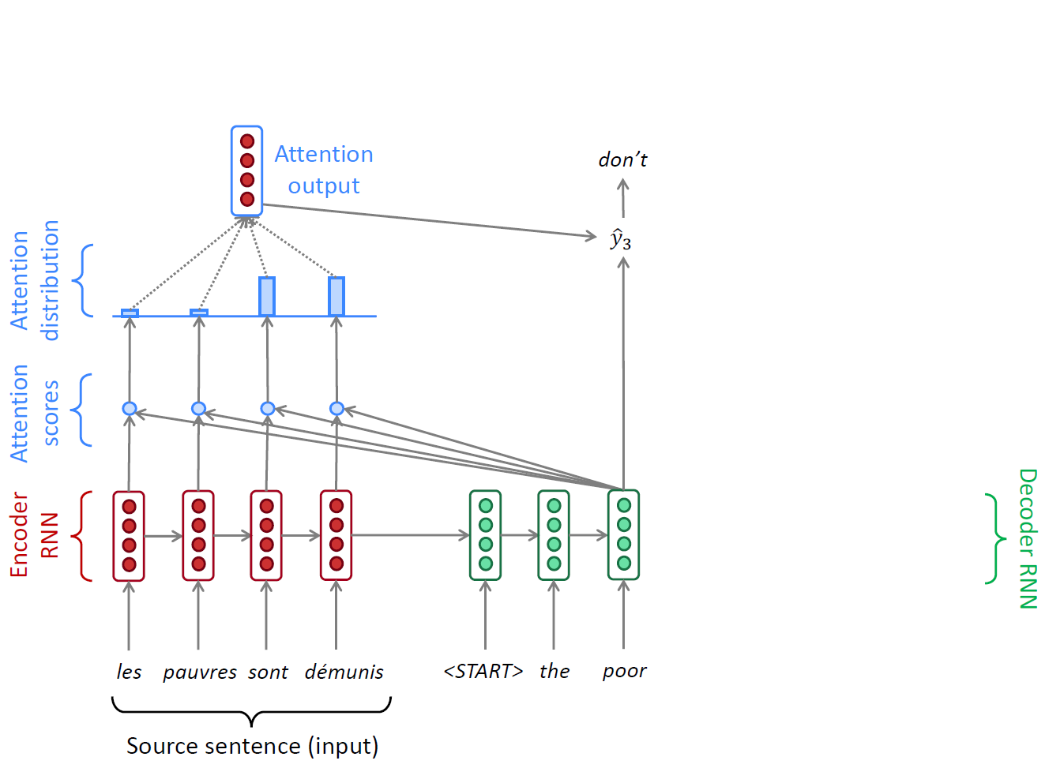
A Running Example
$$α_{t,j}=\frac{exp⁡(e_{t,j})}{\sum_{k=1}^{T}{exp⁡(e_{t,k})}}$$
$$c_{t}=\sum_{j=1}^{T}{α_{t,j}h_{j}}$$
$$p\left(y_{t} | y_{t−1},…,y_{1},x\right)=f(y_{t−1},s_{t},c_{t})$$
$$e_{t,j}=a\left(s_{t−1},h_{j}\right)$$

Slide 64
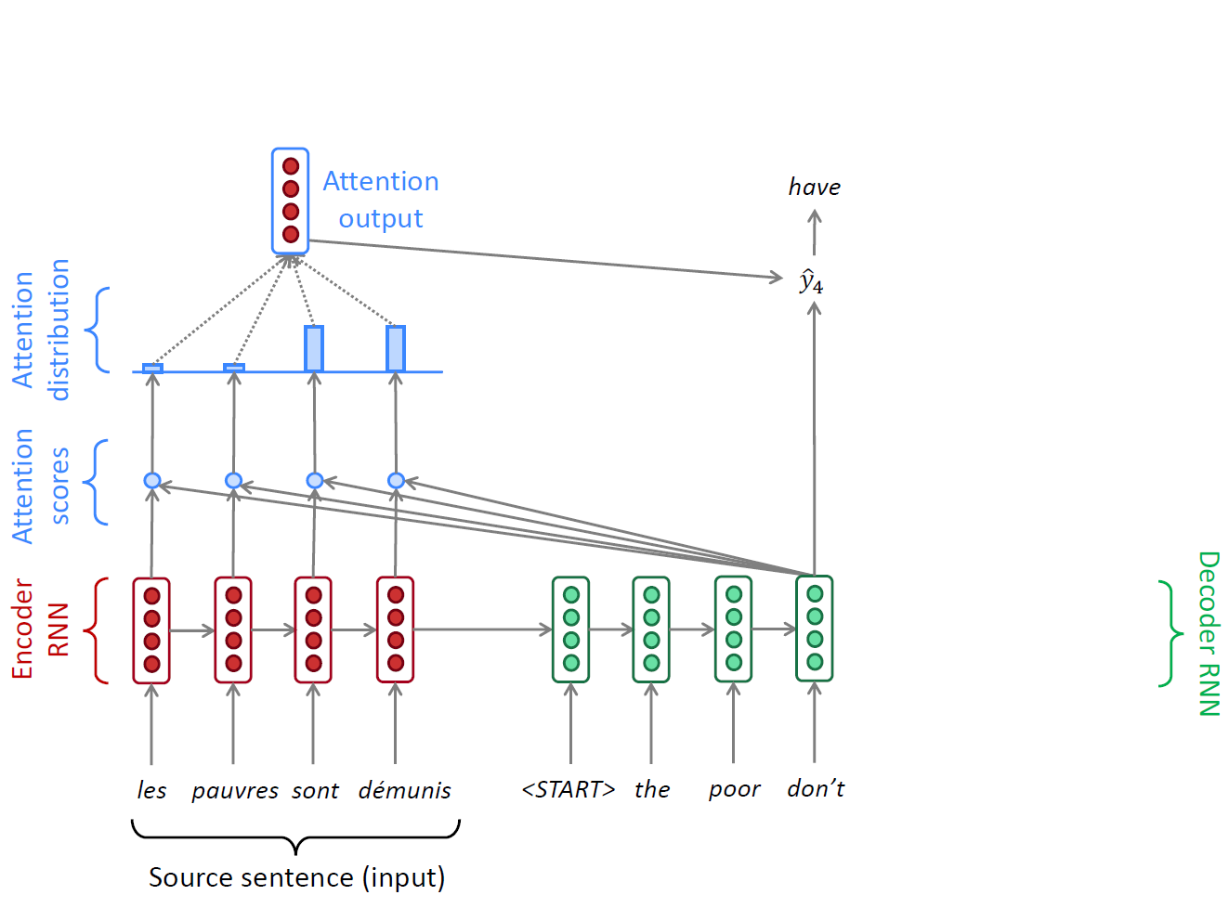
A Running Example
$$α_{t,j}=\frac{exp⁡(e_{t,j})}{\sum_{k=1}^{T}{exp⁡(e_{t,k})}}$$
$$c_{t}=\sum_{j=1}^{T}{α_{t,j}h_{j}}$$
$$p\left(y_{t} | y_{t−1},…,y_{1},x\right)=f(y_{t−1},s_{t},c_{t})$$
$$e_{t,j}=a\left(s_{t−1},h_{j}\right)$$

Slide 65
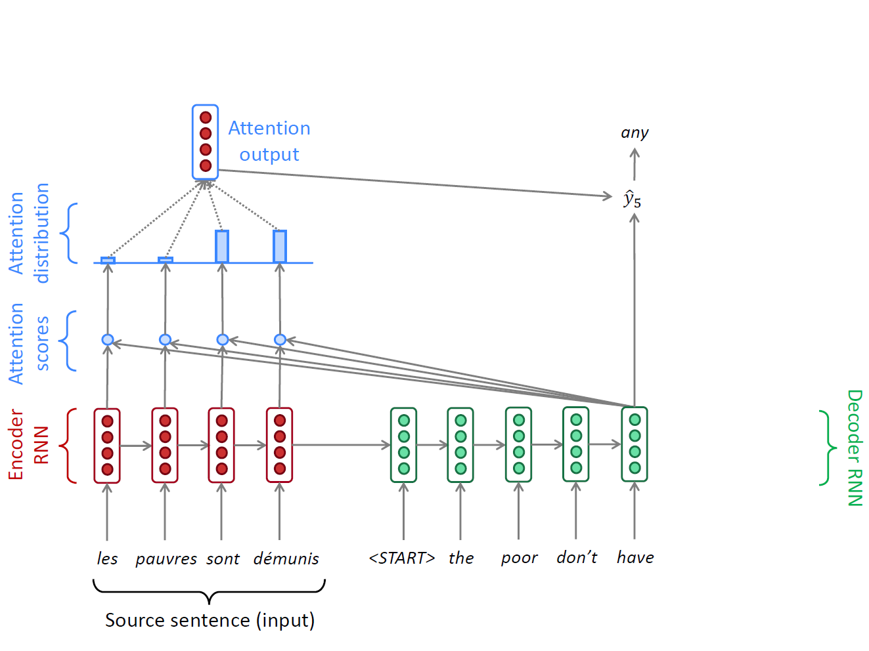
A Running Example
$$α_{t,j}=\frac{exp⁡(e_{t,j})}{\sum_{k=1}^{T}{exp⁡(e_{t,k})}}$$
$$c_{t}=\sum_{j=1}^{T}{α_{t,j}h_{j}}$$
$$p\left(y_{t} | y_{t−1},…,y_{1},x\right)=f(y_{t−1},s_{t},c_{t})$$
$$e_{t,j}=a\left(s_{t−1},h_{j}\right)$$

Slide 66
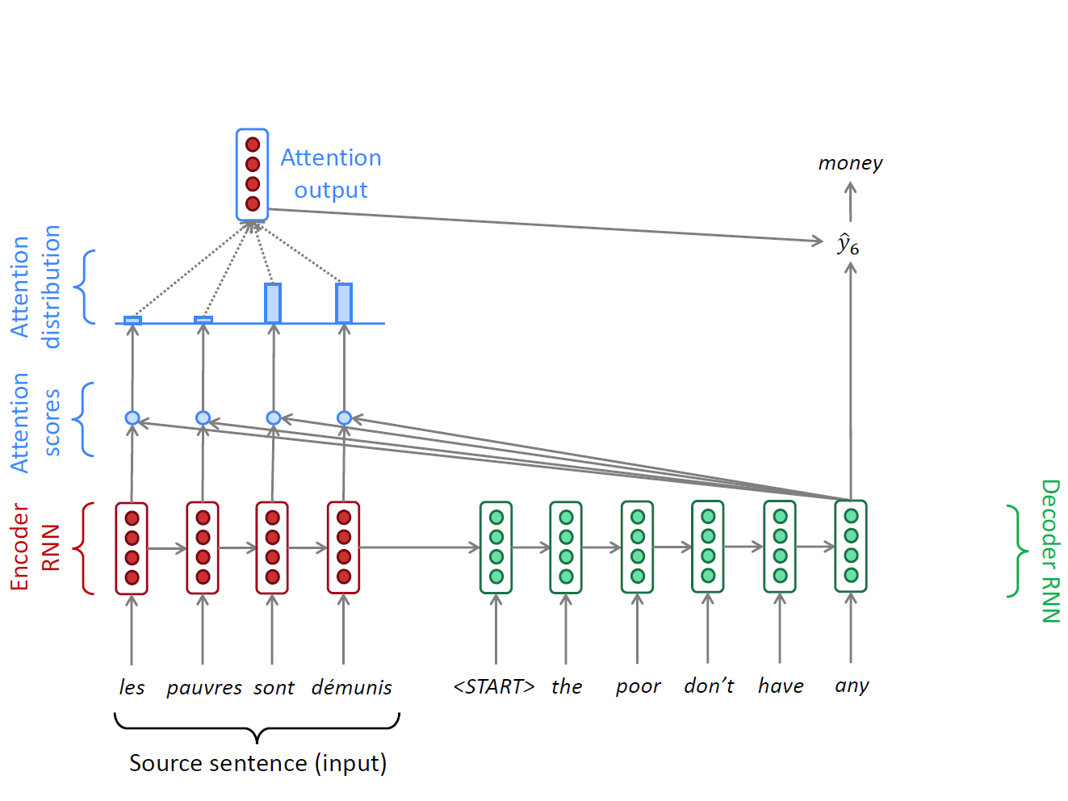
A Running Example
$$α_{t,j}=\frac{exp⁡(e_{t,j})}{\sum_{k=1}^{T}{exp⁡(e_{t,k})}}$$
$$c_{t}=\sum_{j=1}^{T}{α_{t,j}h_{j}}$$
$$p\left(y_{t} | y_{t−1},…,y_{1},x\right)=f(y_{t−1},s_{t},c_{t})$$
$$e_{t,j}=a\left(s_{t−1},h_{j}\right)$$

Slide 67
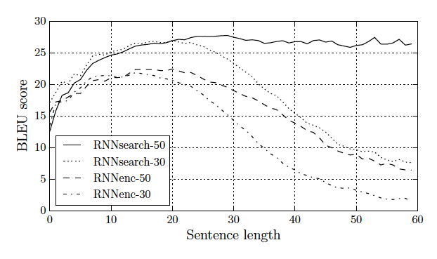
Jointly Learning to Align and Translate
No performance drop for long sentences
“We train each model twice: first with the sentences of length up to 30 words (RNNencdec-30, RNNsearch-30) and then with the sentences of length up to 50 word (RNNencdec-50, RNNsearch-50).”
RNNencdec: Cho et al. 2014 https://www.aclweb.org/anthology/D14-1179
RNNsearch: Bahdanauet al, ICLR 2015, https://arxiv.org/pdf/1409.0473.pdf

Slide 68
OpenNMT
http://opennmt.net/

Slide 69
Google Neural Machine Translation (Wu et al. (2016))

Slide 70
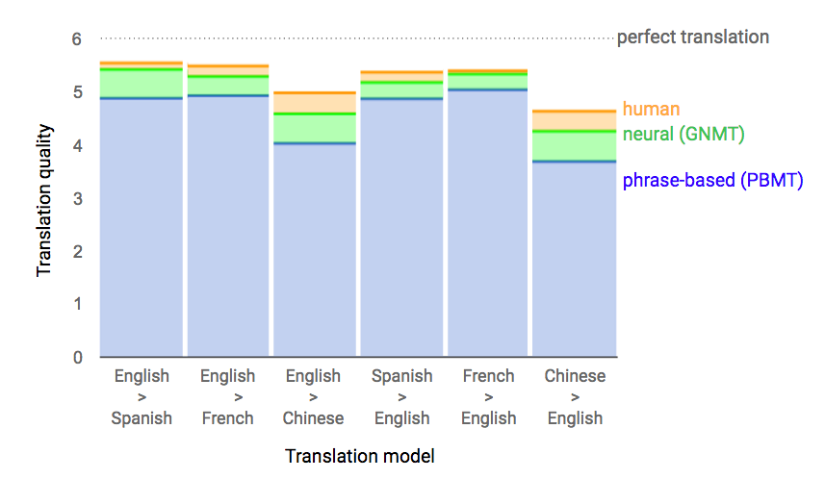
Google Neural Machine Translation (Wu et al. (2016))
https://ai.googleblog.com/2016/09/a-neural-network-for-machine.html

Slide 71
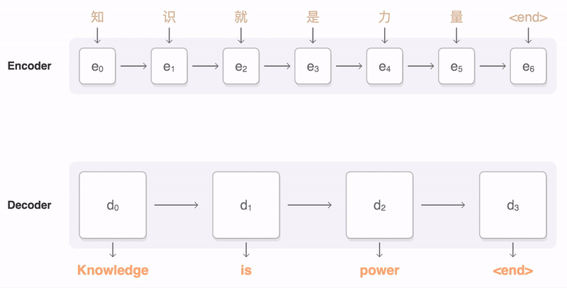
Google Neural Machine Translation (Wu et al. (2016))
https://ai.googleblog.com/2016/09/a-neural-network-for-machine.html

Slide 72
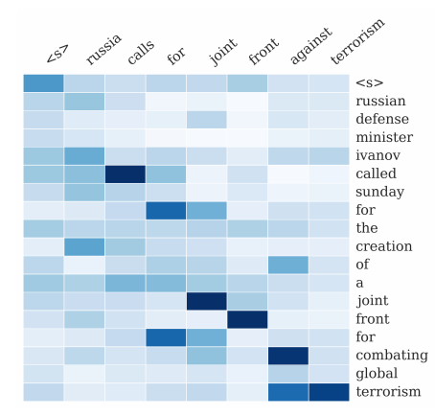
Summary
Attention significantly improves NMT performance
  It’s very useful to allow decoder to focus on certain parts of the source
Attention solves the bottleneck problem
  Attention allows decoder to look directly at source; bypass bottleneck
Attention helps with vanishing gradient problem
  Provides shortcut to faraway states
Attention provides some interpretability
  By inspecting attention distribution, we can see what the decoder was focusing on
  We get alignment for free!
  This is cool because we never explicitly trained an alignment system
  The network just learned alignment by itself

Slide 73
Sequence-to-sequence is everywhere!
Sequence-to-sequence is useful for more than just MT
Many NLP tasks can be phrased as sequence-to-sequence:
  Summarization (long text → short text)
  Dialogue (previous utterances → next utterance)
  Parsing (input text → output parse as sequence)
  Code generation (natural language → Python code)

Slide 74
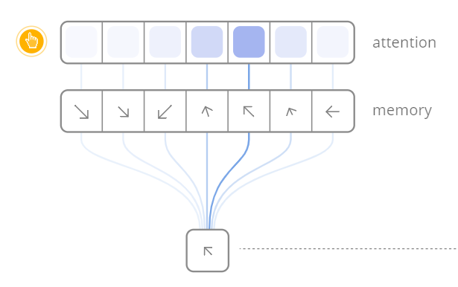
Attention is a general Deep Learning technique
More general definition of attention
  Given a set of vector values, and a vector query, attention is a technique to compute a weighted sum of the values, dependent on the query.
  We sometimes say that the query attends to the values
  For example, in the seq2seq + attention model, each decoder hidden state attends to the encoder hidden states
https://distill.pub/2016/augmented-rnns/

Slide 75
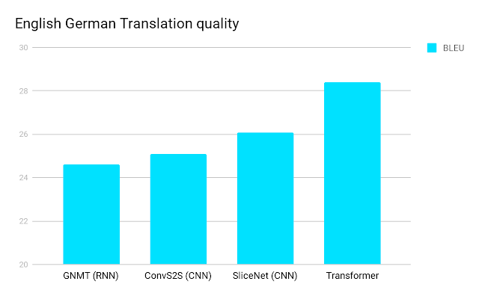
Attention is all you need?
– Transformer Networks
https://ai.googleblog.com/2017/08/transformer-novel-neural-network.html

Slide 76
Problems with RNNs = Motivation for Transformers
Recurrent models typically factor computation along the symbol positions of the input and output sequences
  Sequential computation prevents parallelization
  Critical at longer sequence lengths, as memory constraints limit batching across examples
Despite advanced RNNs like LSTMs, RNNs still need attention mechanism to deal with long range dependencies – path length for codependent computation between states grows with sequence
But if attention gives us access to any state… maybe we don’t need the RNN?

Slide 77
Transformer Overview
Sequence-to-sequence
Encoder-Decoder
Task: machine translation with parallel corpus
Predict each translated word
Final cost/error function is standard cross-entropy error on top of a softmax classifier
https://arxiv.org/pdf/1706.03762.pdf

Slide 78
Transformer Basics
Let’s define the basic building blocks of transformer networks first: new attention layers!

Slide 79
Dot-Product Attention (Extending our previous def.)
Inputs: a query q and a set of key-value (k-v) pairs to an output
  Query, keys, values, and output are all vectors
Output is weighted sum of values, where
  Weight of each value is computed by an inner product of query and corresponding key
  Queries and keys have same dimensionality

Slide 80
Dot-Product Attention – Matrix notation
When we have multiple queries q, we stack them in a matrix Q:
Becomes:

Slide 81
Scaled Dot-Product Attention
Problem: As $d_{k}$ gets large, the variance of $q^{T}k$ increases → some values inside the softmax get large → the softmax gets very peaked → hence its gradient gets smaller.
Solution: Scale by length of query/key vectors:

Slide 82
Self-attention and Multi-head attention
The input word vectors could be the queries, keys and values
  In other words: the word vectors themselves select each other
  Word vector stack = Q = K = V
Problem: Only one way for words to interact with one-another
Solution: Multi-head attention
  First map Q, K, V into h many lower dimensional spaces via W matrices
  Then apply attention, then concatenate outputs and pipe through linear layer

Slide 83
Self-Attention
(example and picture from David Talbot)

Slide 84
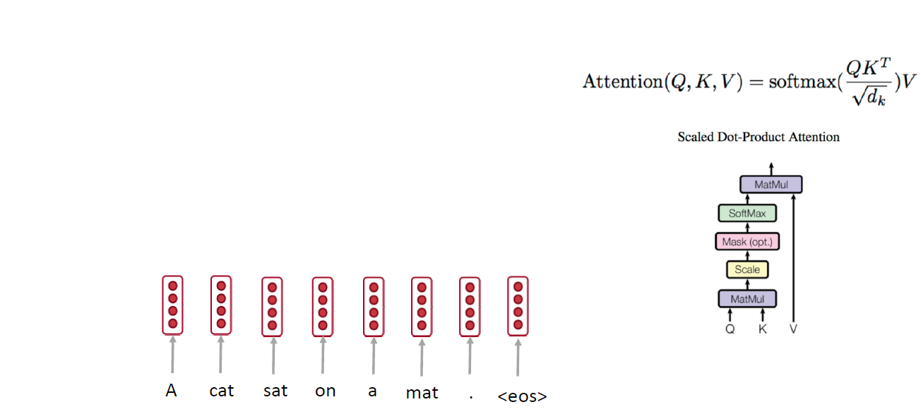
Self-attention: A Running Example

Slide 85
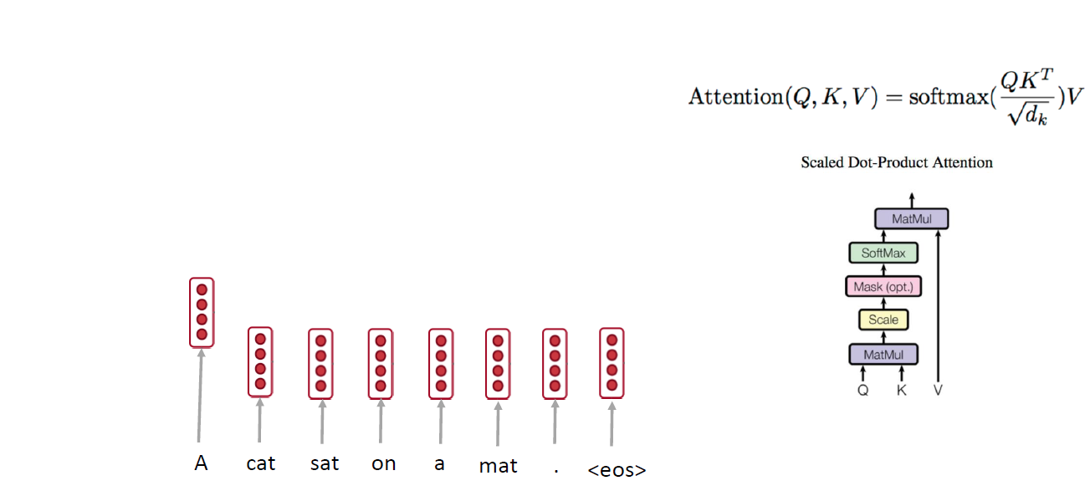
Self-attention: A Running Example

Slide 86
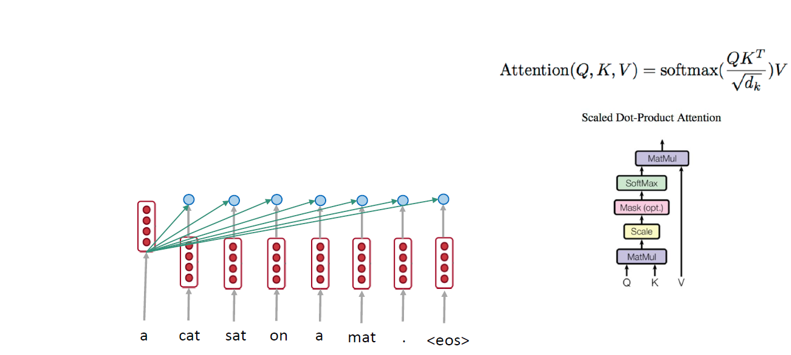
Self-attention: A Running Example

Slide 87
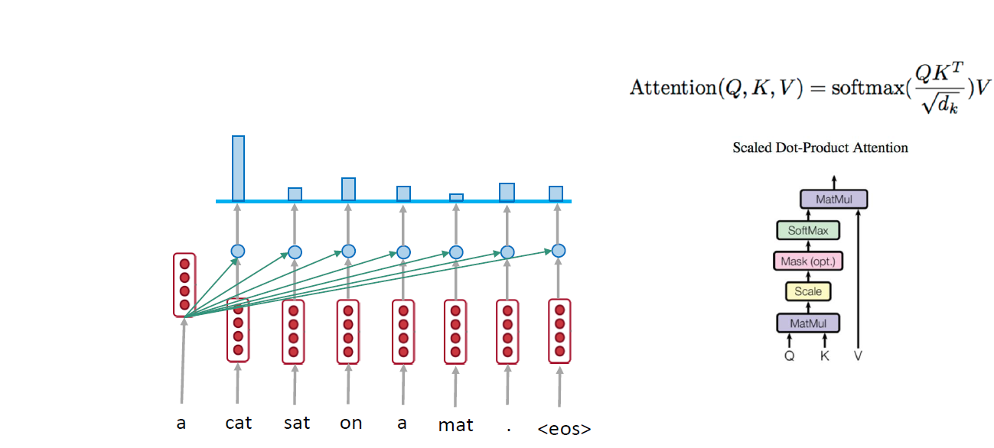
Self-attention: A Running Example

Slide 88
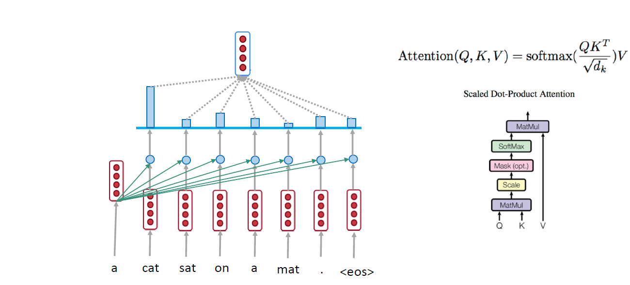
Self-attention: A Running Example

Slide 89
Self-attention: A Running Example

Slide 90
Self-attention: A Running Example

Slide 91
Self-attention: A Running Example

Slide 92
Self-attention: A Running Example

Slide 93
Self-attention: A Running Example

Slide 94
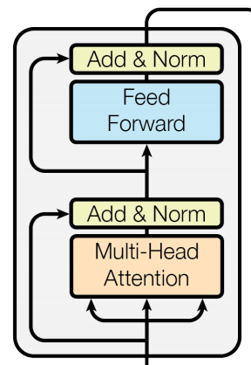
Complete transformer block
Each block has two “sublayers”
  1. Multihead attention
  2. 2 layer feed-forward Nnet (with relu)
Each of these two steps also has:
  Residual (short-circuit) connection and LayerNorm:
  LayerNorm(x + Sublayer(x))
    Layernorm changes input to have mean 0 and variance 1, per layer and per training point (and adds two more parameters)
Layer Normalization by Ba, Kiros and Hinton, https://arxiv.org/pdf/1607.06450.pdf

Slide 95
Blocks are repeated N=6 times

Slide 96
Encoder Input
Actual word representations are byte-pair encodings
  Rico Sennrich, Barry Haddow, and Alexandra Birch. Neural Machine Translation of Rare Words with Subword Units. ACL 2016.
Added is a positional encoding so same words at different locations have different overall representations:
pos is the position of a word
i is the dimension index

Slide 97
Self Attention Visualization in Layer 5
Words start to pay attention to other words in sensible ways

Slide 98
Transformer Decoder
2 sublayer changes in decoder
Masked decoder self-attention
  Only depends on previous words
Encoder-Decoder Attention
  Queries come from previous decoder layer and keys and values come from output of encoder

Slide 99
Advantages
No recurrence: parallel encoding
Fast training: both encoder and decoder are parallel
No long range problem: O(1) for all tokens direct connections
Three attentions: the model does not have to remember too much
Multi-head attention allows to pay attention to different aspects
Why self-attention and CNN is better than RNN on NMT is still under investigation
A comparison of RNN, CNN, and self-attention
http://aclweb.org/anthology/D18-1458

Slide 100

Transformer Networks Visualization
https://ai.googleblog.com/2017/08/transformer-novel-neural-network.html

Slide 101
Google’s BERT
Training of BERT-BASE was performed on 4 Cloud TPUs in Pod configuration (16 TPU chips total).
Training of BERT-LARGE was performed on 16 Cloud TPUs (64 TPU chips total).
Each pre-training took 4 days to complete.
https://ai.googleblog.com/2018/11/open-sourcing-bert-state-of-art-pre.html
https://arxiv.org/pdf/1810.04805.pdf

Slide 102
Grammar as a Foreign Language
Vinyals et al., 2015

Slide 103
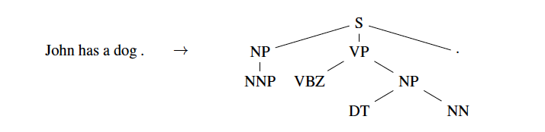
Grammar as a Foreign Language
Parsing tree

Slide 104
Grammar as a Foreign Language
Parsing tree

Slide 105
Grammar as a Foreign Language
Parsing tree

Slide 106
Grammar as a Foreign Language
Parsing tree

Slide 107
Grammar as a Foreign Language
Parsing tree
John has a dog .

Slide 108
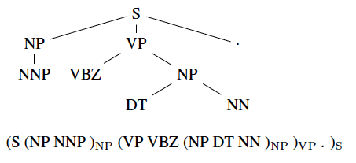
Grammar as a Foreign Language
Converting tree to sequence

Slide 109
Grammar as a Foreign Language
Converting tree to sequence

Slide 110
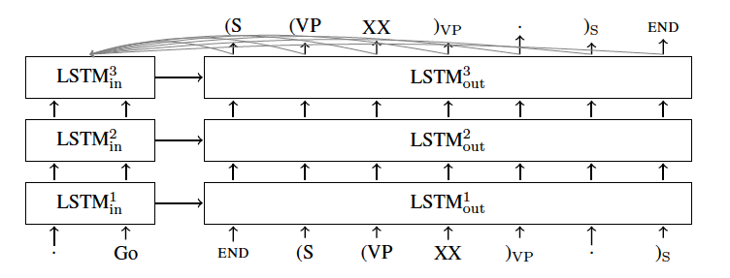
Grammar as a Foreign Language
Model

Slide 111
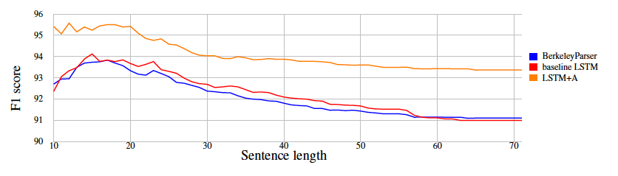
Grammar as a Foreign Language
Results

