Slide 1
End-to-End Memory Networks for Question Answering
Zheye Deng
BSc, CSE

Slide 2
Outline
Background of QA and Memory Networks
Discussion about several kinds of End-to-end Memory Networks
My implementation & Experiments
Future work

Slide 3
Question Answering
Machine translation What is the translation into French?
Named entity recognition What are the named entity tags in this sentences?
POS tagging What are the POS tags?
Sentiment analysis What is the sentiment?
Coreference resolution Who does “their” refer to?
A. Kumar et al. 2016

Slide 4
Question Answering
I: Jane went to the hallway.
I: Mary walked to the bathroom.
I: Sandra went to the garden.
I: Daniel went back to the garden.
I: Sandra took the milk there.
Q: Where is the milk?
A: garden
I: It started boring, but then it got interesting.
Q: What’s the sentiment?
A: positive
Q: POS tags?
A: PRP VBD JJ , CC RB PRP VBD JJ .
A. Kumar et al. 2016

Slide 5
General Format

Slide 6
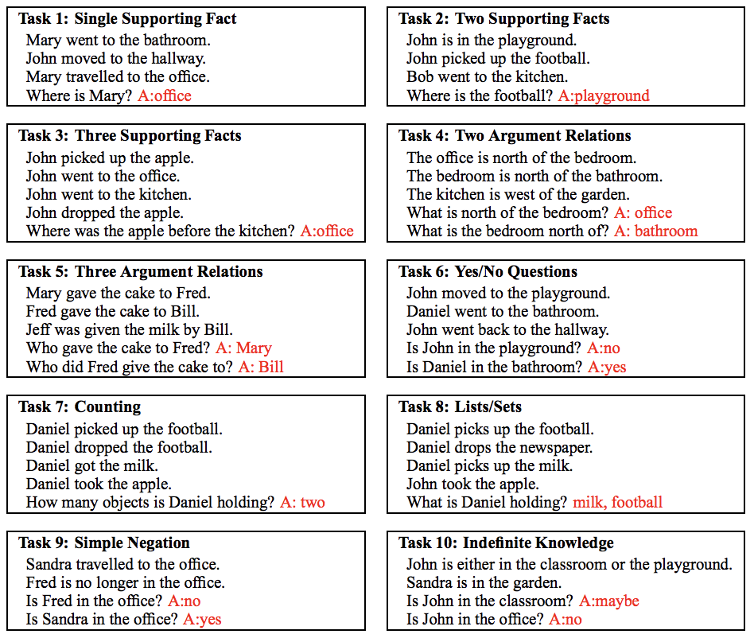
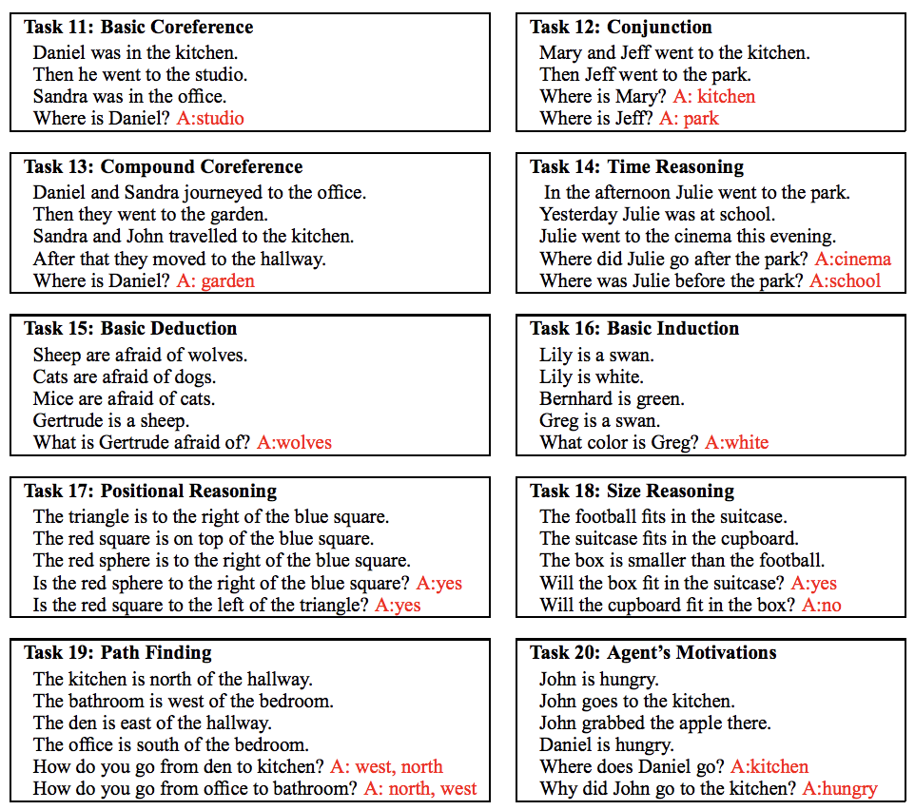
Facebook bAbI dataset
Consists of memory, query, answer and supporting facts that leads to the answer.
A synthetic dataset for testing a model’s ability to retrieve facts and reason over them.
Each task tests a different skill that a question answering model ought to have.
It may be a little toyish, because showing an ability exists here is not sufficient to conclude a model would also exhibit it on real world text data.
However, it is a necessary condition.
J. Weston et al, 2015

Slide 7
Facebook bAbI dataset

Slide 8
Memory Networks
A memory network consists of a memory m and four components I, G, O and R as follows:
Input feature map : input => feature
Generalization: update memories
Output feature map: produce a output given the new input and the current memory state
Response: output => answer
J. Weston et al, 2014

Slide 9
Outline
Background of QA and Memory Networks
Discussion about several kinds of End-to-end Memory Networks
My implementation & Experiments
Future work

Slide 10
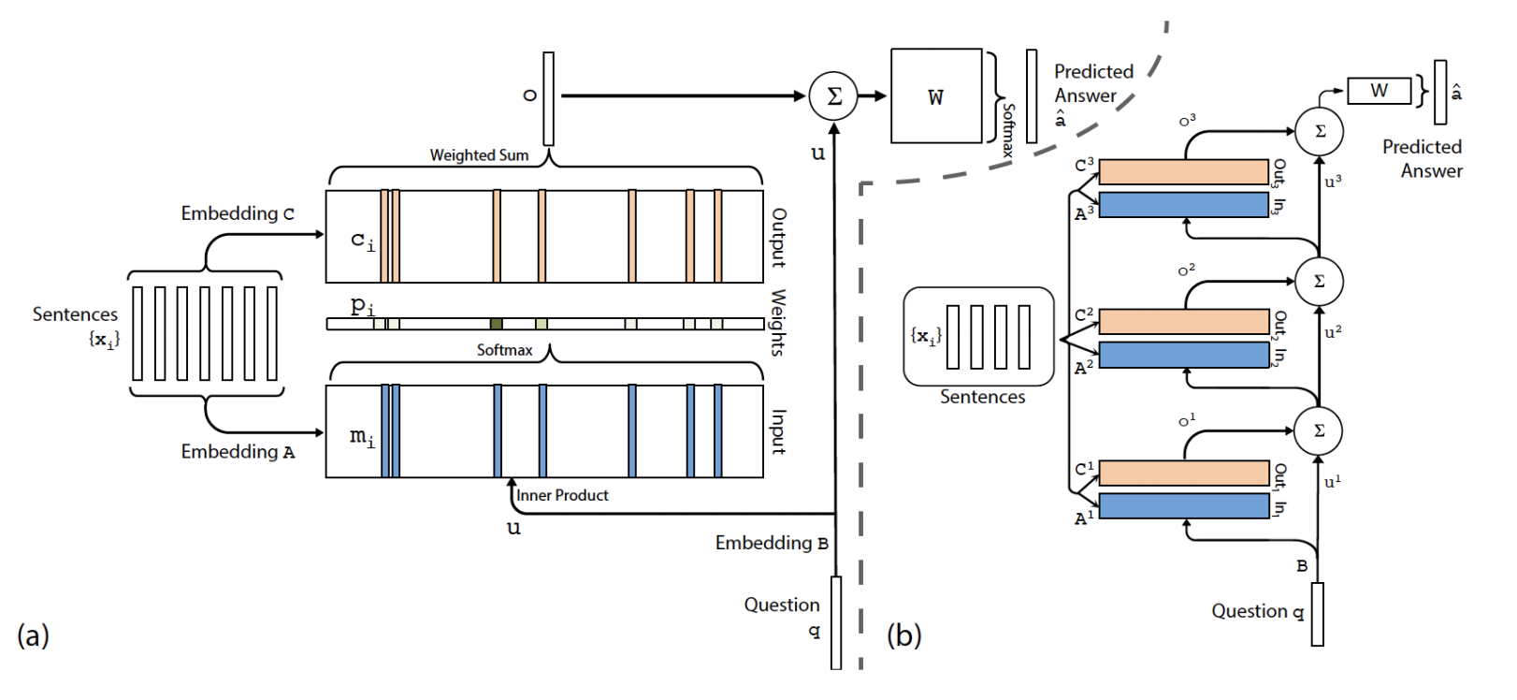
End-To-End Memory Networks
S. Sukhbaatar et al, 2015

Slide 11
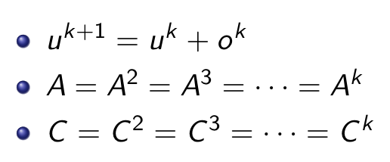
End-To-End Memory Networks
S. Sukhbaatar et al, 2015

Slide 12
Dynamic Memory Networks
A. Kumar et al, 2016

Slide 13
Dynamic Memory Networks
Encode the input and query via a GRU
A. Kumar et al, 2016

Slide 14
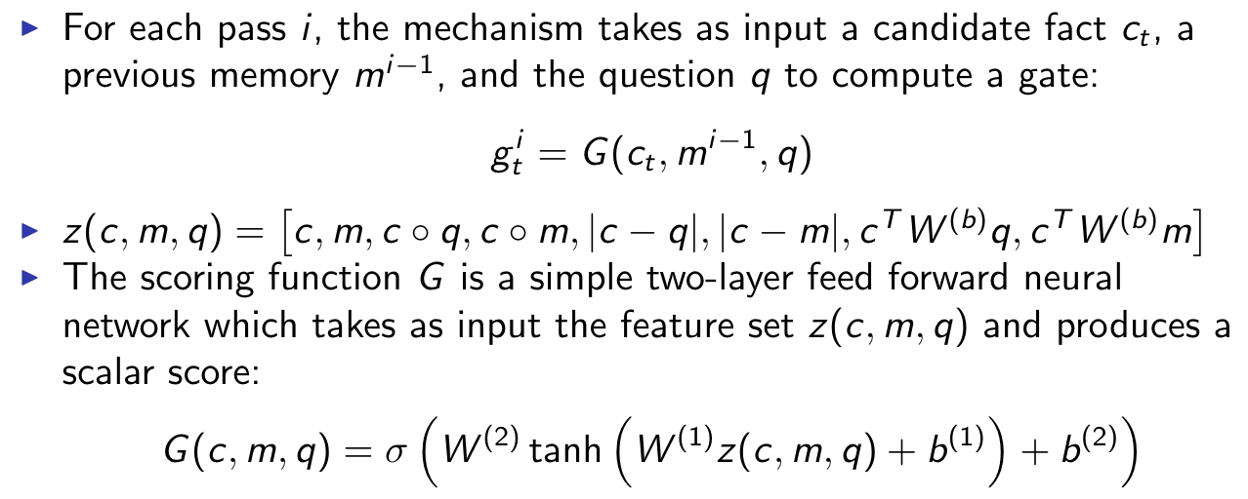
Dynamic Memory Networks
A. Kumar et al, 2016

Slide 15
Dynamic Memory Networks
A. Kumar et al, 2016

Slide 16
Dynamic Memory Networks
A. Kumar et al, 2016

Slide 17
Comparison
 | Sentence Encoding | Computing Attention | Attenion Mechanism | Updating Memory | Memory Weights | Answer Module
E2E MN/ Gated E2E MN | BoW/Positional Encoder + Weighted Sum | Linear Regression | Soft Attention | Concatena- tion | Tied | Softmax
DMN | GRU | Gating Function | GRU | GRU | Tied | Softmax + GRU

Slide 18
Two main problems of DMN
The GRU only allows sentences to have context from sentences before them, but not after them. This prevents information propagation from future sentences.
The supporting sentences may be too far away from each other on a word level to allow for these distant sentences to interact through the word level GRU.

Slide 19
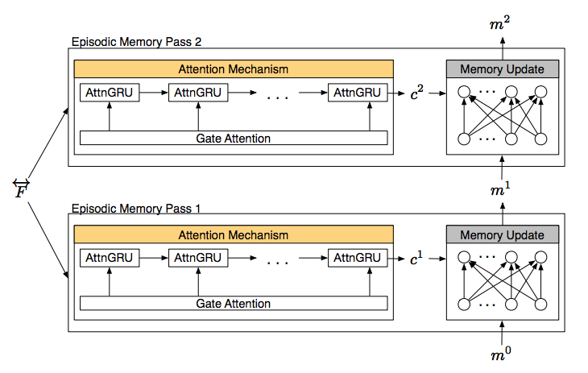
Dynamic Memory Networks Plus
Episodic memory module
Input Module
C. Xiong et al, 2016

Slide 20
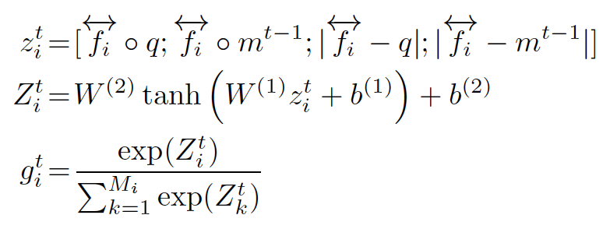
Dynamic Memory Networks Plus
Attention based GRU
Computing attention
C. Xiong et al, 2016

Slide 21
Dynamic Memory Networks Plus
GRU => Fusion -7.9%
Soft Attn => AttnGRU -0.6%
GRU => ReLU -0.5%
C. Xiong et al, 2016

Slide 22
Comparison
 | Sentence Encoding | Computing Attention | Attenion Mechanism | Updating Memory | Memory Weights | Answer Module
E2E MN/ Gated E2E MN | BoW/Positional Encoder + Weighted Sum | Linear Regression | Soft Attention | Concatena- tion | Tied | Softmax
DMN | GRU | Gating Function | GRU | GRU | Tied | Softmax + GRU
DMN+ | Positional Encoder + Bi-GRU | Gating Function + Softmax | Attention based GRU | ReLU | Untied | Softmax + GRU

Slide 23
Outline
Background of QA and Memory Networks
Discussion about several kinds of End-to-end Memory Networks
My implementation & Experiments
Future work

Slide 24
Training Environment
Hardware Environment
Intel(R) Core(TM) i3-4160 CPU @ 3.60GHz
GeForce GTX 960
Hyper parameters
Optimizer: Adam
Batch size: 128
Learning rate: 0.002
L2 regularization: 0.001
Dimension of embedding: 64
Initialization with range: [-2, 2]
Dropout rate: 0.9

Slide 25
Strongly supervised model

Slide 26
Weakly supervised model

Slide 27
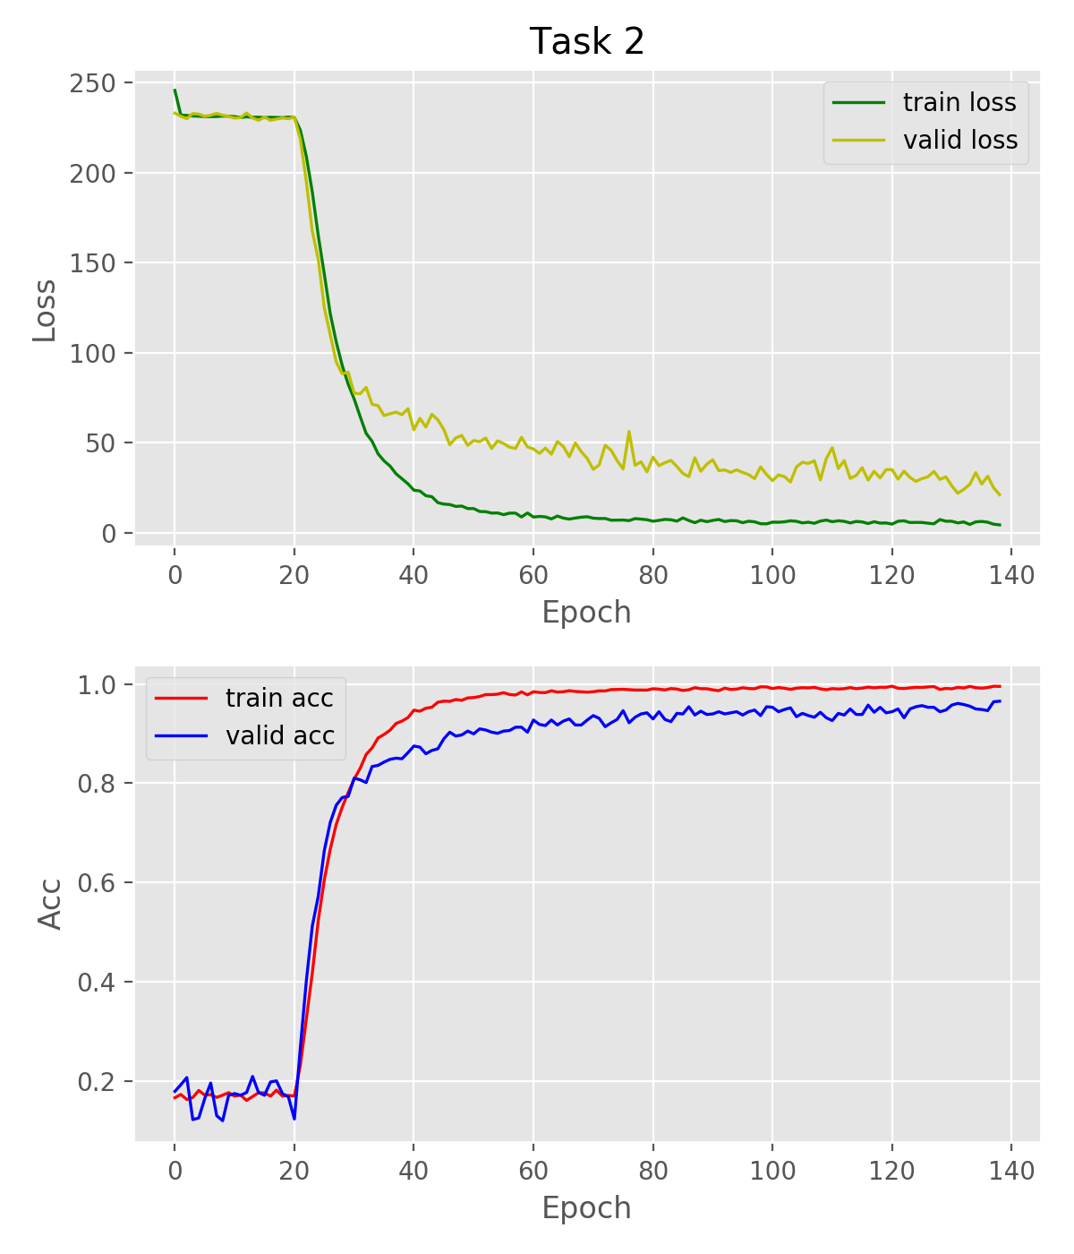
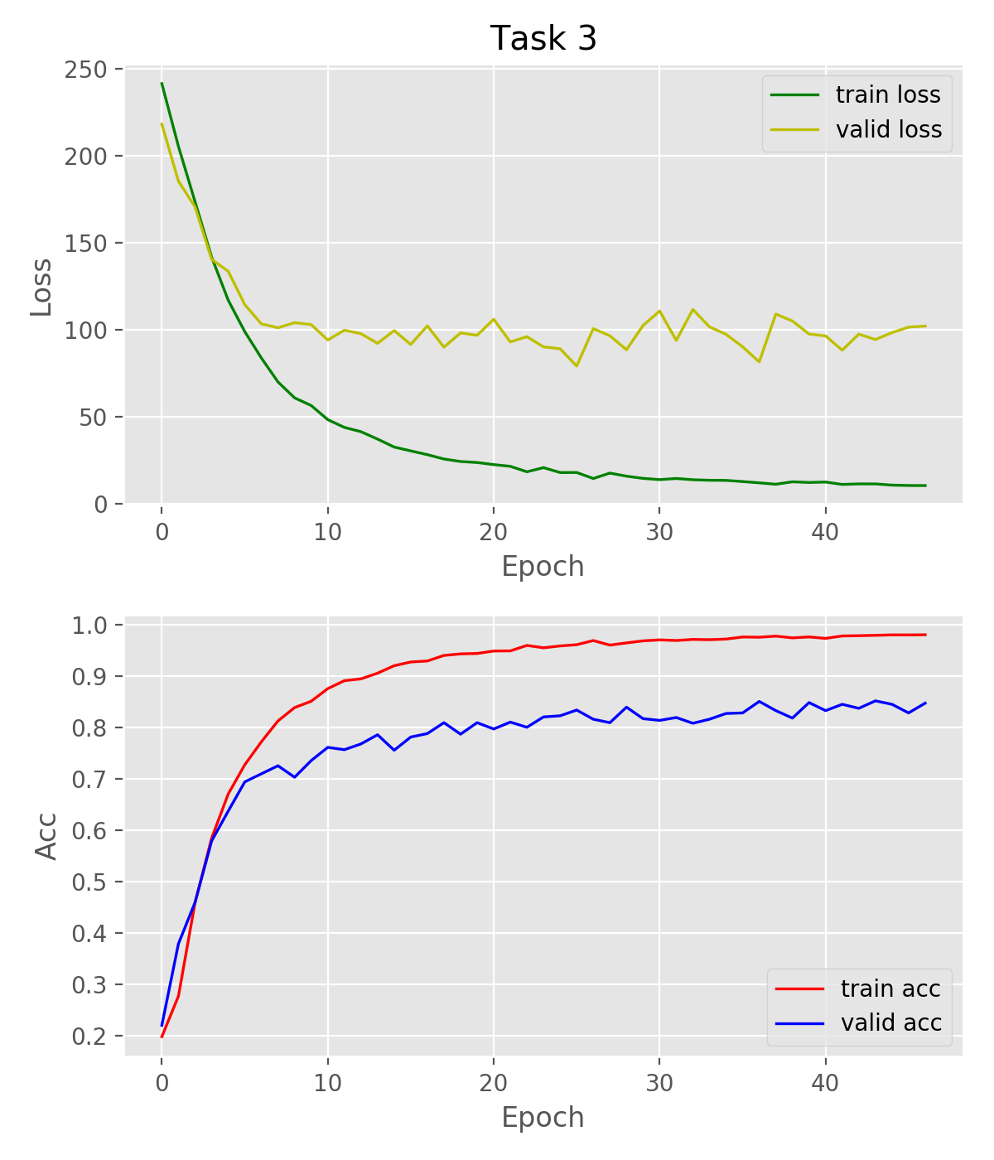
Task 1,2,3 supporting fact(s)

Slide 28
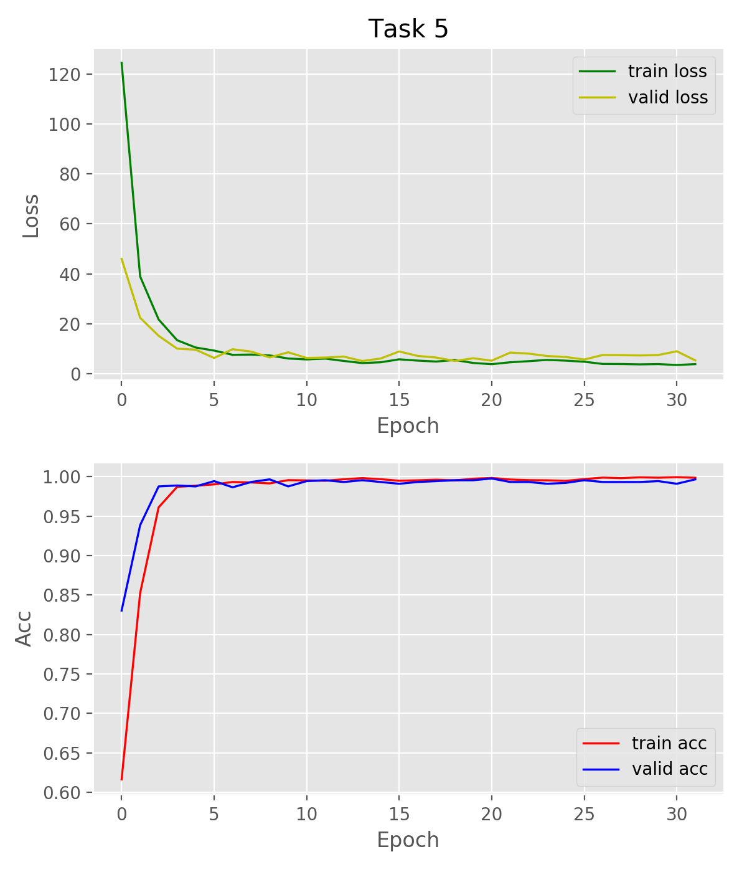
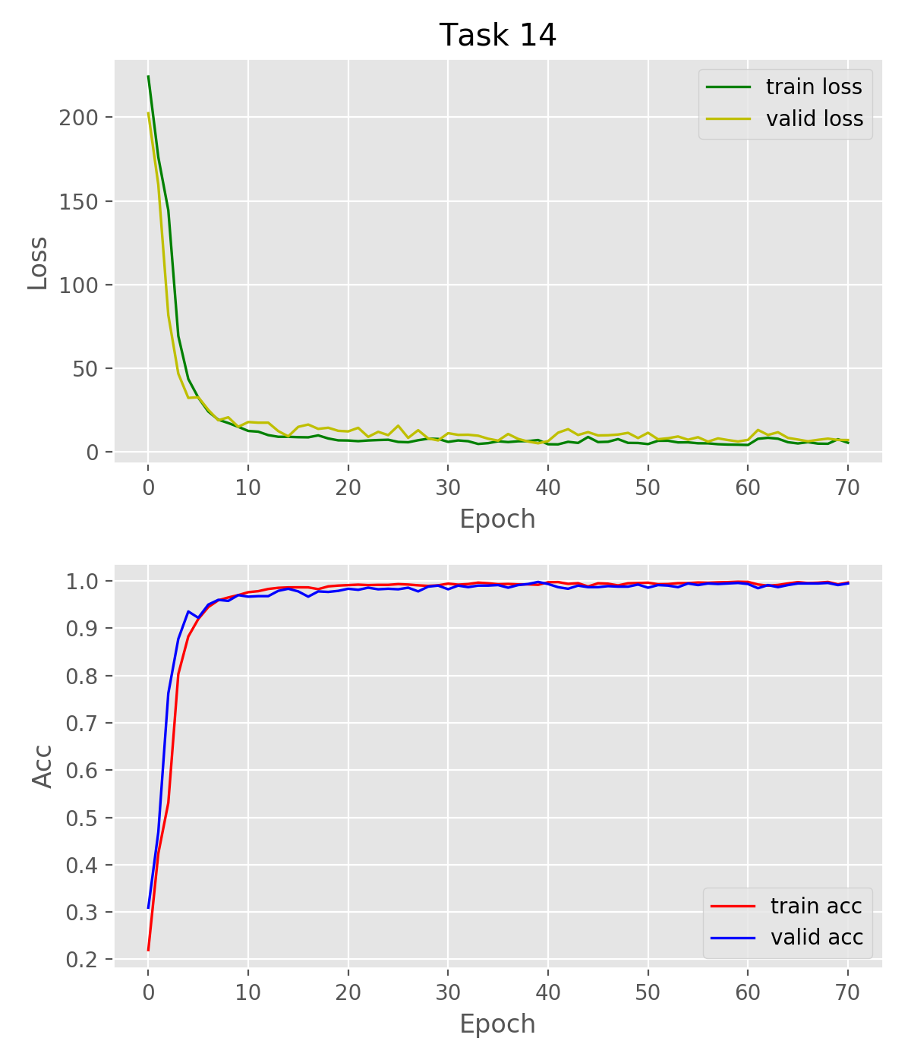
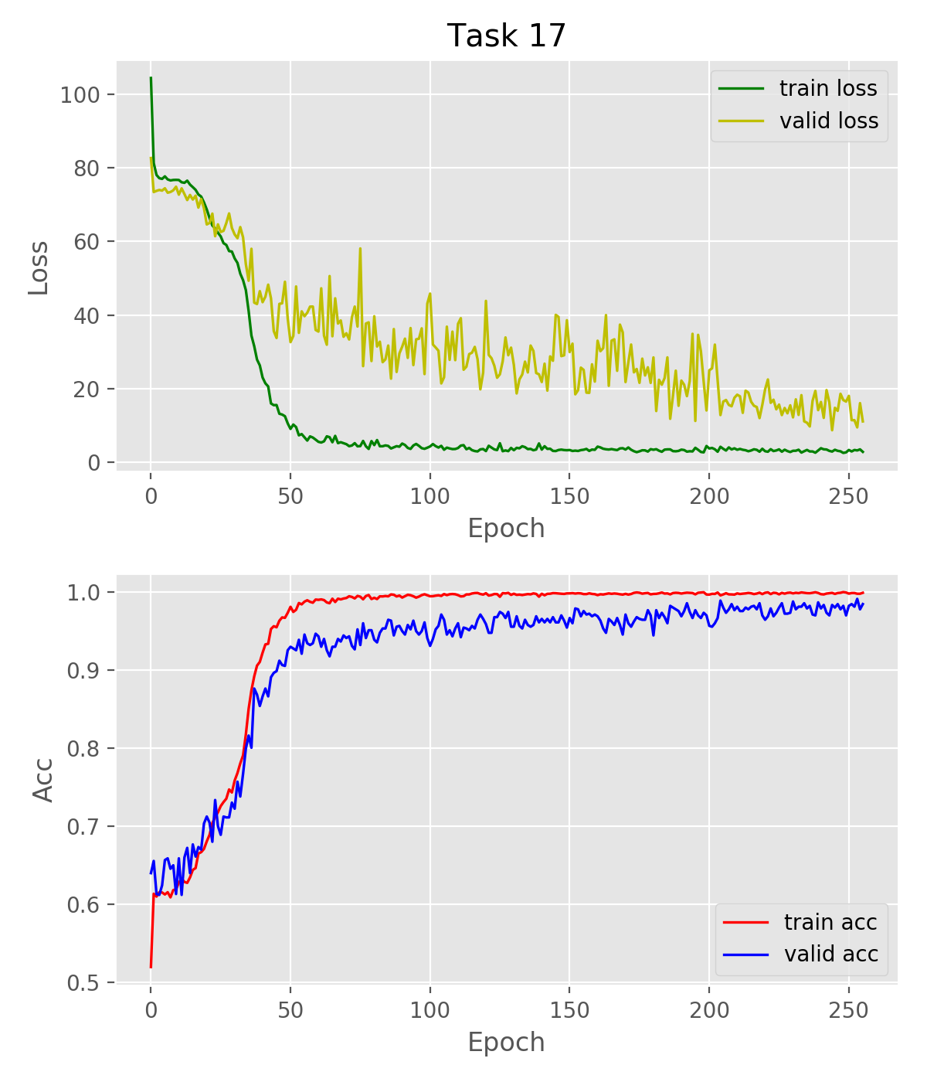
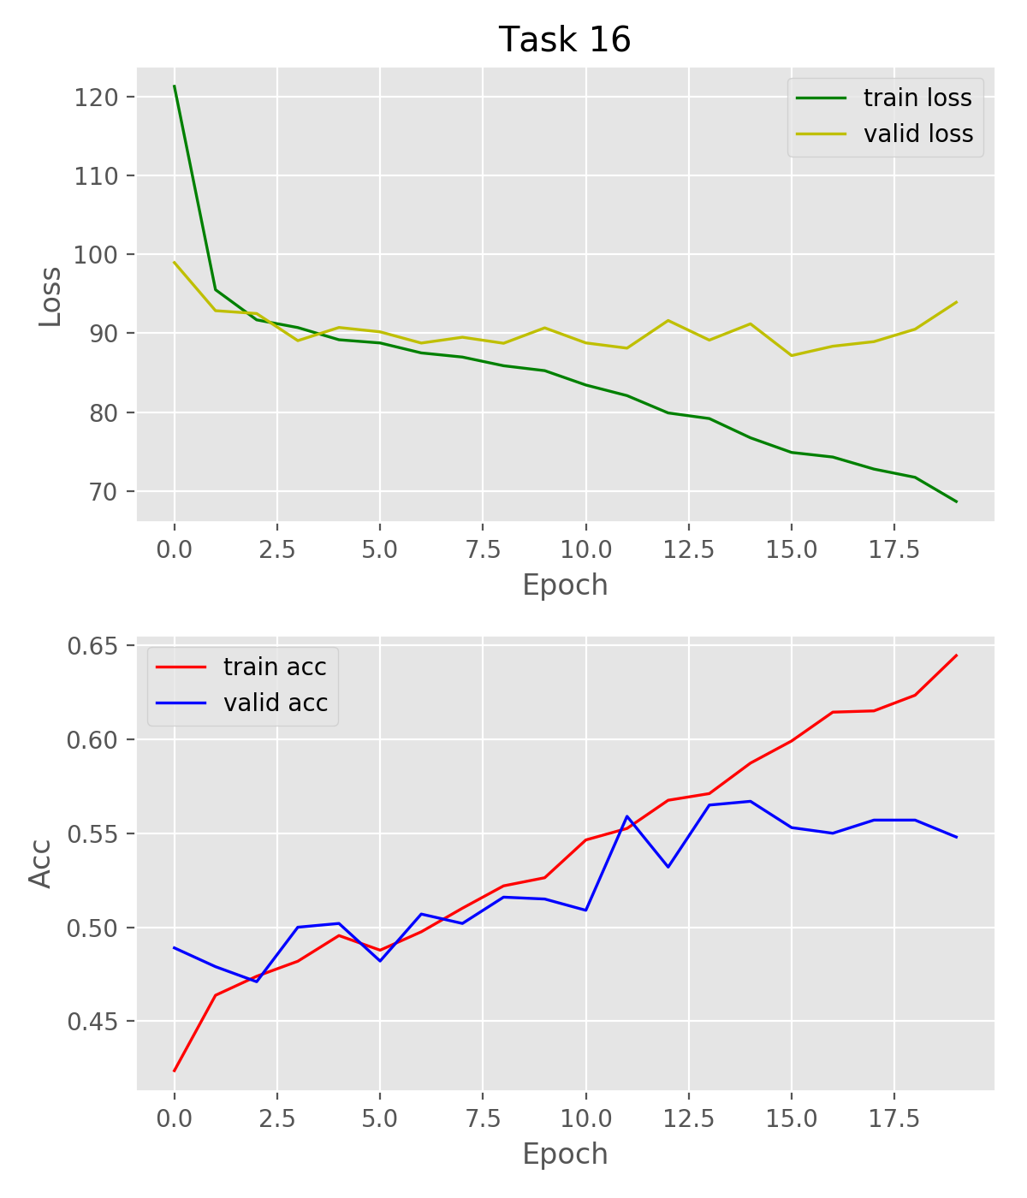
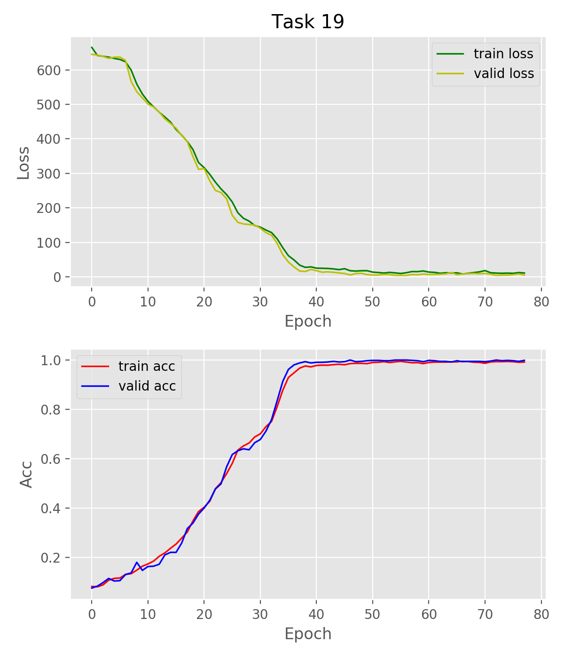
Tasks where I got better accuracy

Slide 29
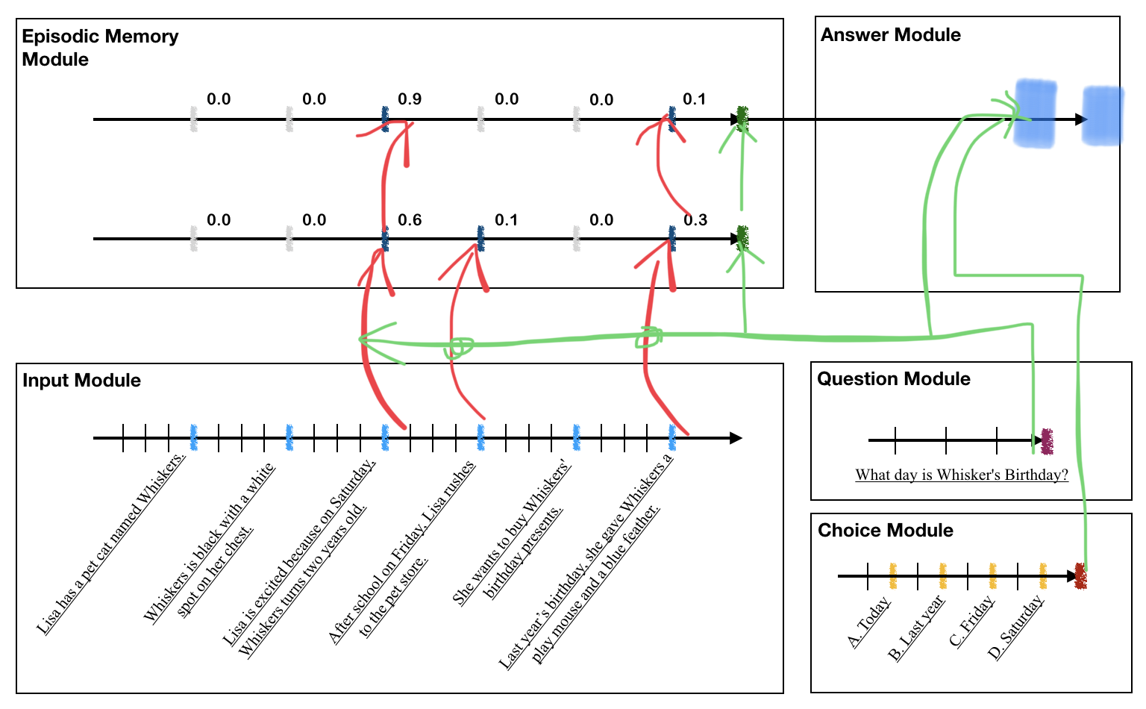
Microsoft MCTest dataset
Context
Question
4 Choices.

Slide 30
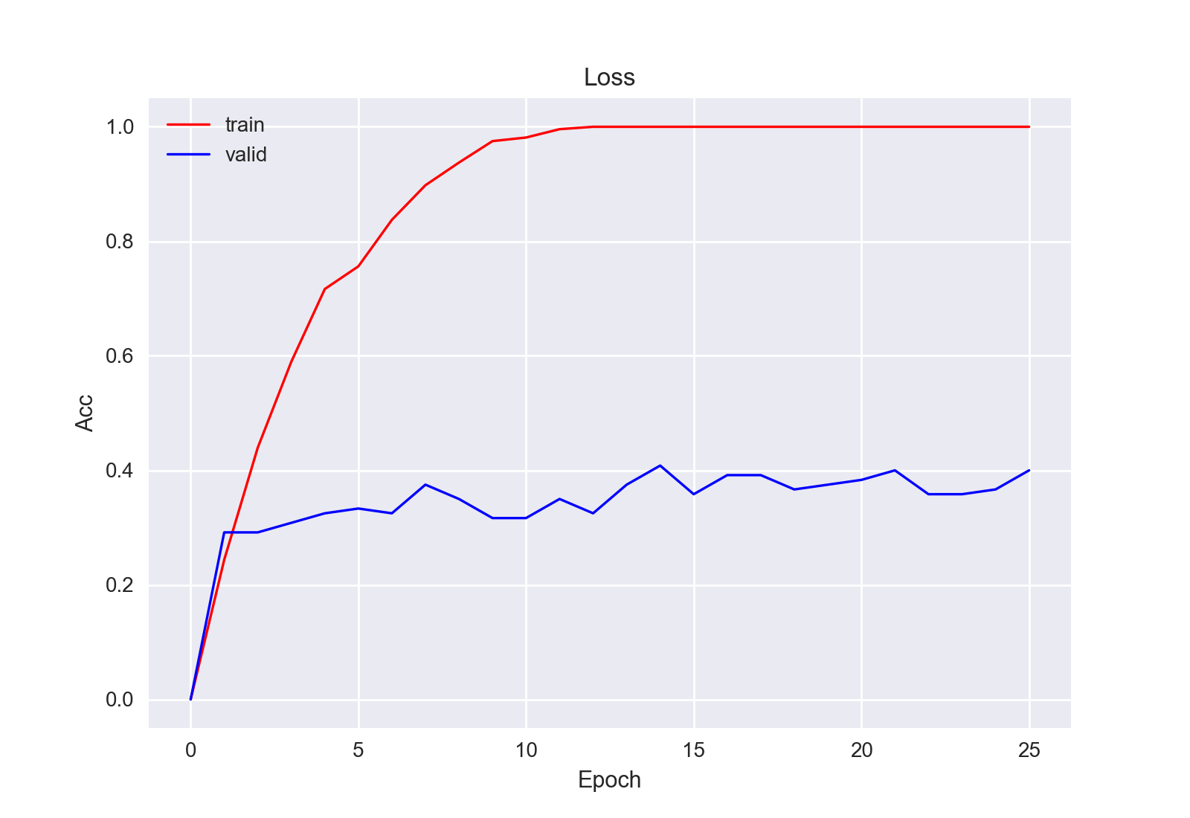
Microsoft MCTest
 | Accuracy
Baseline(Sliding window) | 66.2%
DMN(Qian L. et al) | 37.3%
DMN+(My implementation) | 39.2%

Slide 31
Outline
Background of QA and Memory Networks
Discussion about several kinds of End-to-end Memory Networks
My implementation & Experiments
Future work

Slide 32
Future work
Use GloVe Pre-trained word vectors to train the model.
Improve the sentence reader to solve the problem of long input sequences.
Explore the application of DMN+ on some NLP tasks like Sentiment Analysis, POS Tagging, etc.

Slide 33
Q&A

