Slide 1
A Survey on seq2seq models for neural machine translation
Presented by: YU Xinyuan
01

Slide 2
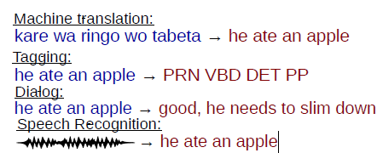
/ Introduction
Seq2seq models refers to all models that take in a sequence as input and output another.
The motivation for using machine translation as a representative is
Machine translation is a widely-recognized and useful instance of seq2seq models
Machine translation is often one of the main driving tasks behind the development of new models.
text
Sept2013
02

Slide 3
/ Encoder-Decoder
In general, seq2seq models in neural machine translation (NMT) follow an encoder-decoder architecture.
The encoder would first transform the whole input sentence into a sequence of representations.
$$c= f^{enc}(x_{1:\left|F\right|}^{})$$
Then decoder predicts the distribution of each target word conditioned on context c one at a time.
$$p\left(y_{1:\left|E\right|}^{}\right)=\prod_{t=1}^{\left|E\right|}{p\left(y_{t} | {\{y}_{1}, …,y_{t−1}\}, c\right)}$$
Generally, the model parameters $θ$ is trained to maximize the log likelihood on a parallel training set consisting of $N$ sentence pairs.
$$J\left(θ\right)= \sum_{n=1}^{N}{\sum_{t=1}^{\left|E\right|}{\log{p\left(y_{t}^{(n)} | y_{<t}^{\left(n\right)},f^{enc}\left(x_{1:\left|F\right|}^{(n)}\right);θ\right)}}}$$
03

Slide 4
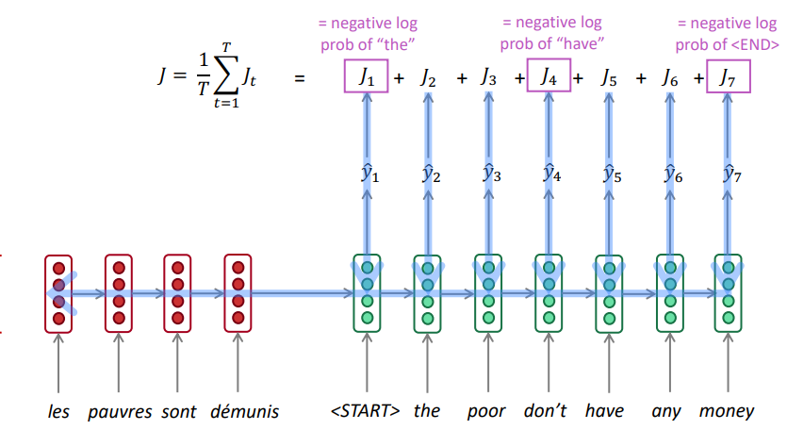
/ Encoder-Decoder
04

Slide 5
/ Encoder-Decoder
/ Encoder-Decoder
The most intuitive way of building encoders and decoders would be using two recurrent neural network
$$h_{t}=f(h_{t−1},x_{t})$$
Where $f$ is a non-linear function, which can be as complex as a GRU or LSTM unit.
GRU
LSTM
05

Slide 6
/ Encoder-Decoder
/ Encoder-Decoder
Sutskever et al. (2014), Cho et al. (2014a)
In both paper, the source sentence was mapped to a fixed size of vector using one RNN
$$c=f^{enc}\left(x_{1:\left|F\right|}\right)={f(h}_{t})$$
Cho et al. (2014a) used GRU for encoding and decoding, and the decoder generates the distribution of next word $y_{t}$ conditioned on both $y_{t−1}$ and $c$.
$$p\left(y_{t} | y_{<t},c\right)=g(s_{t},y_{t−1},c)$$
Where the hidden state $s_{t}$ is computed as.
$$s_{t}=f(s_{t−1},y_{t−1}, c)$$
Performance drop for long input sentence.
06

Slide 7
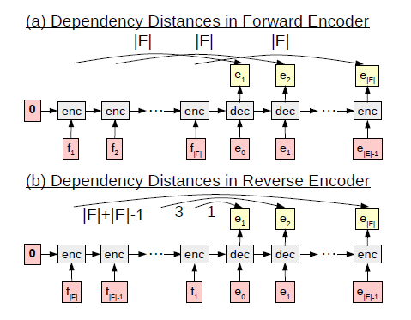
/ Encoder-Decoder
/ Encoder-Decoder
Sutskever et al. (2014), Cho et al. (2014a)
Sutskever et al. (2014) used a 4-layer LSTM
In their work, the encoded representation $c$ was not involved in computing the decoder states and outputs
Also they found an important trick: by reversing the order for input sentences, the BLEU score increased by 5 points.
07

Slide 8
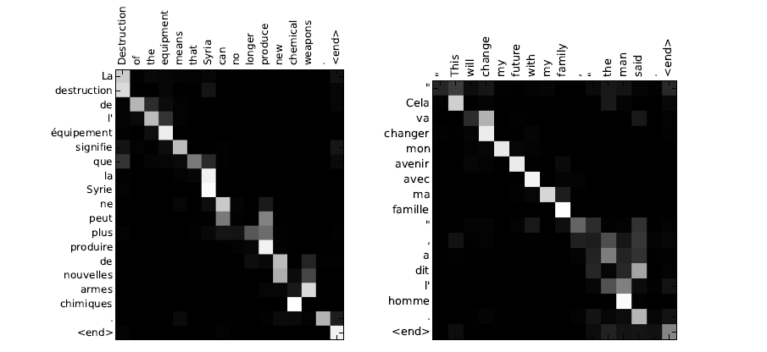
/ Encoder-Decoder with Attention Mechanism
/ Encoder-Decoder
Encoding source sentences into fixed-size vectors could be a bottleneck in improving models’ performance.
Problems with fixed-size vectors:
Hard for the models to learn long-distance dependencies
Hard to pick an appropriate size for all possible input length
08

Slide 9
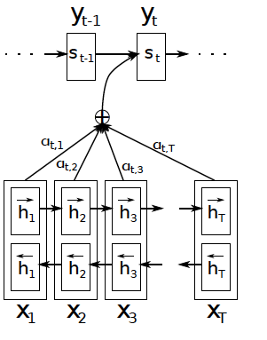
/ Encoder-Decoder with Attention Mechanism
/ Encoder-Decoder
Bahdanau et al. (2014)
Adopted a bi-directional RNN with GRU as encoder
The encoded representation became $f^{enc}\left(x_{1:\left|F\right|}\right)=concat_col(h_{1},…,h_{\left|F\right|})$,
where $h_{j}=[\overset{⃖}{h_{j}};\vec{h_{j}}]$, and $\overset{⃖}{h_{j}}=\overset{⃖}{RNN}({\overset{⃖}{h}}_{j+1}, x_{j})$, $\vec{h_{j}}=\vec{RNN}({\vec{h}}_{j−1},x_{j})$
Calculated a context vector $c_{t}$ at each time step as a weighted sum of encoded representation
$$c_{t}=H∗α_{t}$$
Where $α_{tj}=\frac{exp⁡(score\left(s_{t−1},h_{j}\right))}{\sum_{k}{exp⁡(score(s_{t−1},h_{k}}))}$ and $H=f^{enc}\left(x_{1:\left|F\right|}\right)$
Finally, the output distribution was computed based on $c_{t}$
$$p\left(y_{t} | y_{<t},H\right)=g(s_{t},y_{t−1},c_{t})$$
And $s_{t}=f(s_{t−1},y_{t−1},c_{t})$ is the hidden state of RNN.
$$c_{t}$$
09

Slide 10
/ Encoder-Decoder with Attention Mechanism
/ Encoder-Decoder
Bahdanau et al. (2014)
$$α_{tj}=\frac{exp⁡(score\left(s_{t−1},h_{j}\right))}{\sum_{k}{exp⁡(score(s_{t−1},h_{k}}))}$$
The $score$ function was used to calculate the attention score
Bahdanau et al. used a one layer feed forward neural network to calculate the score:
$$score\left(s_{t−1}, h_{j}\right)=υ^{T}\tanh\left(W\left[s_{t−1};h_{j}\right]\right)∈ ℝ$$
It tells the model how much to pay attention to each input word
10

Slide 11
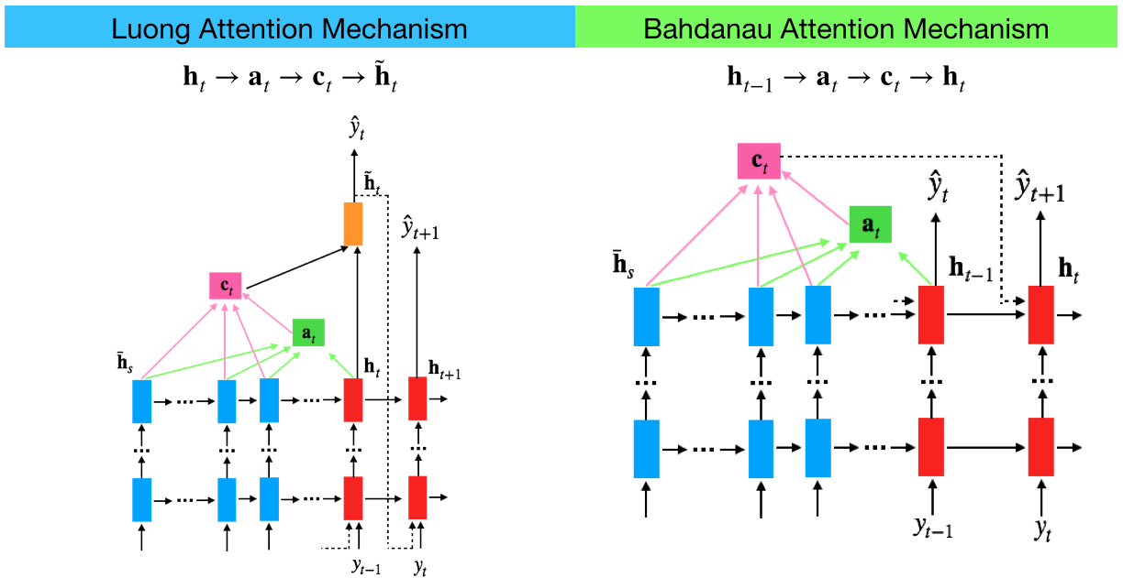
/ Encoder-Decoder with Attention Mechanism
/ Encoder-Decoder
Luong et al. (2015)
Two types of attention: global attention vs local attention
Different ways of calculating the attention score
The global attention model essentially resembled the model of Bahdanau et al. (2014)
Dotted line: concatenated ${\tilde{h}}_{t}$ with input at next time step to make the model aware of previous alignment choice
11

Slide 12
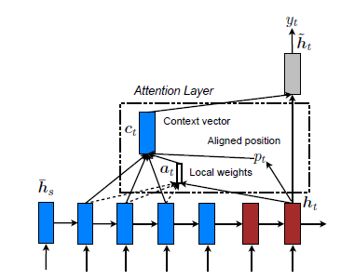
/ Encoder-Decoder with Attention Mechanism
/ Encoder-Decoder
Luong et al. (2015)
$c_{t}$ was derived from source states within $\left[p_{t}−D, p_{t}+D\right]$
Two ways of determine $p_{t}$:
Monotonic alignment (local-m) $p_{t}=t$
Predictive alignment (local-p) $p_{t}=\left|F\right|⋅sigmoid(υ_{p}^{T}\tanh\left(W_{p}h_{t}\right))$
Two types of attention: global attention vs local attention
Different ways of calculating the attention score
Instead of attending all source representations, the local attention model focused only on part of the source representations every time.
12

Slide 13
/ Encoder-Decoder with Attention Mechanism
/ Encoder-Decoder
Luong et al. (2015)
Two types of attention: global attention vs local attention
Different ways of calculating the attention score
dot works well for the global attention and general is better for the local attention.
Bahdanau et al. (2014)
13

Slide 14
/ Encoder-Decoder with Attention Mechanism
/ Encoder-Decoder
Gehring et al. (2017)
Recurrent neural network is computationally inefficient as it cannot be parallelized during training
RNN is not good at establishing long term dependency ( it takes O(n) steps )
Gehring et al. used multi-layer convolutional neural network to encode input sentences as well as generate target sentences (ConvS2S).
Each convolution layer was parameterized as $W∈ℝ^{2d×kd}$, $b_{W}∈ℝ^{2d}$, where $k$ was the kernel width and $d$ was the embedding size
The input would be $X∈ℝ^{kd}$, which was either the input to the encoder(decoder) or output from previous convolution layer
The output of convolution would be $Y=W∗X+b$ and $Y=\left[A;B\right]∈ℝ^{2d}$
Used a gated linear units (GLU) as non-linearity
$υ\left(\left[A;B\right]\right)=A⨂σ(B)$, where $A,B∈ℝ^{d}$, $⨂$ is point-wise multiplication.
Equipped the model with a sense of ordering by embedding the absolute position to both the input and output embeddings
$e=(x_{1}+p_{1}, …,x_{\left|F\right|}+p_{\left|F\right|})$ and $g=(y_{1}+p_{1}, …,y_{\left|E\right|}+p_{\left|E\right|})$
14

Slide 15
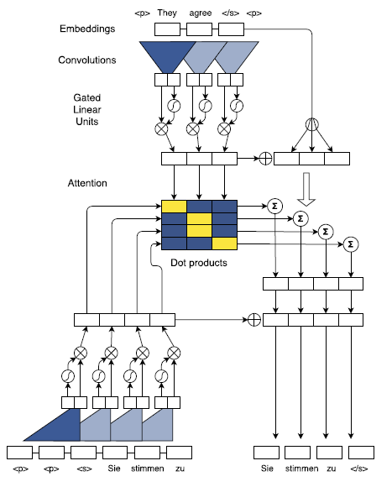
/ Encoder-Decoder with Attention Mechanism
/ Encoder-Decoder
Gehring et al. (2017)
Multi-step attention
Global attention for each decoder layer
For layer $l$, combined decoder state $h_{t}^{l}$ and previous target element $g_{t}$, similar to RNN
$$d_{t}^{l}=W_{d}^{l}h_{t}^{l}+b_{d}^{l}+g_{t}$$
Attention was then computed between $d_{i}^{l}$ and the last encoder block $z^{u}$:
$$α_{tj}^{l}=\frac{exp⁡(d_{t}^{l}⋅z_{j}^{u})}{\sum_{k}{exp⁡(d_{t}^{l}⋅z_{k}^{u})}}$$
The context $c_{t}^{l}$ is slightly different:
$$c_{t}^{l}=\sum_{j}{α_{tj}^{l}}(z_{j}^{u}+e_{j})$$
Once $c_{t}^{l}$ has been computed, it is simply added to the output of the corresponding decoder layer $h_{t}^{l}$.
15

Slide 16
/ Encoder-Decoder with Attention Mechanism
/ Encoder-Decoder
16

Slide 17
/ Encoder-Decoder with Attention Mechanism
/ Encoder-Decoder
Vaswani et al. (2017)
The Transformer, based solely on attention mechanisms, dispensing with RNN and CNN entirely
Building blocks: a general view of attention.
Input: a query $q$ and a set of key-value pairs $K$ and $V$. (query, key and value are all vectors)
Output: weighted sum of values, where weights are computed by a compatibility function of query and corresponding keys.
Scaled dot-product attention
$Attention\left(Q,K,V\right)=softmax\left(\frac{QK^{T}}{\sqrt{d_{k}}}\right)V$
Multi-head attention
Linearly project the queries, keys and values h times with different linear projections.
The results are then concatenated and projected to get the final result.
$$MultiHead\left(Q,K,V\right)=concat\left({head}_{1},…,{head}_{h}\right)W^{O}$$
Where ${head}_{i}=Attention(QW_{i}^{Q},KW_{i}^{K},VW_{i}^{V})$
17

Slide 18
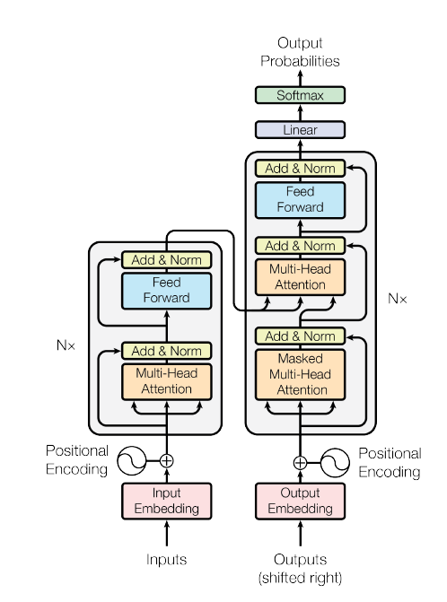
/ Encoder-Decoder with Attention Mechanism
/ Encoder-Decoder
Vaswani et al. (2017)
The encoder and decoder are composed of a stack of N=6 identical layers
Largely rely on self-attention mechanism (CNN)
$$SelfAttention\left(X\right)=Attention(X,X,X)$$
Position-wise FFN, which is applied to each position separately and identically (GLU)
$$FFN\left(x\right)=RELU\left(xW_{1}+b_{1}\right)W_{2}+b_{2}$$
Unique decoder sublayer: global attention (Multi-step attention)
Residual (short-circuit) connection and $LayerNorm: LayerNorm(x + Sublayer(x))$
Positional encoding
18

Slide 19
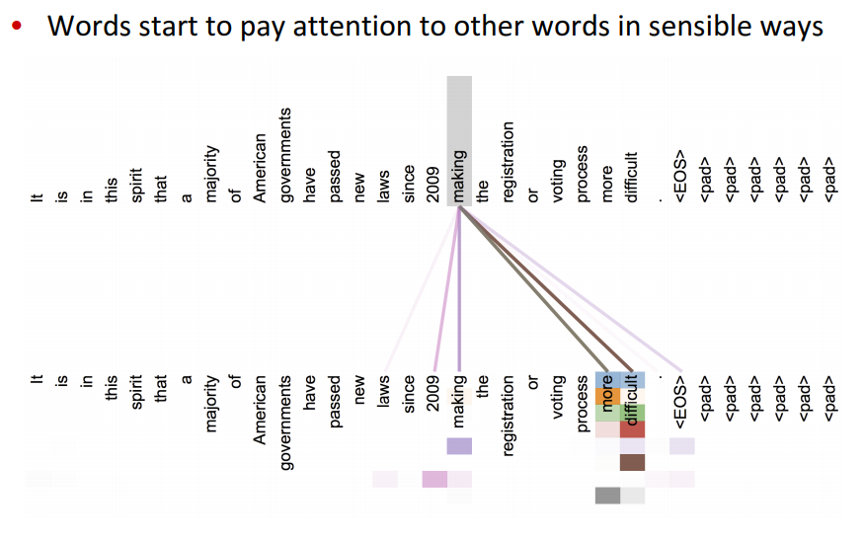
/ Encoder-Decoder with Attention Mechanism
/ Encoder-Decoder
19

Slide 20
/ Encoder-Decoder with Attention Mechanism
/ Encoder-Decoder
20

Slide 21
/ Utilizing Monolingual Data
/ Encoder-Decoder
What’s the problem with the model now?
Large deep neural networks require a huge amount of labeled data
Large parallel corpus is expensive to acquire, while a large amount of monolingual data are available
Target side monolingual data play an important role in boosting performance of traditional SMT systems
21

Slide 22
/ Utilizing Monolingual Data
/ Encoder-Decoder
Sennrich et al. (2016)
Proposed two general methods to use target side monolingual data for NMT.
providing monolingual training examples with an empty (or dummy) source sentence
The parameters of encoder and attention layer were frozen
This setting was similar to train a language model
The network might unlearned its conditioning on source context
Providing monolingual training data with a synthetic source (back translation)
Mixed synthetic parallel text into original parallel text
in domain monolingual data, back-translated into source language, can be effectively used for domain adaptation.
22

Slide 23
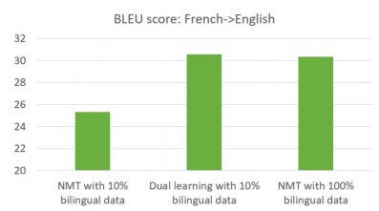
/ Utilizing Monolingual Data
/ Encoder-Decoder
Di He et al. (2016)
Duality of machine translation task e.g., En to Zh translation (primal) vs Zh to En translation (dual)
Leveraged monolingual data (in both source and target languages)
Dual learning mechanism as a two-agent communication game, and optimized through a reinforcement learning process
Monolingual data corpus $D_{A} and D_{B}$
Two language models as agent e.g., ${LM}_{A}\left(.\right) and {LM}_{B}(.)$
Two NMT models as noisy communication channel e.g., $P\left(. | s;Θ_{AB}\right) andP\left(. | s;Θ_{BA}\right)$
23

Slide 24
/ Utilizing Monolingual Data
/ Encoder-Decoder
Di He et al. (2016)
24

Slide 25
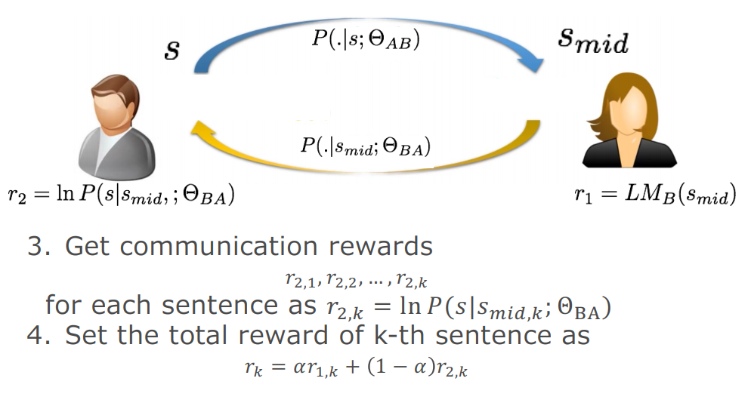
/ Utilizing Monolingual Data
/ Encoder-Decoder
Di He et al. (2016)
25

Slide 26
/ Utilizing Monolingual Data
/ Encoder-Decoder
Di He et al. (2016)
26

Slide 27
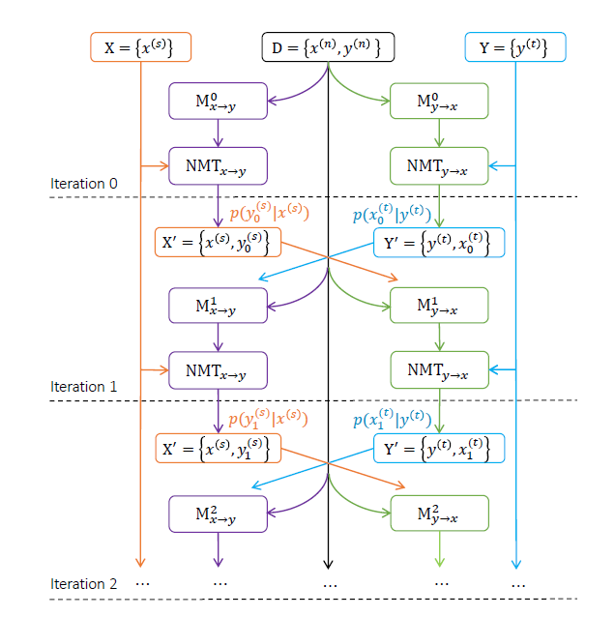
/ Utilizing Monolingual Data
/ Encoder-Decoder
Zhirui Zhang et al. (2018)
Jointly learning source-to-target and target-to-source NMT models for a language pair with a joint EM optimization method.
The E-step tries to estimate the expectations of translations of the monolingual data
The M-step updates model parameters with the smoothed translation probability estimation
27

Slide 28
/ Utilizing Monolingual Data
/ Encoder-Decoder
Zhirui Zhang et al. (2018)
Given parallel corpus $D={\left\{\left(x^{(n)},y^{(n)}\right)\right\}}_{n=1}^{N}$ and monolingual corpus in target language Y$={\left\{\left(y^{(t)}\right)\right\}}_{t=1}^{T}$
In semi-supervised learning, our objective change from
$$L^{∗}\left(θ_{xy}\right)=\sum_{n}{logp\left(y^{(n)} | x^{(n)};θ_{xy}\right)}$$
Into maximizing the likelihood of both bilingual data and monolingual data,
$$L^{∗}\left(θ_{xy}\right)=\sum_{n}{logp\left(y^{(n)} | x^{(n)}\right)}+\sum_{t}{logp(}y^{(t)})$$
According to Jensen’s inequality, $logp(y^{(t)})$ can be decomposed as,
$$logp\left(y^{\left(t\right)}\right)=log\sum_{x}{Q(x)\frac{p(x,y^{\left(t\right)})}{Q(x)}}≥\sum_{x}{Q\left(x\right)log\frac{p(x,y^{\left(t\right)})}{Q(x)}}$$
To make the equal sign to be valid, we knew that,
$$Q\left(x\right)=p^{∗}\left(x | y^{(t)}\right)$$
Where $p^{∗}\left(x | y^{(t)}\right)$ denotes the true target-to-source translation distribution. Since this is intractable, we use the back translation model $p\left(x | y^{(t)}\right)$ to approximate it. Then, we have,
$$L^{∗}\left(θ_{xy}\right)≥L\left(θ_{xy}\right)=\sum_{n}{logp\left(y^{(n)} | x^{(n)}\right)}+\sum_{t}{\sum_{x}{p\left(x | y^{(t)}\right)}logp\left(y^{(t)} | x\right)}$$
We then train the model with $L\left(θ_{xy}\right)$
28

Slide 29
/ Summary
Supervised learning
NMT models with RNN encoder and decoder
Encoder-decoder models with attention mechanism
RNN
CNN
Transformer
Semi-supervised learning
Back translation
Dual learning
Joint training for NMT models
text
Sept2013
29

Slide 30
Thank you for your attention
30

